Slide 1
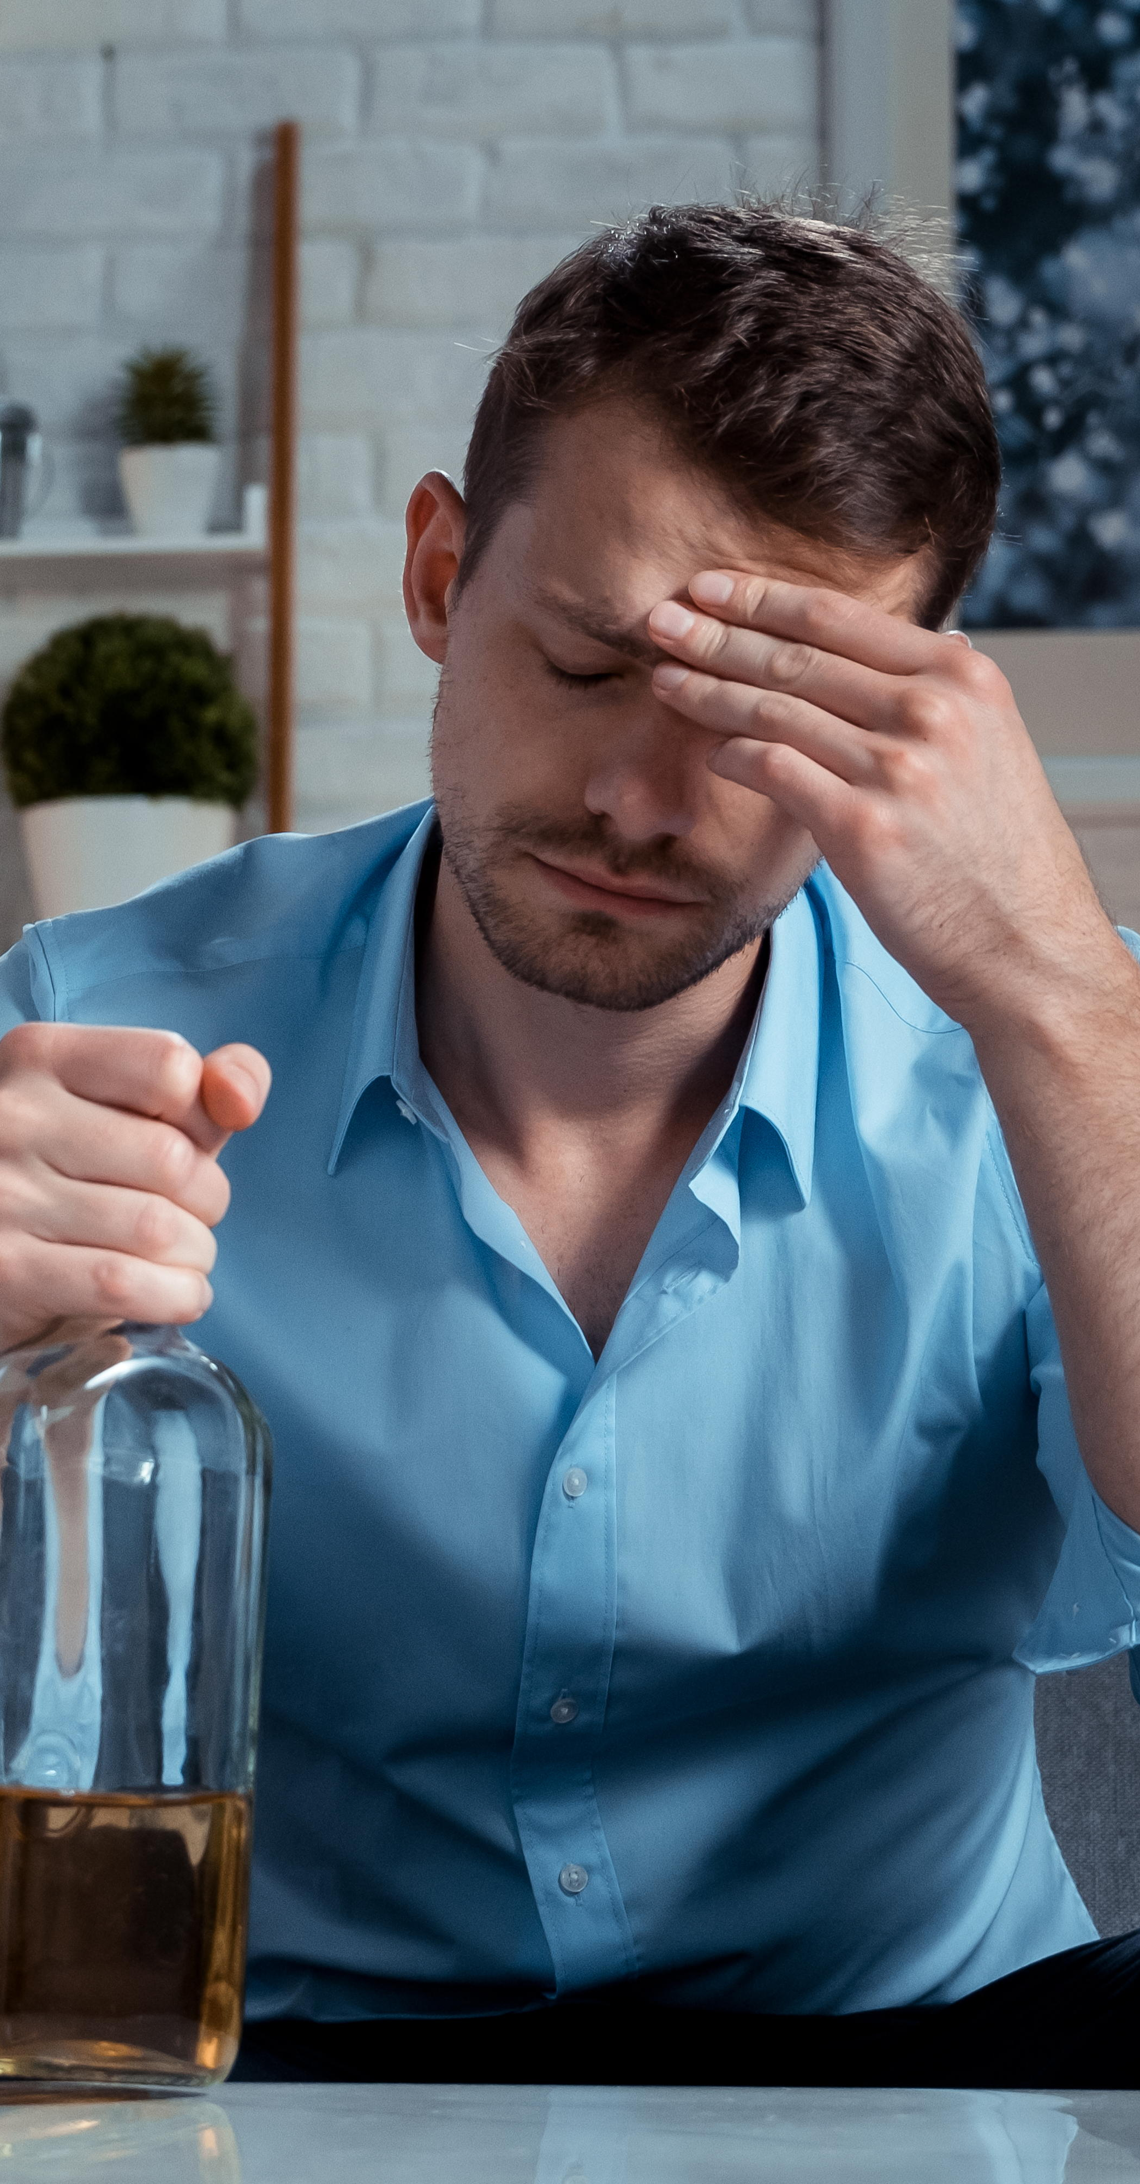
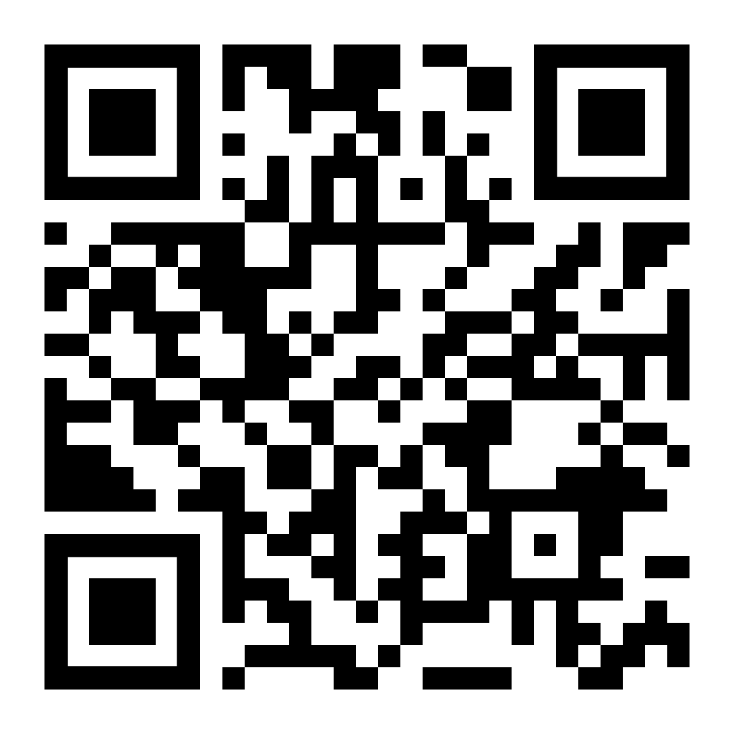

If you struggle to stop drinking once you start, LifeMatters can help.

Slide 2

LifeMatters can help you shop smart and stay within your budget.

Slide 3

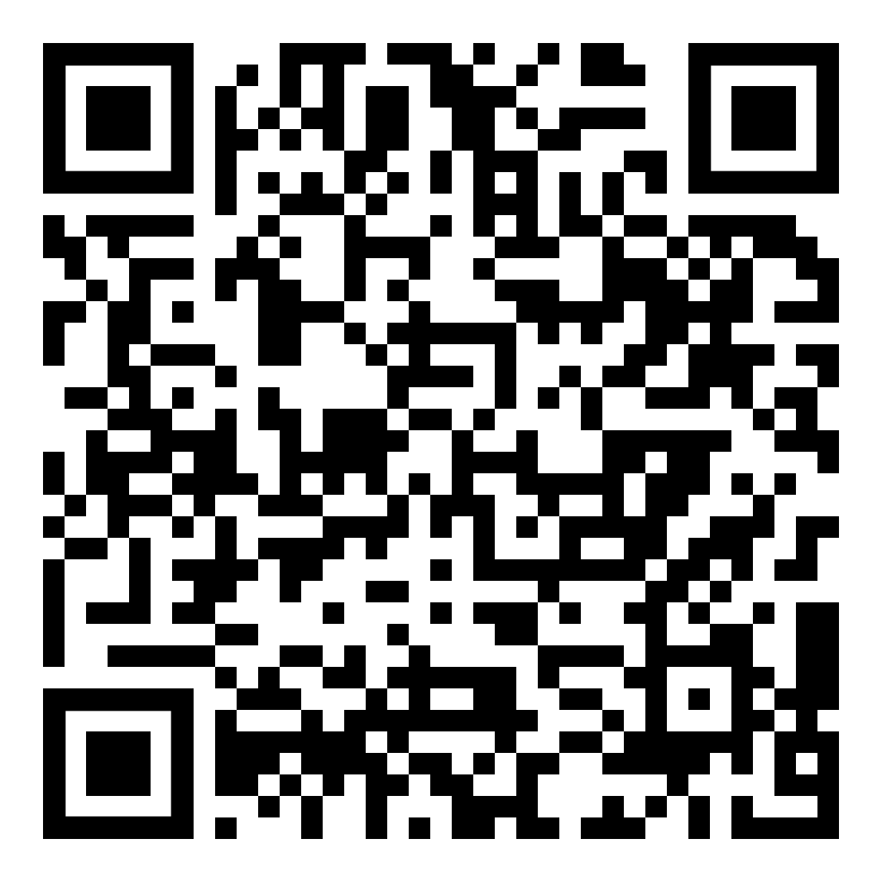
April Webinar
Title: Going Green
Available in April on mylifematters.com
Sign up for an email alert

Slide 4

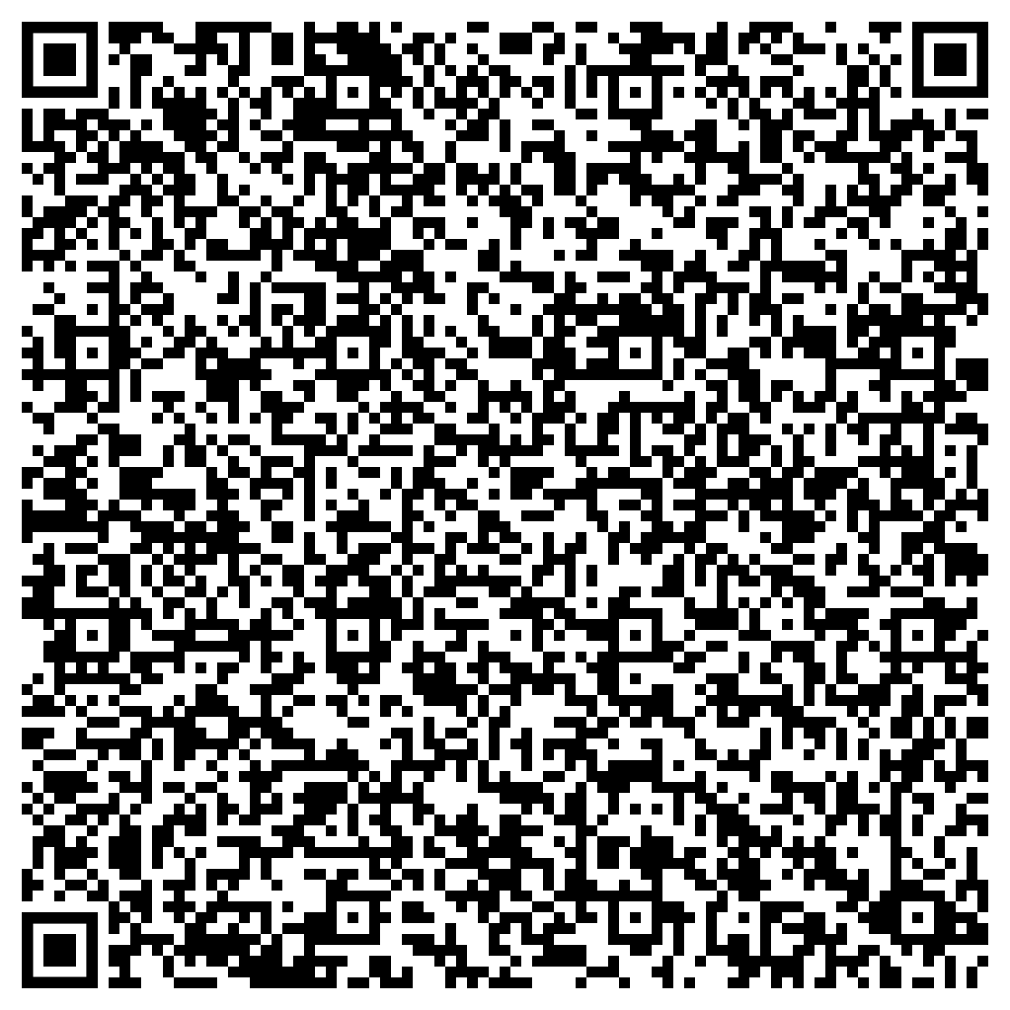
April Support Session
Postpartum Depression
Tuesday, April 16, 1 p.m. EDT
Session Password: YNs2Hxpud67

