Slide 1

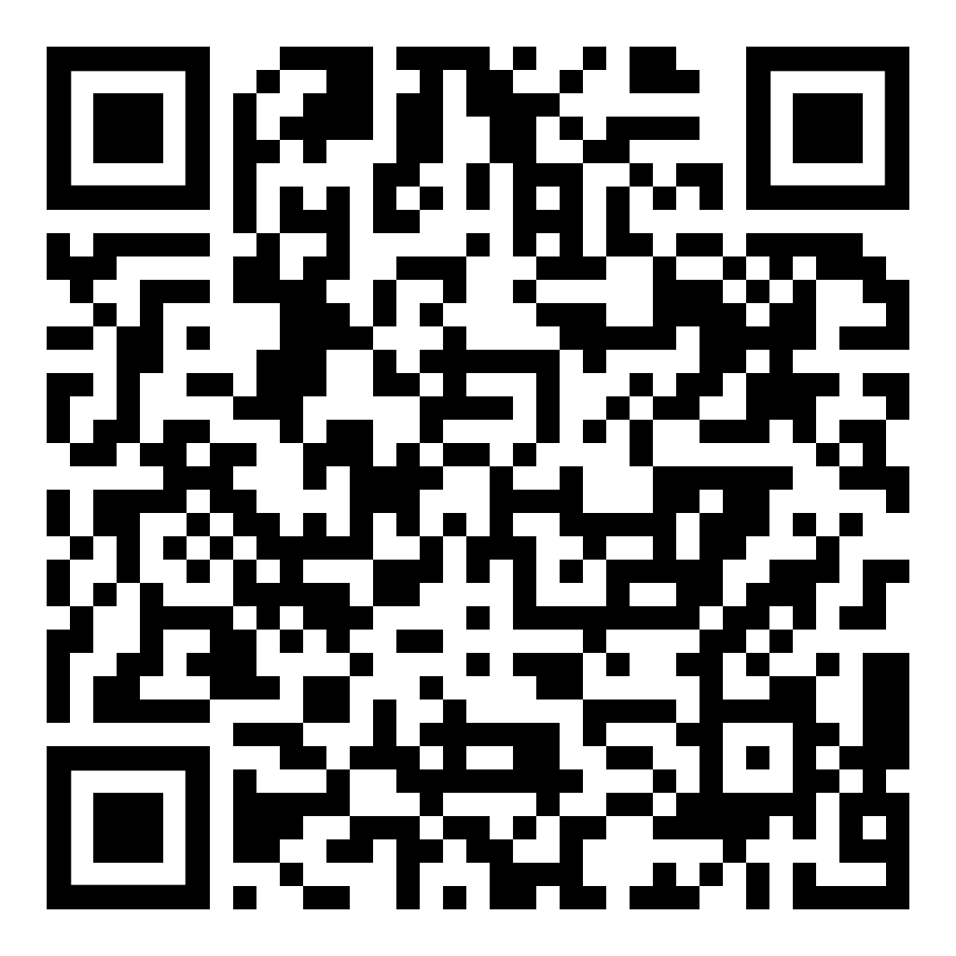
August Webinar
Title: Rebuilding After a Financial Crisis
Available in August on mylifematters.com
Sign up for an email alert

Slide 2

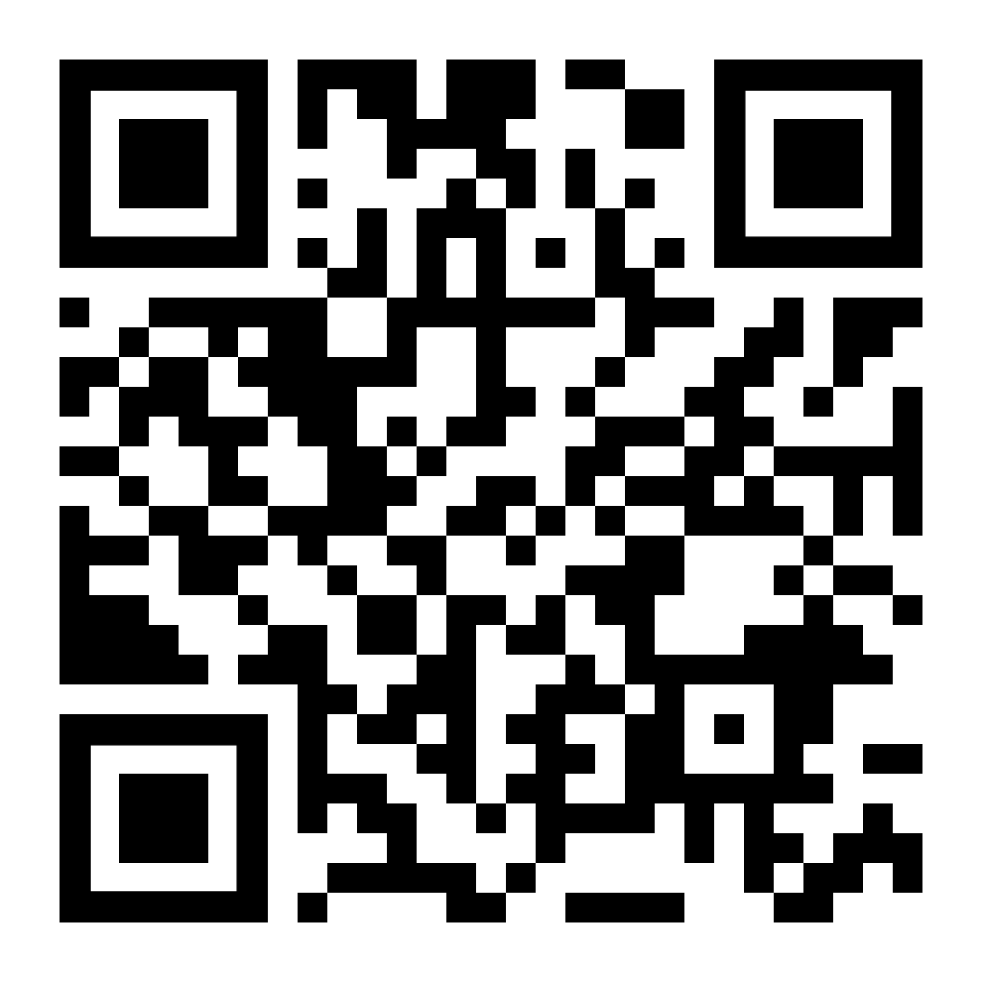
Being Well
LifeMatters offers 24/7/365 assistance with:
Stress management
Mindful meditation
Building healthy relationships
Balancing life and work
Any other wellbeing concern

Slide 3

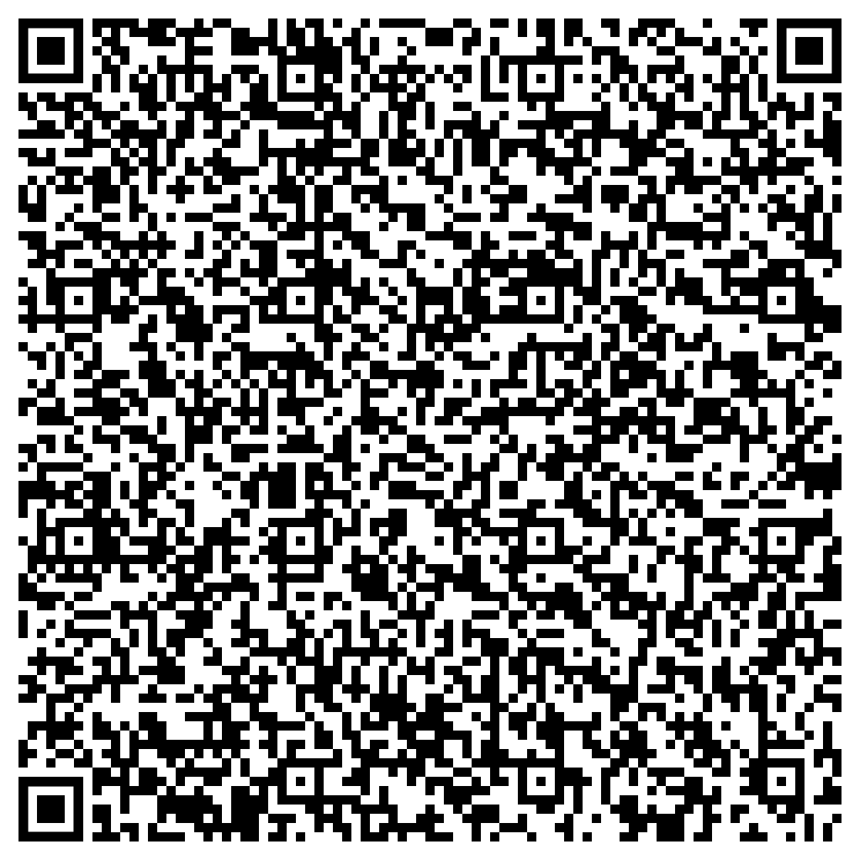
August Support Session
Setting Your Child Up for Success This School Year
Thursday, August 22, 1 p.m. EST
Session Password: fApjQrNV487

