Slide 1

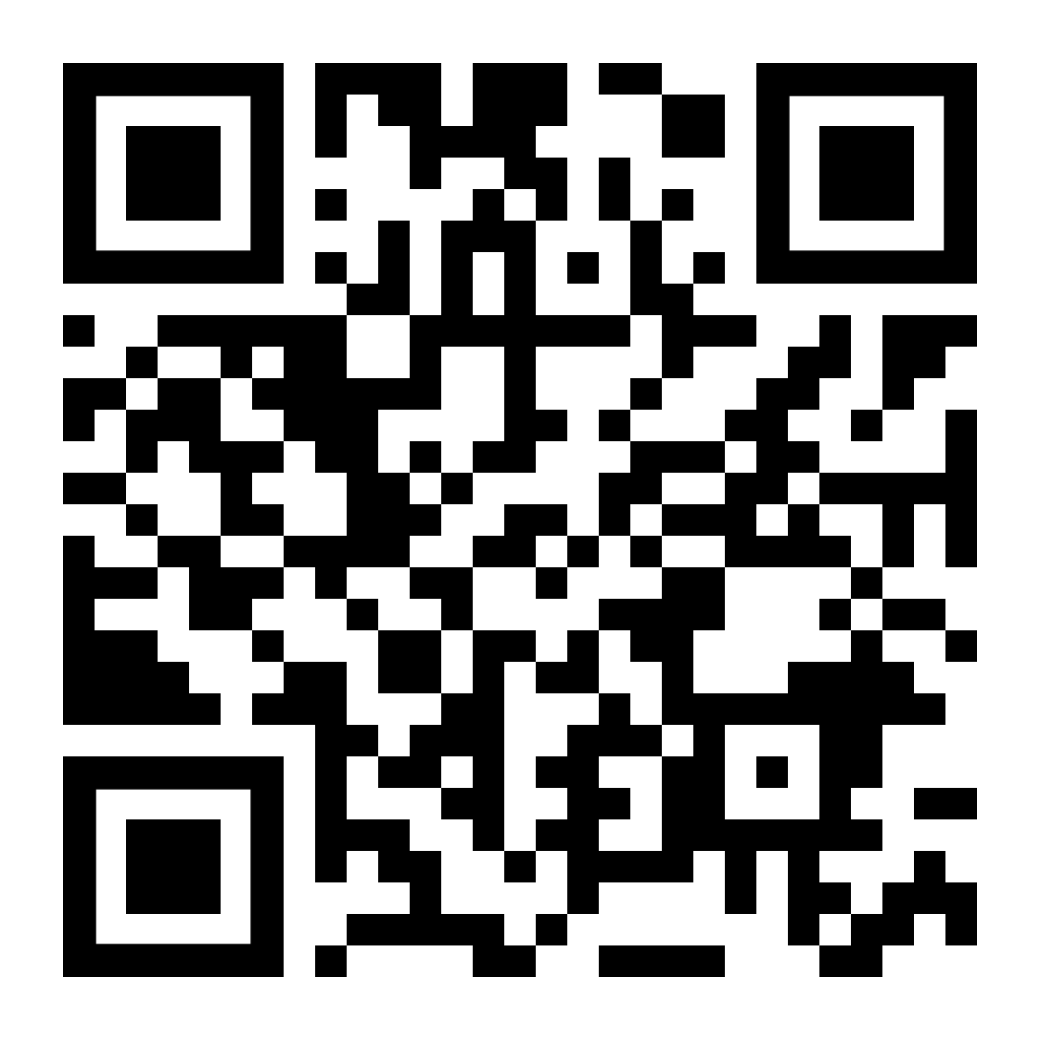

LifeMatters can help you make the most of time with family.

Slide 2

LifeMatters can help you set a holiday budget — and stick to it!

Slide 3

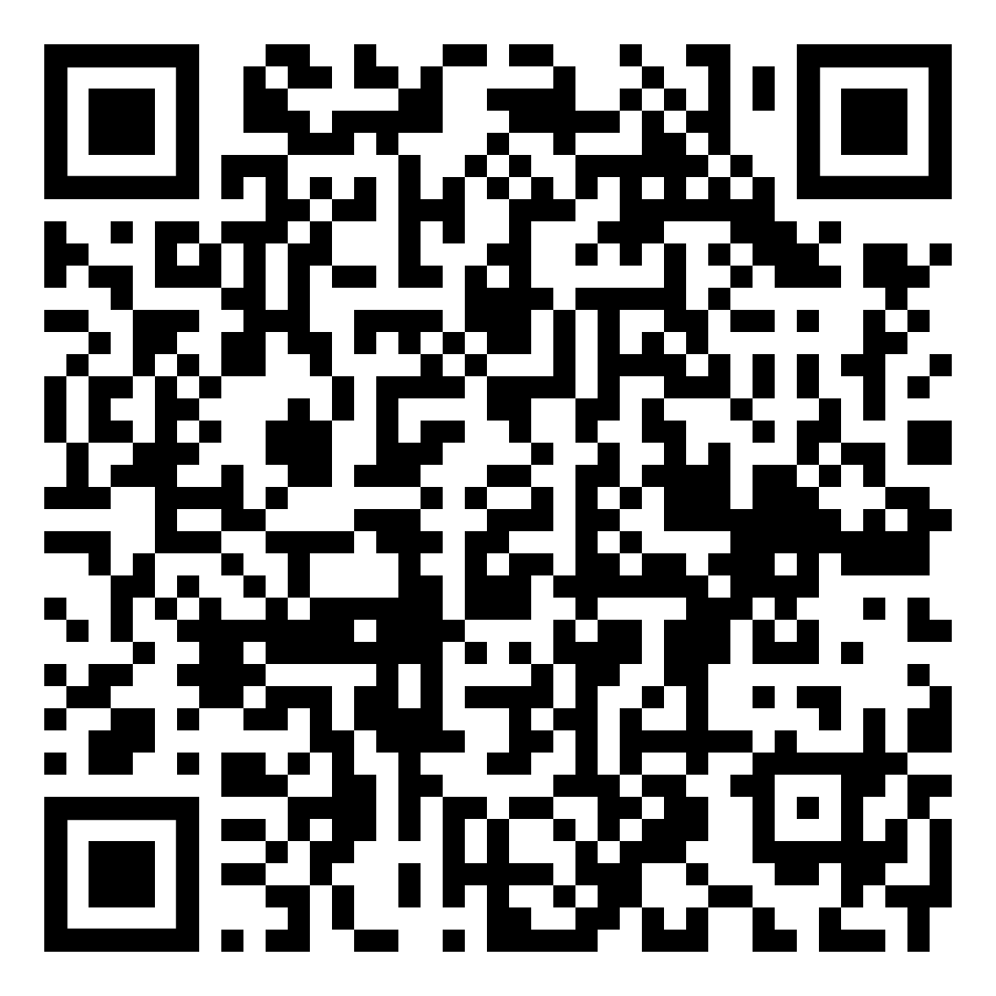
December Webinar
Title: Resolving Conflict at Work
Available in December on mylifematters.com
Sign up for an email alert

Slide 4

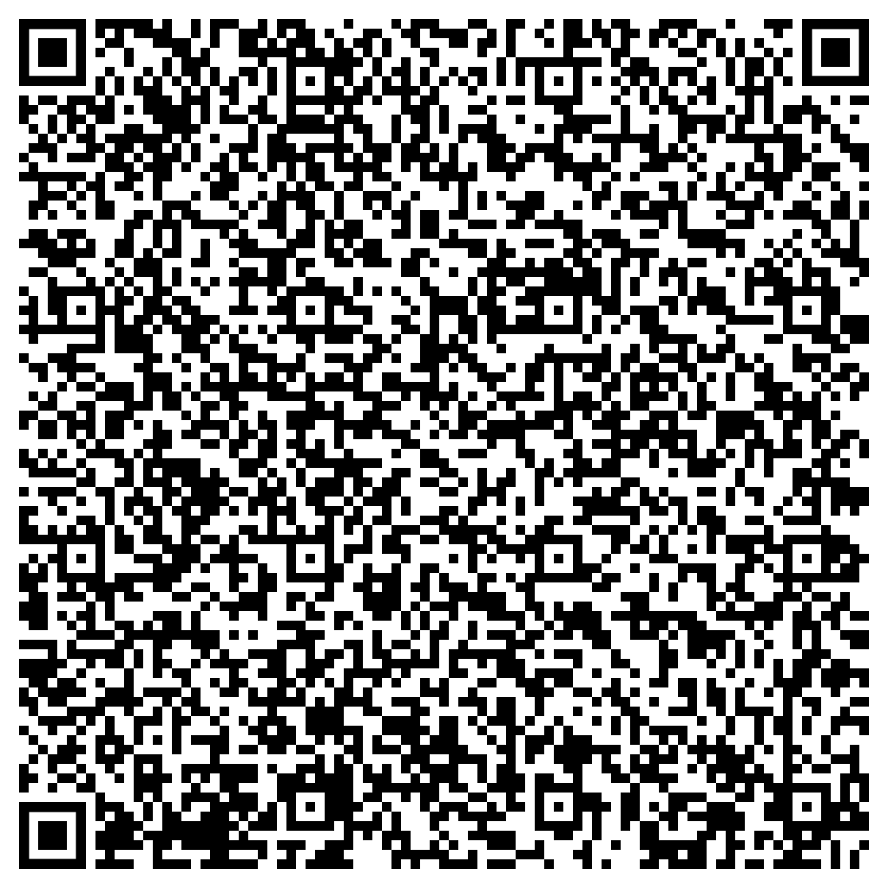
December Support Session
Grief and Loss During the Holidays
Tuesday, December 10, 1 p.m. EST
Session Password: CQd5mzpju44

