Slide 1

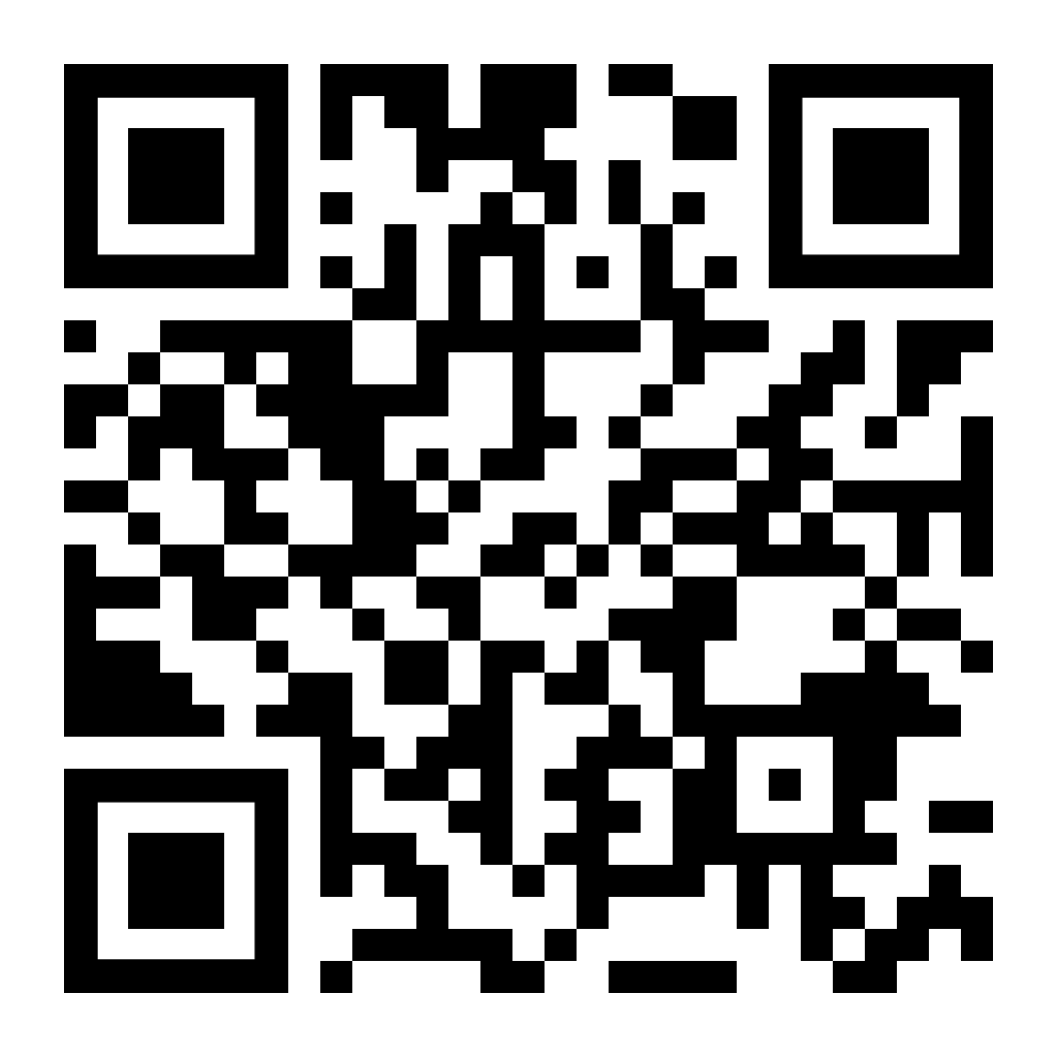

LifeMatters offers helpful resources and emotional support to parents.

Slide 2
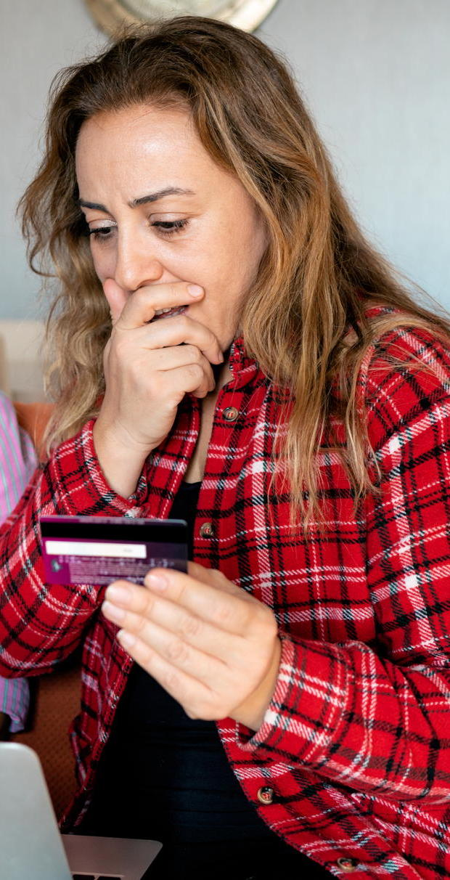
LifeMatters can help you recover from a scam.

Slide 3

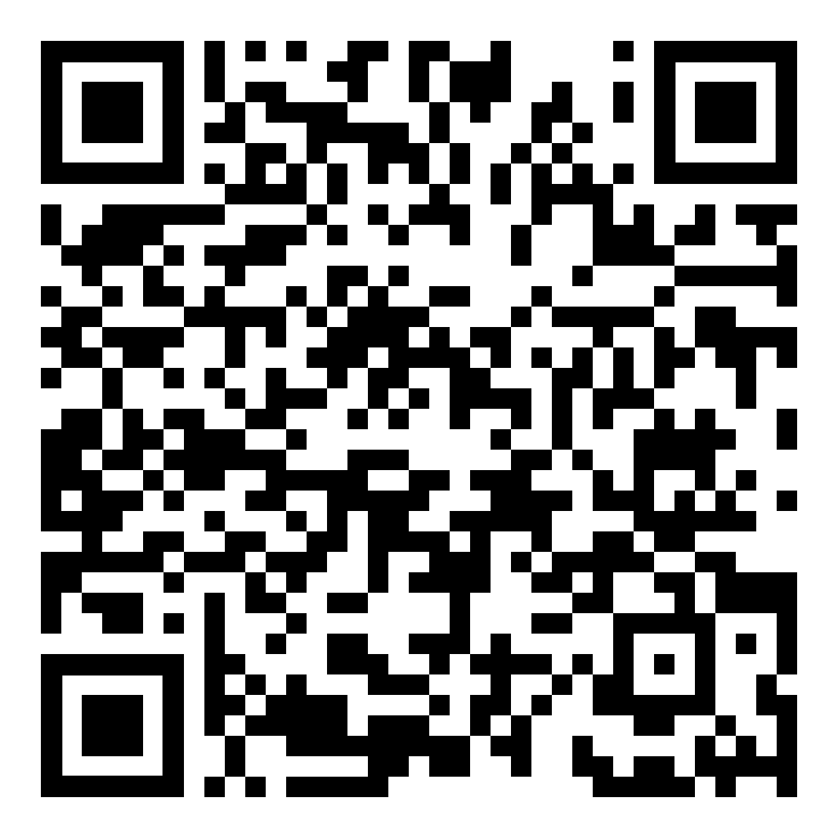
July Webinar
Title: Internet Safety
Available in July on mylifematters.com
Sign up for an email alert

Slide 4

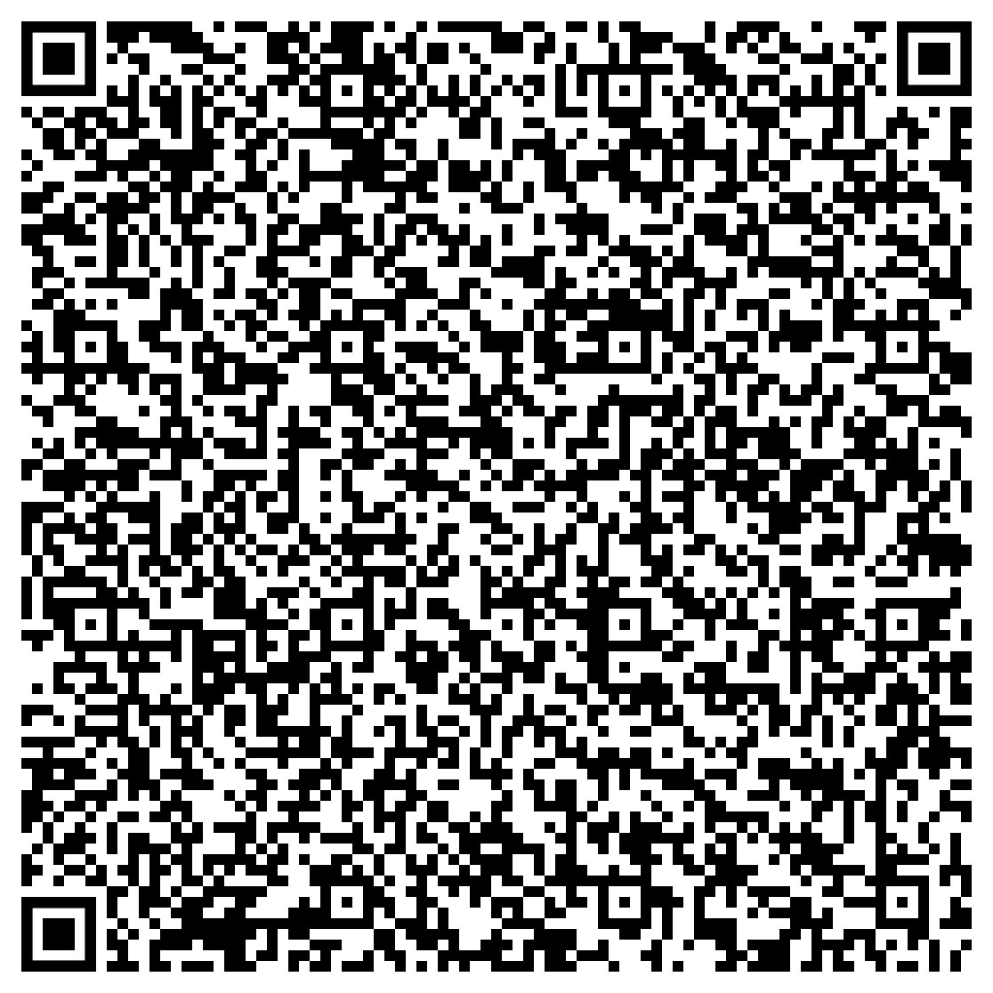
July Support Session
Making Mindfulness Work for You
Tuesday, July 16, 1 p.m. EDT
Session Password: NqDKZw62Pm5

