Slide 1
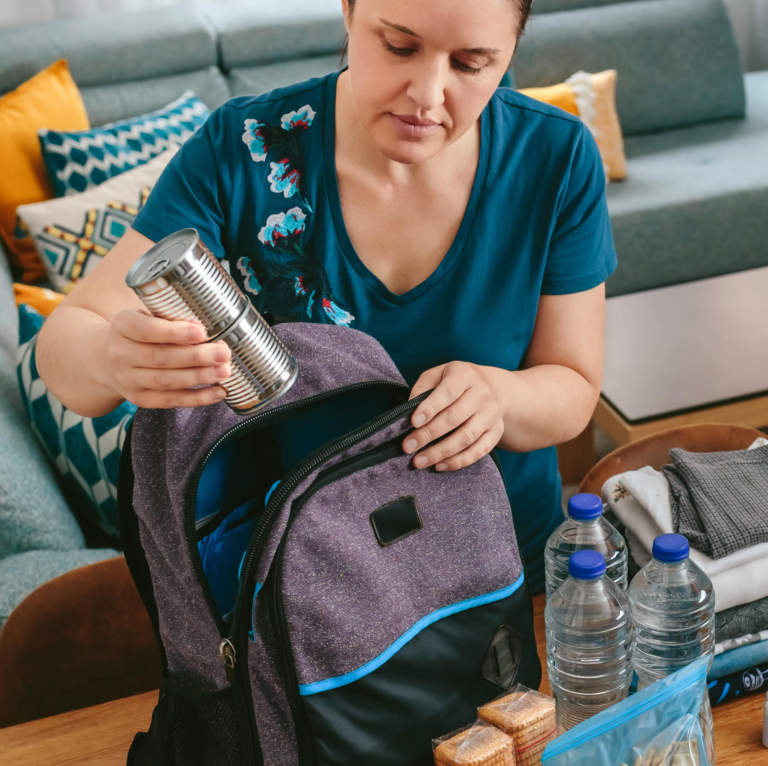
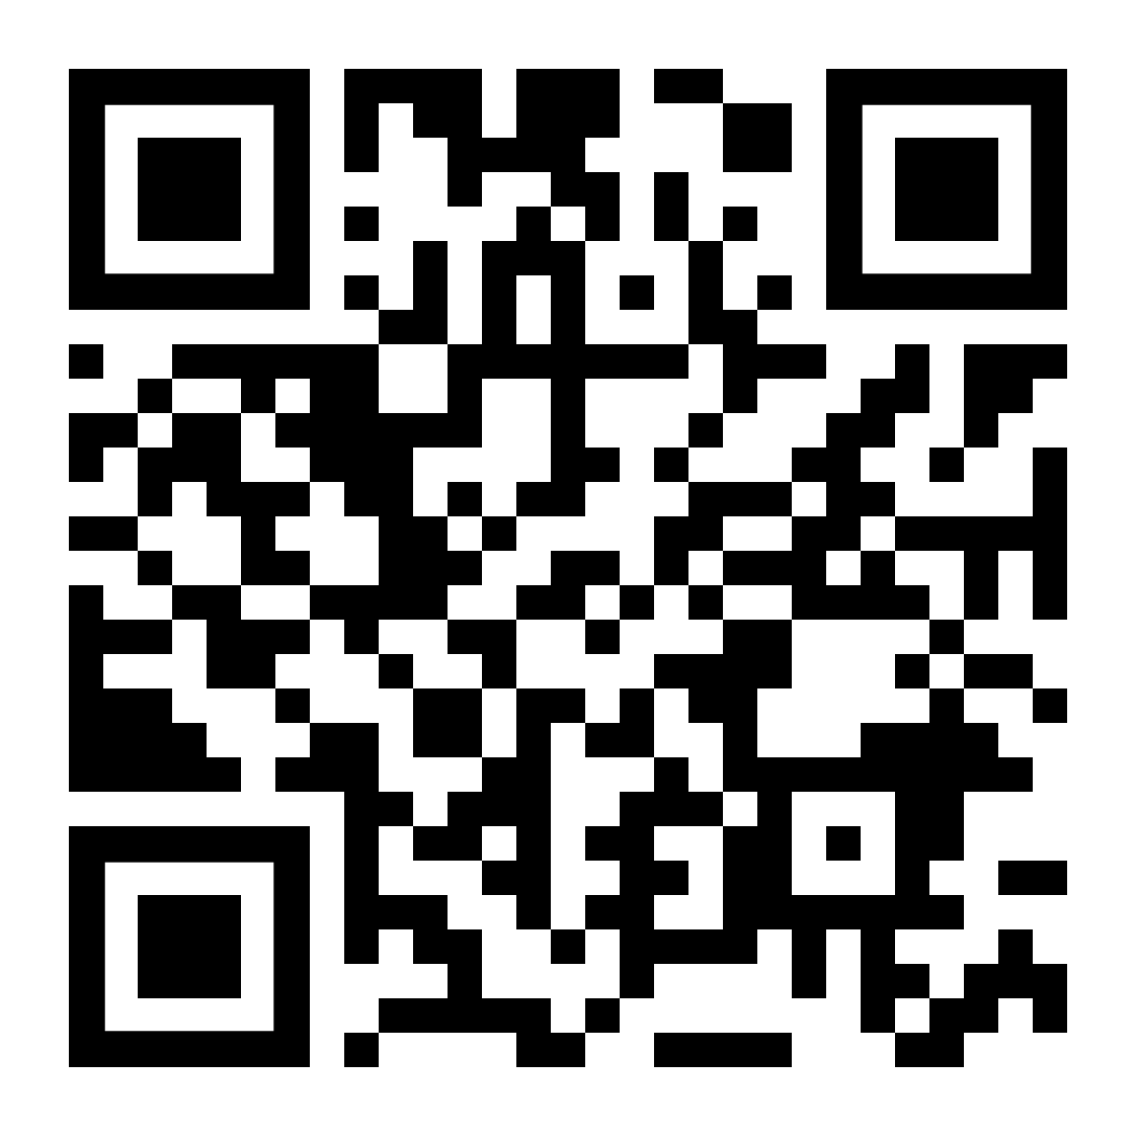
LifeMatters can help you prepare for a disaster.

Slide 2

LifeMatters can help you locate resources for an upcoming move.

Slide 3
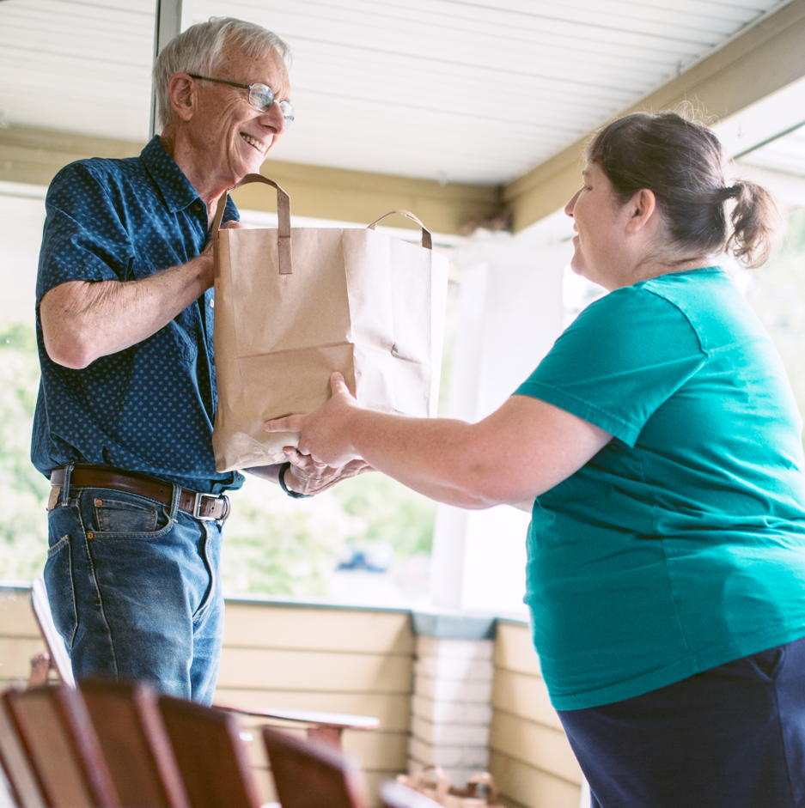
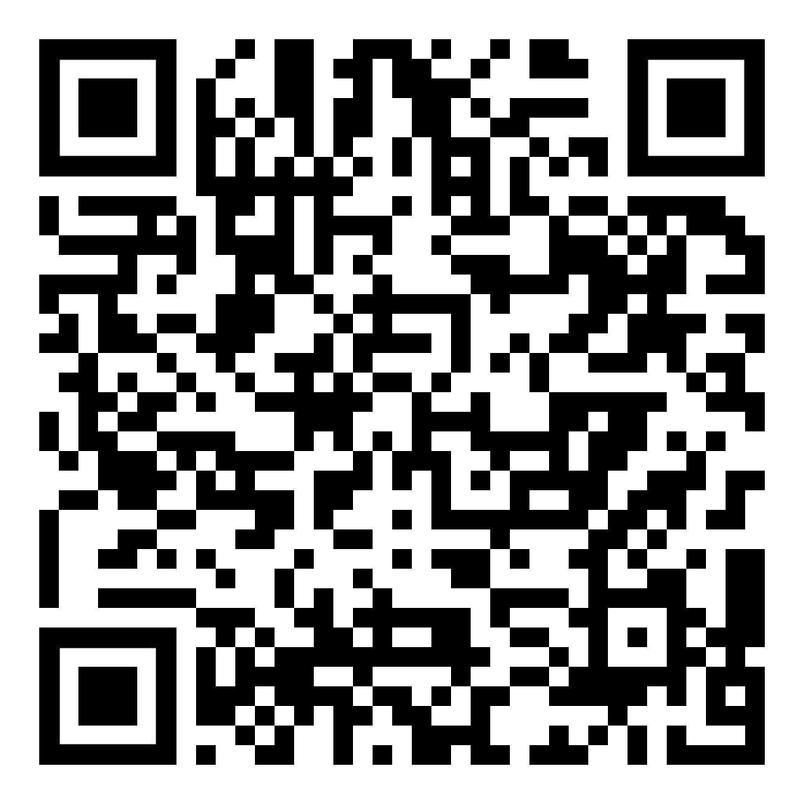
June Webinar
Title: Succeeding Through Kindness
Available in June on mylifematters.com
Sign up for an email alert

Slide 4

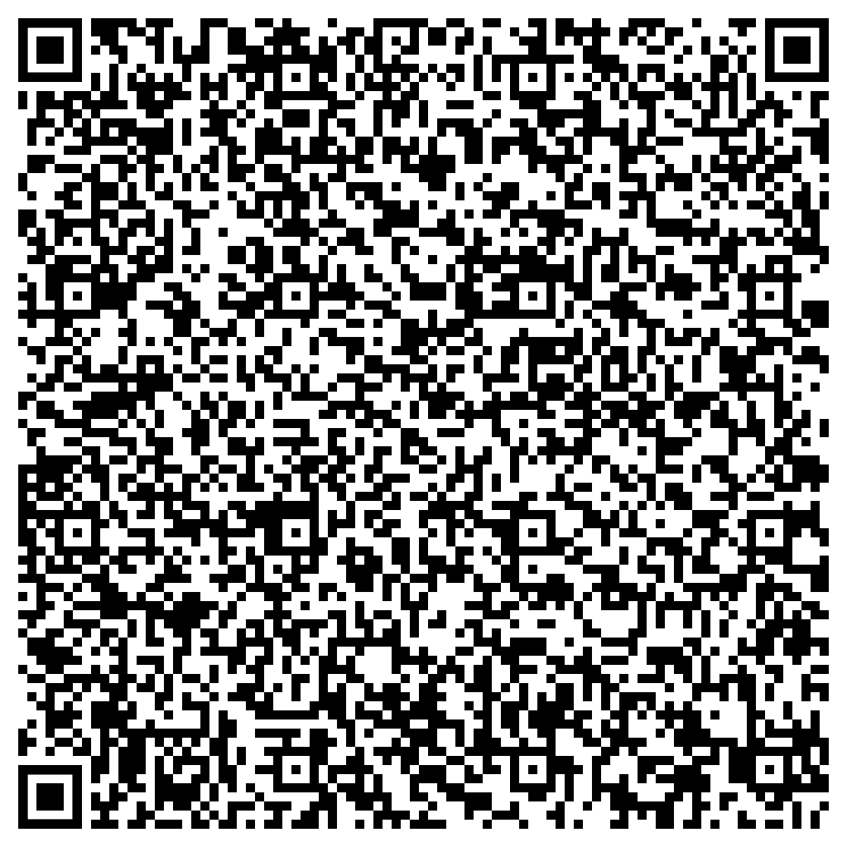
June Support Session
How to Be an Ally to the LGBTQIA+ Community
Wednesday, June 26, 1 p.m. EDT
Session password: pxJzGjh5D82

