Slide 1


Anxiety
LifeMatters can help you cope with occasional or frequent bouts of anxiety.
Call 24/7/365.
1-800-634-6433 • mylifematters.com

Slide 2

Allergies
If seasonal allergies are stressing you out, LifeMatters can help.
Call 24/7/365.
1-800-634-6433 • mylifematters.com

Slide 3

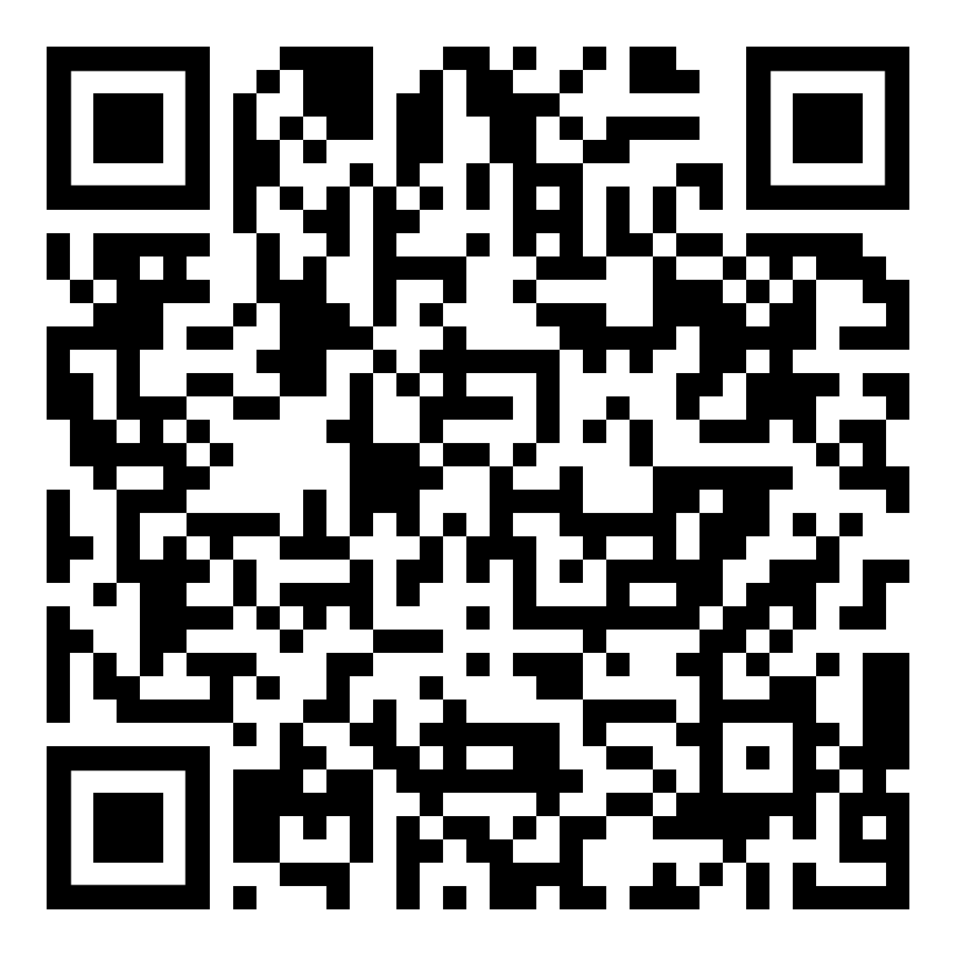
March Webinar
Aging in Place
Available on mylifematters.com in March
Sign up for an email alert
1-800-634-6433 • mylifematters.com

Slide 4

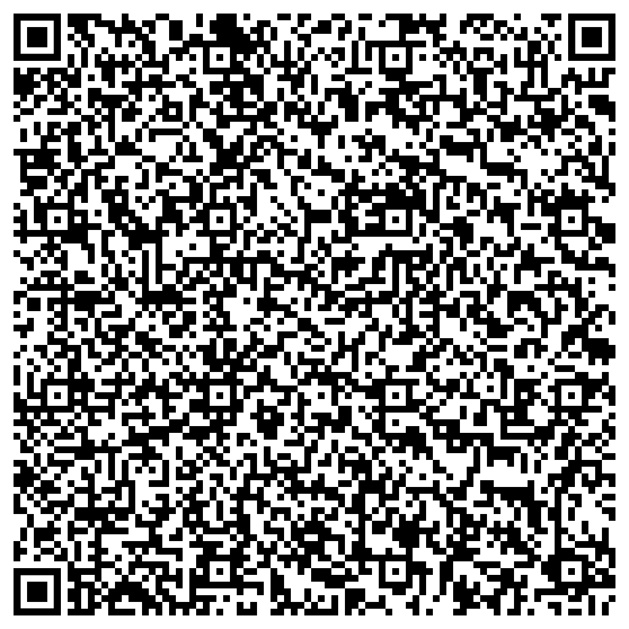
Practicing Gratitude
Support session from LifeMatters
Thursday, March 21
1 p.m. EDT
Session password: wDPkgtd4i73

