Slide 1

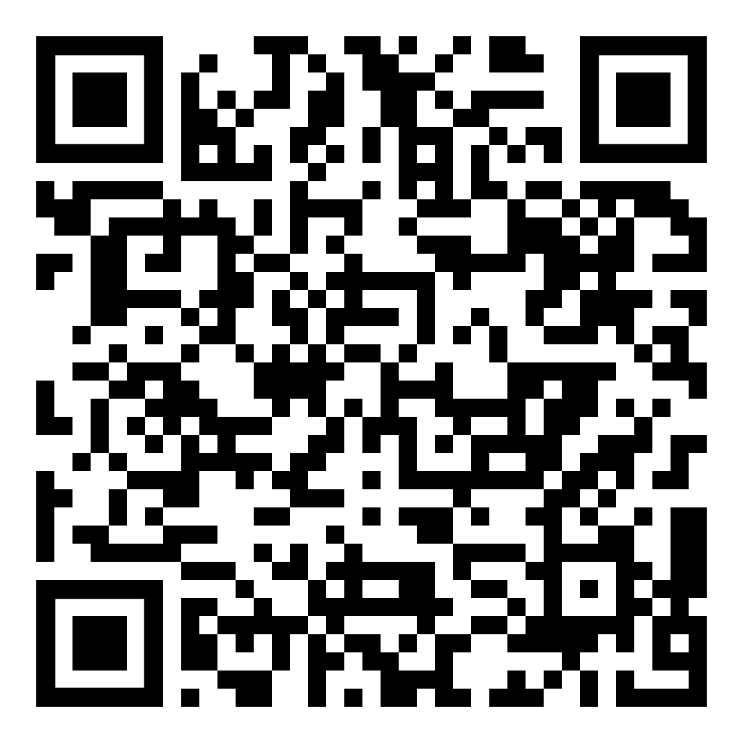
May Webinar
Title: Combating Loneliness
Available in May on mylifematters.com
Sign up for an email alert

Slide 2
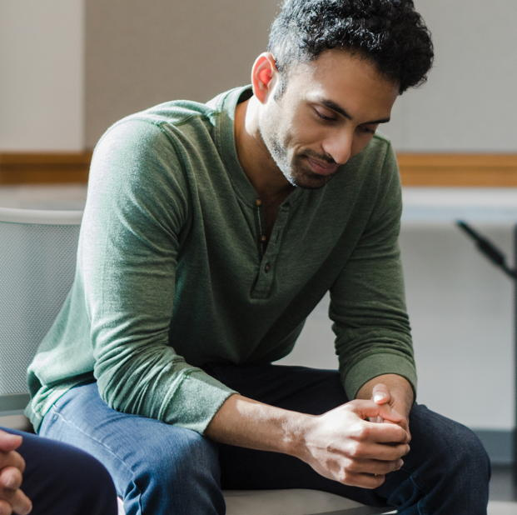
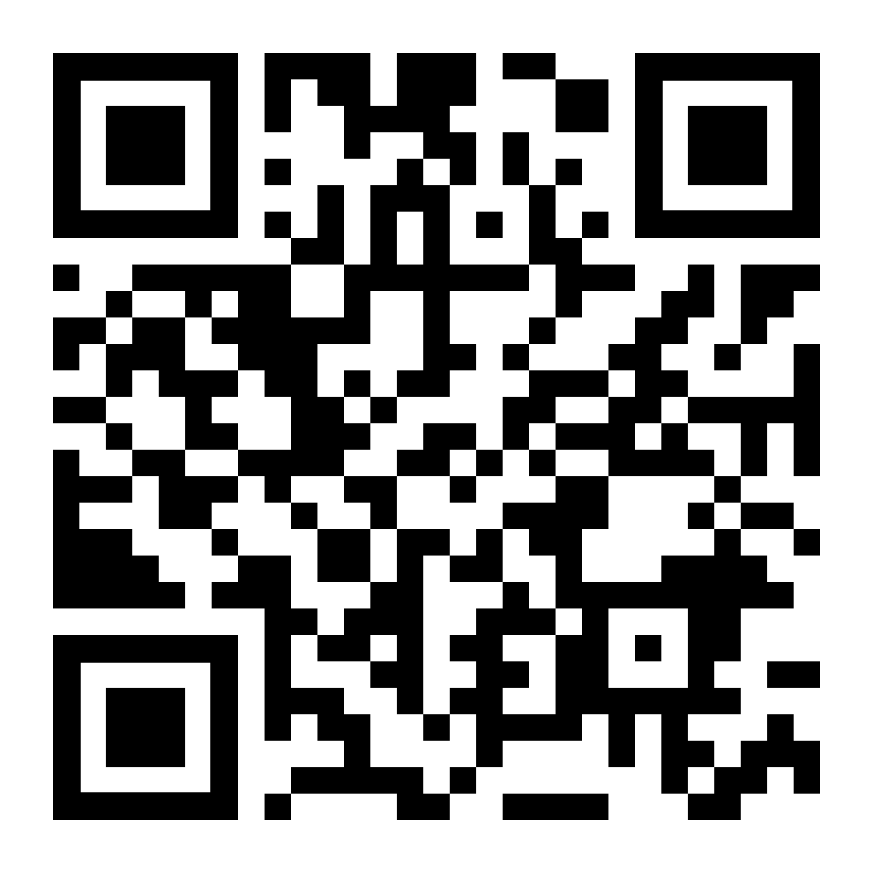
Mental Health
LifeMatters offers 24/7/365 assistance with:
Stress
Depression
Anxiety
Trauma and PTSD
Any other mental health concern

Slide 3

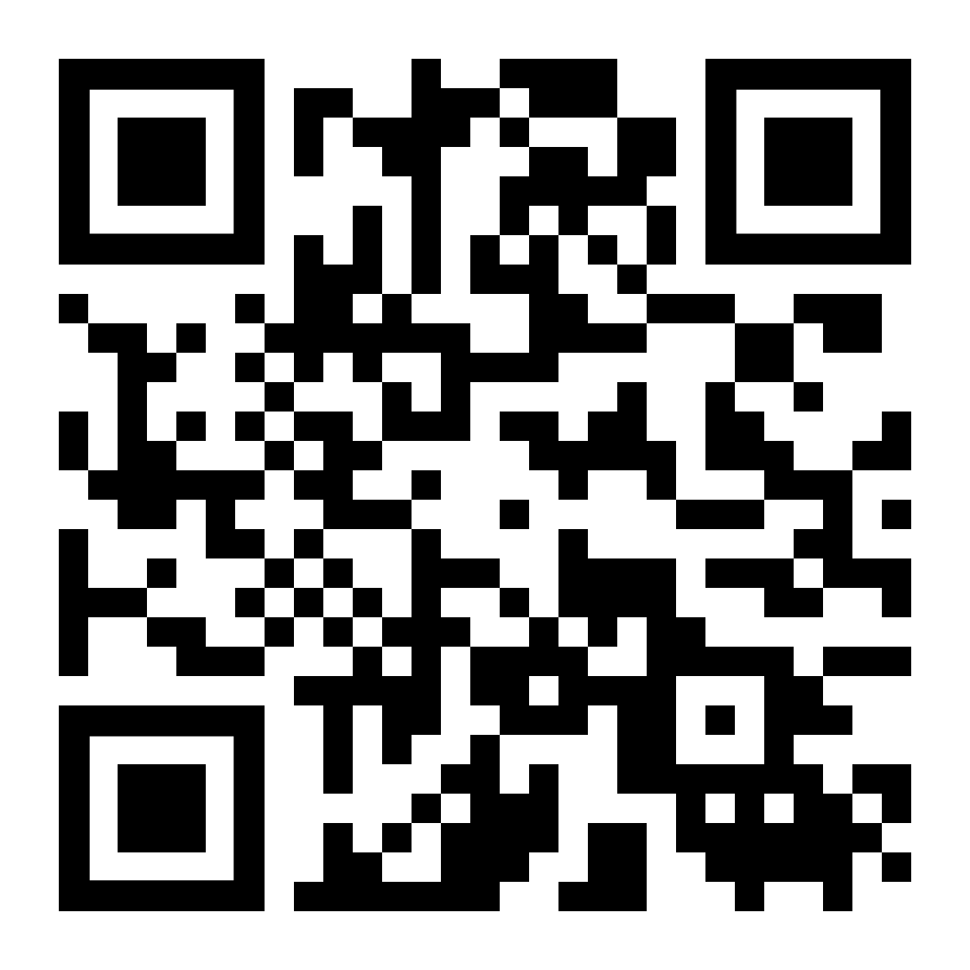
May Support Session
Daily Practices to Boost Your Mental Health
Tuesday, May 14, 1 p.m. EDT
Session Password: 4SSx3y3fJUk

