Slide 1
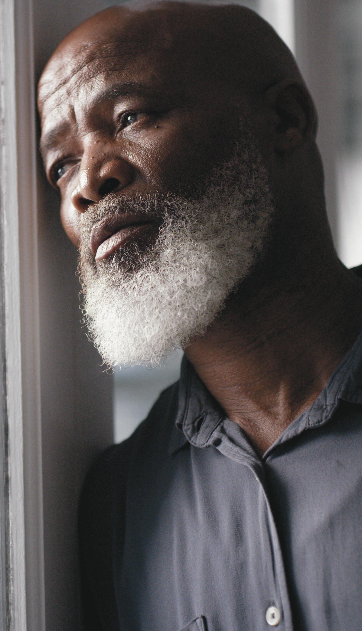
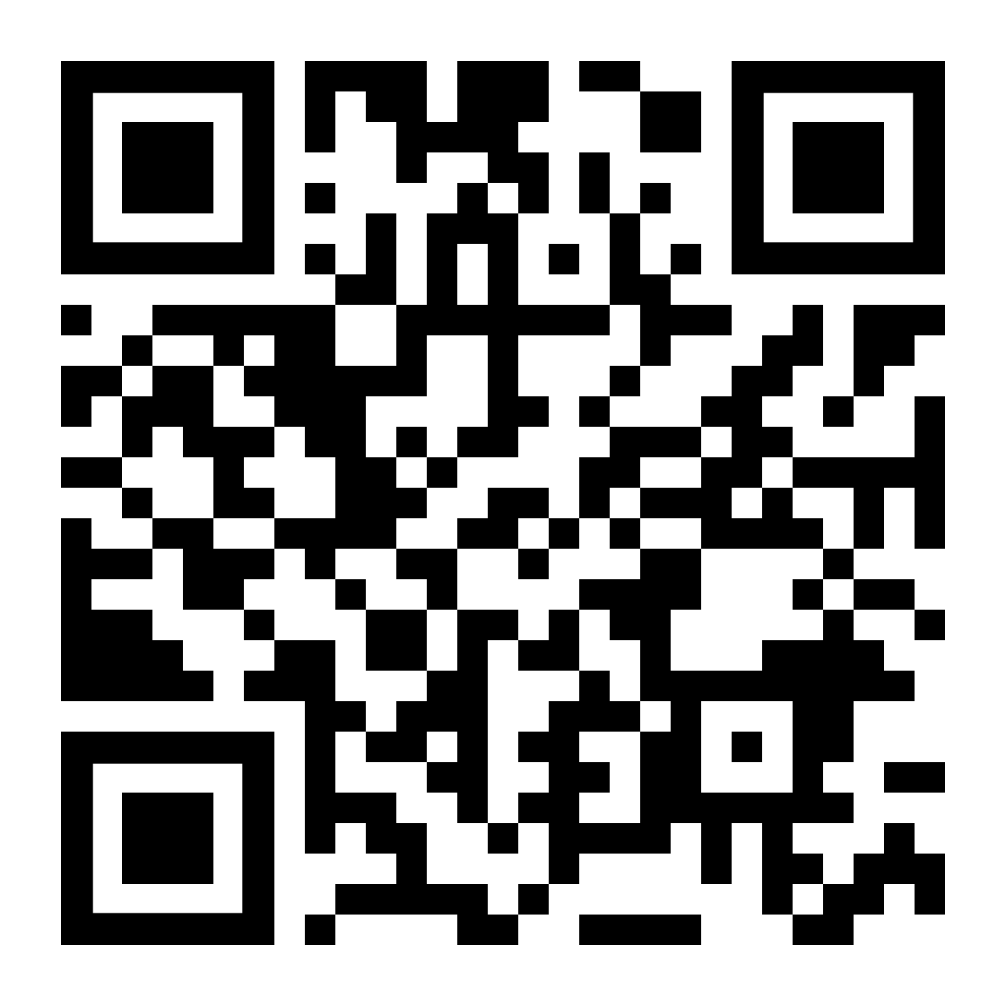

Grief and Loss
LifeMatters offers 24/7/365 assistance with:
The death of a loved one
The end of a relationship
Loneliness
A difficult change
Any other loss

Slide 2
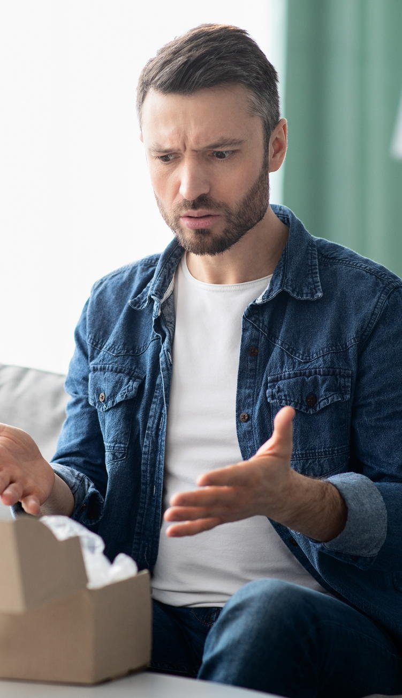
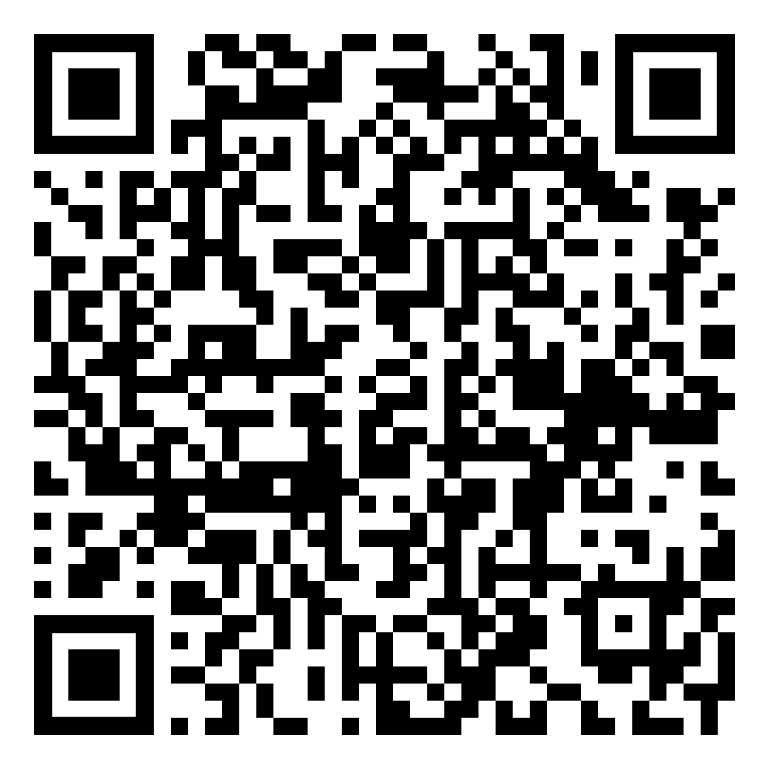
November Webinar
Title: Building Your Frustration Tolerance
Available in November on mylifematters.com
Sign up for an email alert

Slide 3
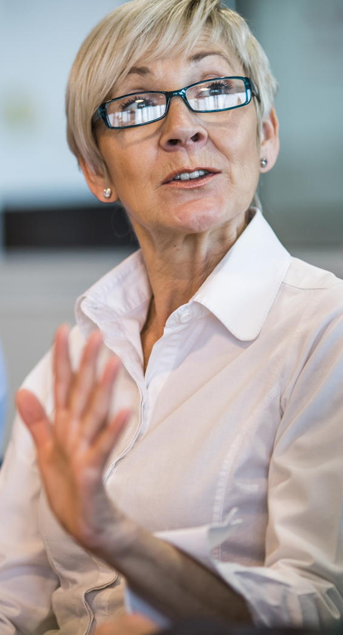
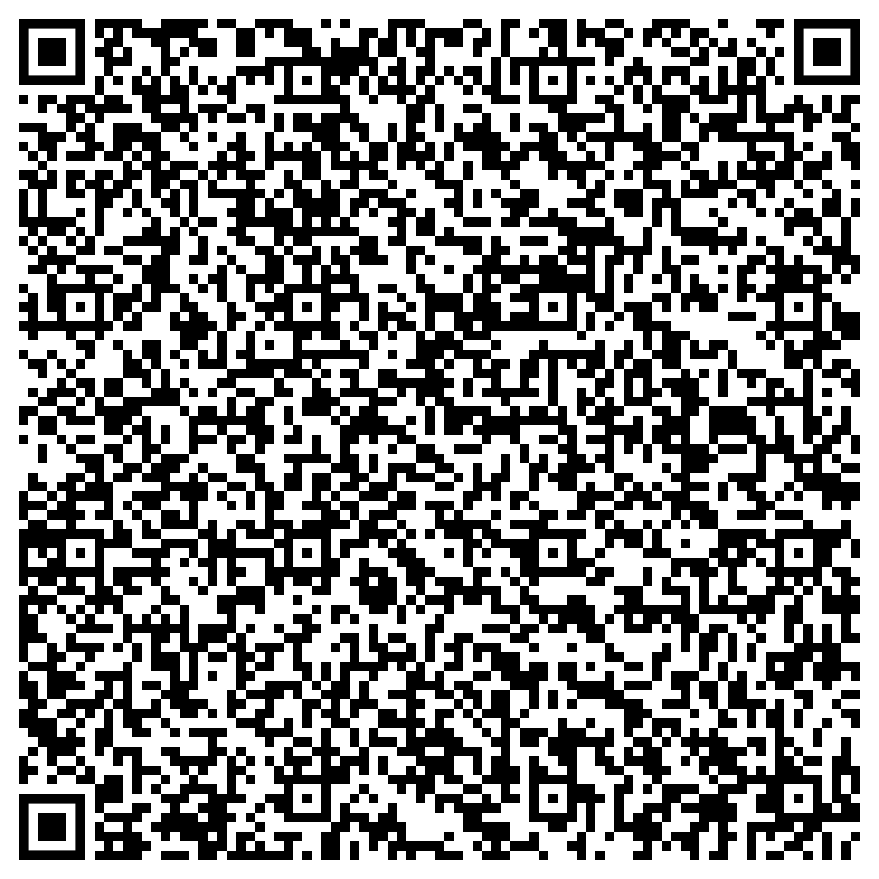
November Support Session
Maintaining Relationships During Emotionally Charged Times
Monday, November 18, 1 p.m. EST
Session Password: xuPPpJEa845

