Slide 1

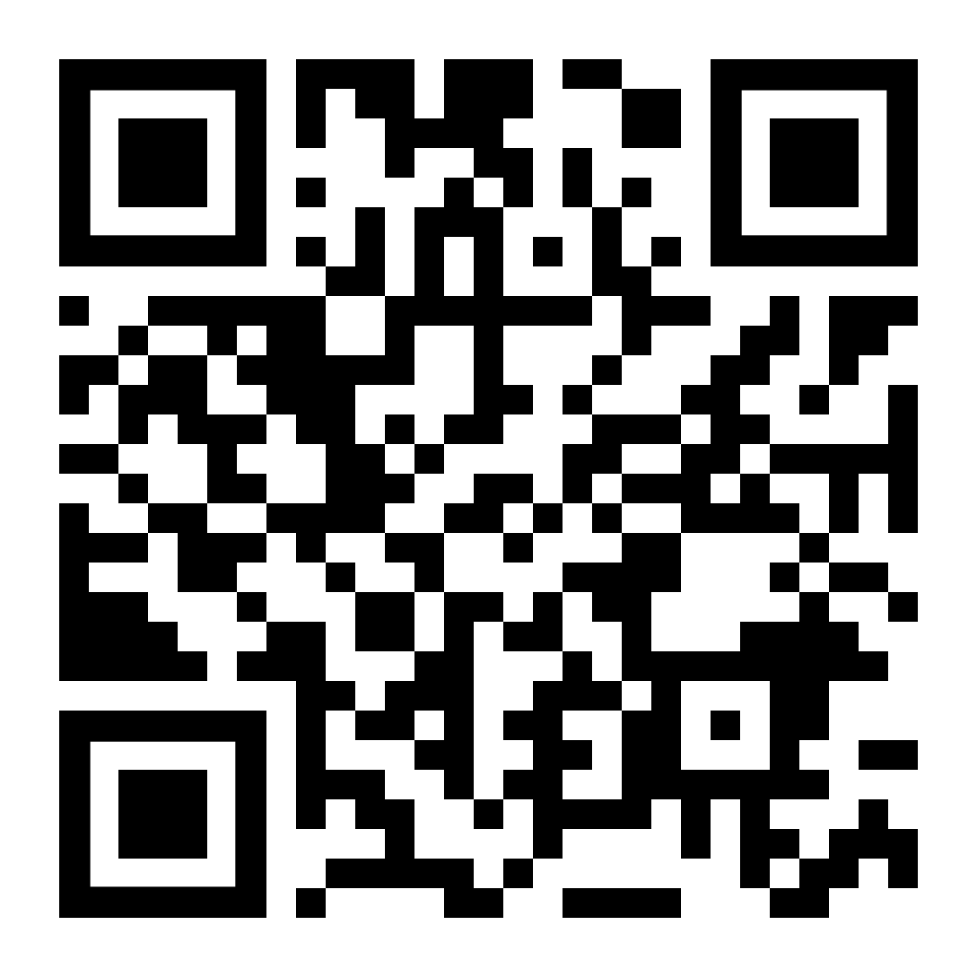

LifeMatters can help you cope with stress about the upcoming election.

Slide 2
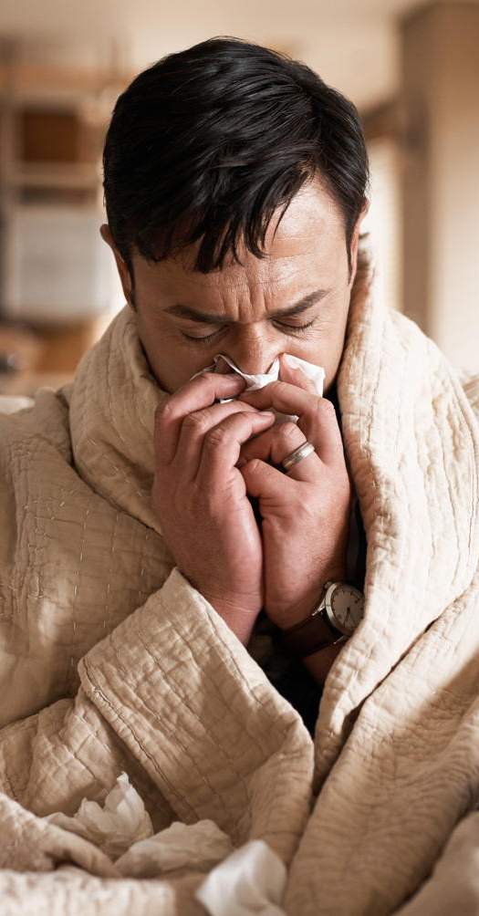
If being sick has you feeling down, LifeMatters can help.

Slide 3

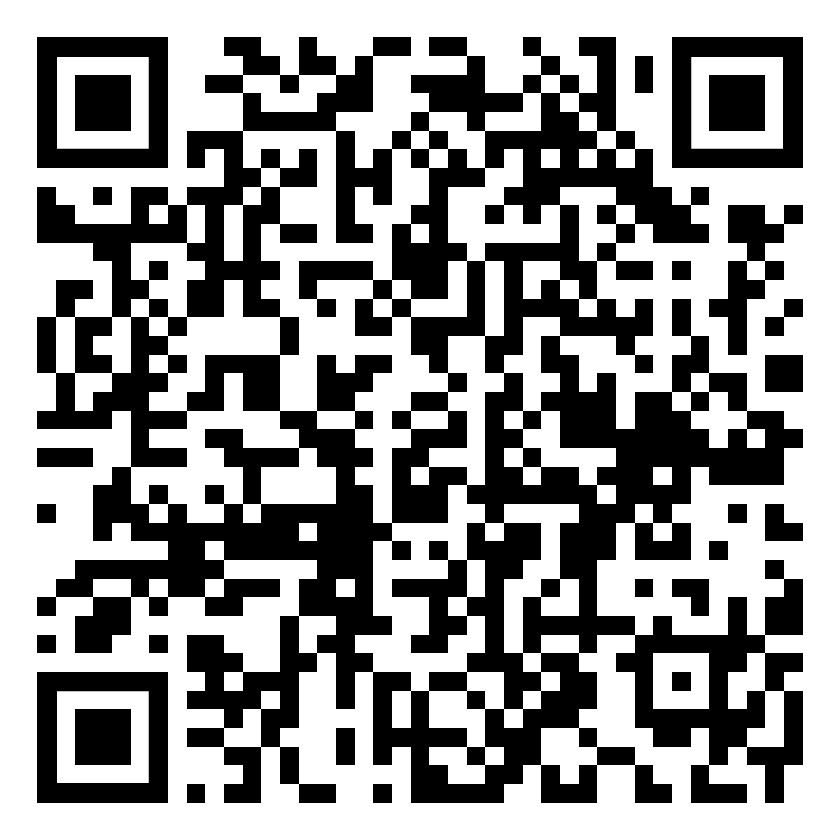
October Webinar
Title: Breaking Out of a Rut
Available in October on mylifematters.com
Sign up for an email alert

Slide 4

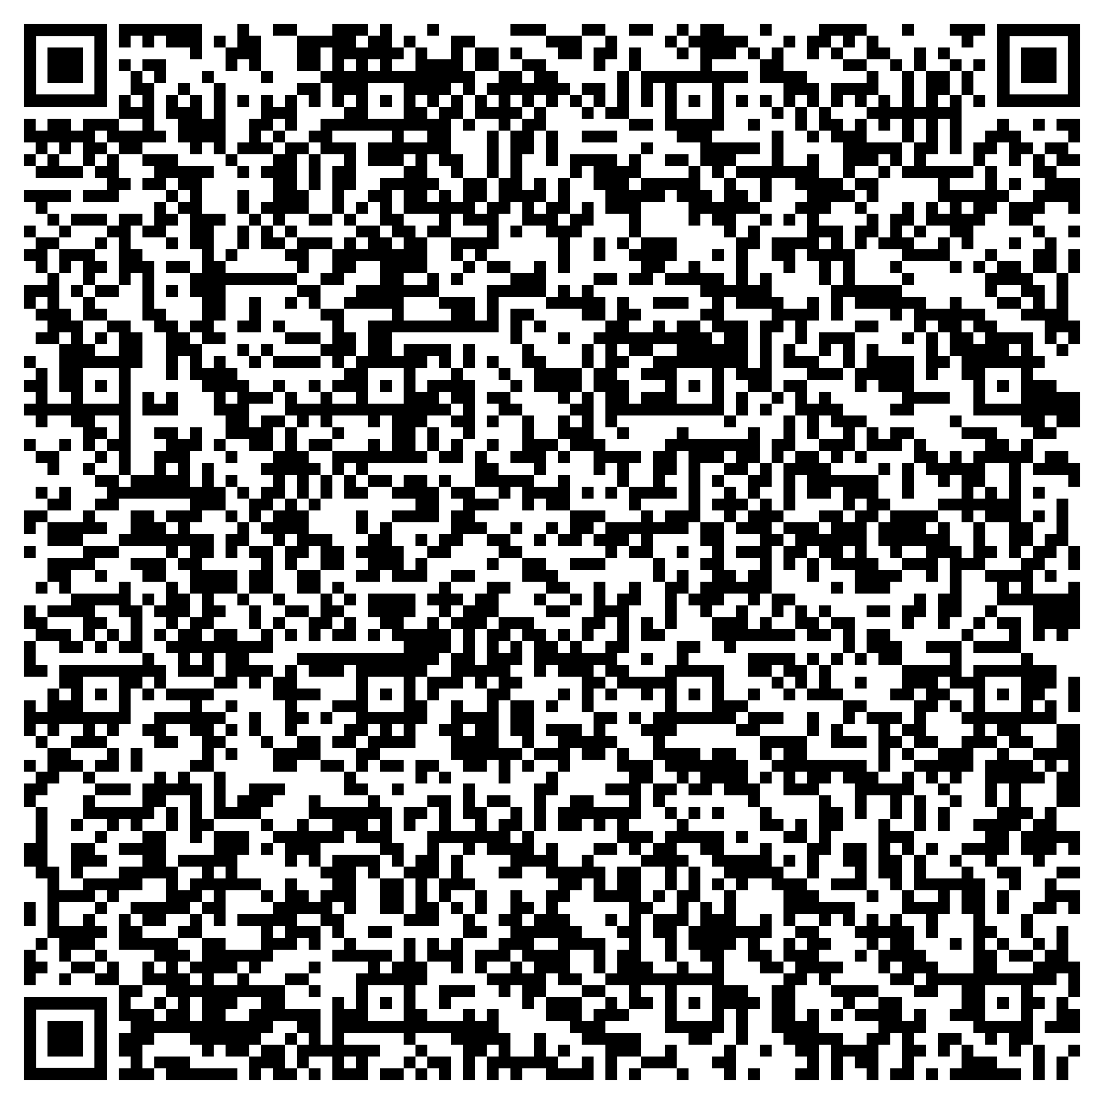
October Support Session
Is Social Media Harming or Helping Your Mental Health?
Thursday, October 10, 1 p.m. EDT
Session Password: ZkhjpwA2U86

