Slide 1

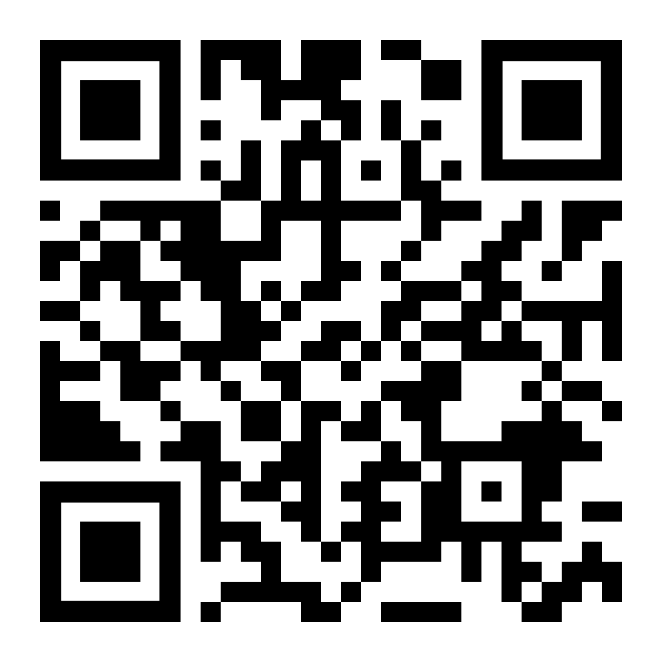
LifeMatters can suggest ways to incorporate mindfulness into your daily routine.

Slide 2
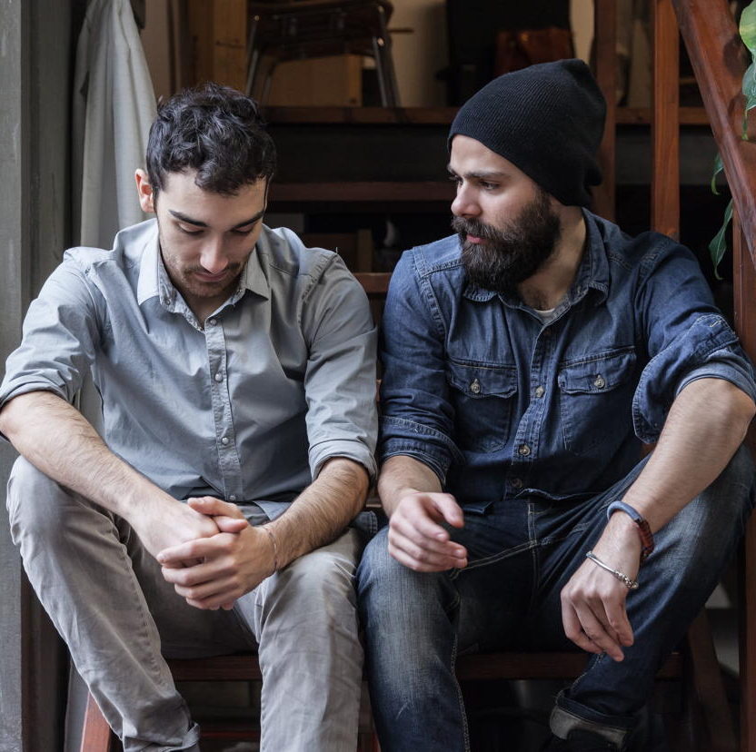
LifeMatters can help you support a friend who is struggling with suicidal thoughts.

Slide 3

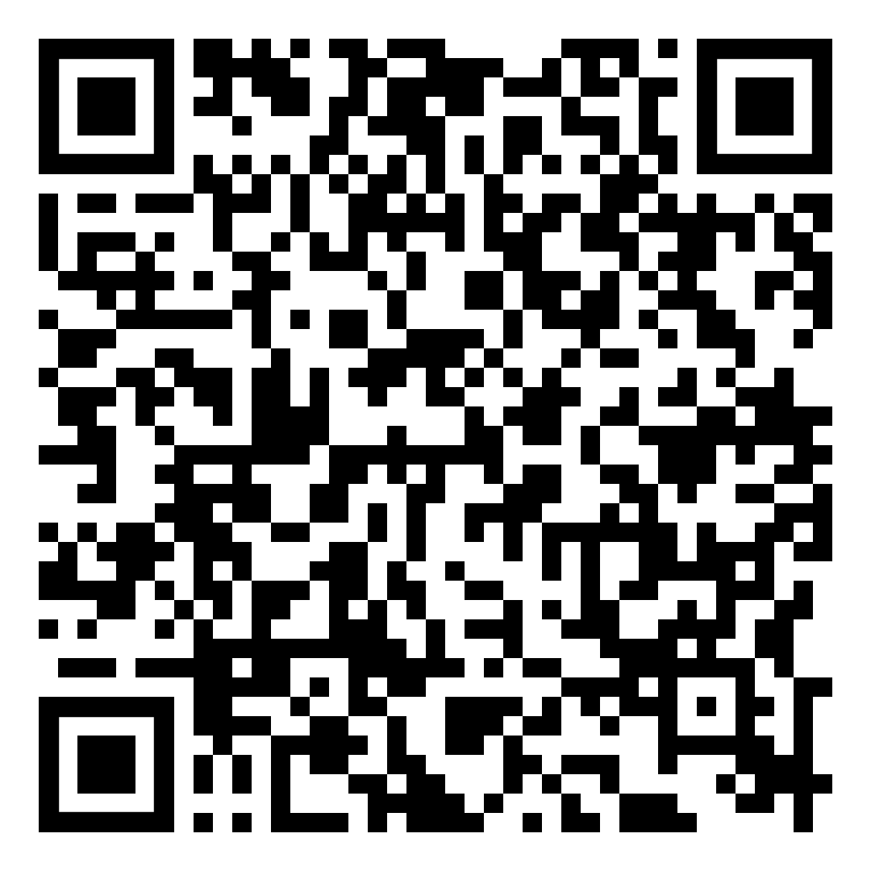
September Webinar
Title: The Successful Stepfamily
Available in September on mylifematters.com
Sign up for an email alert

Slide 4

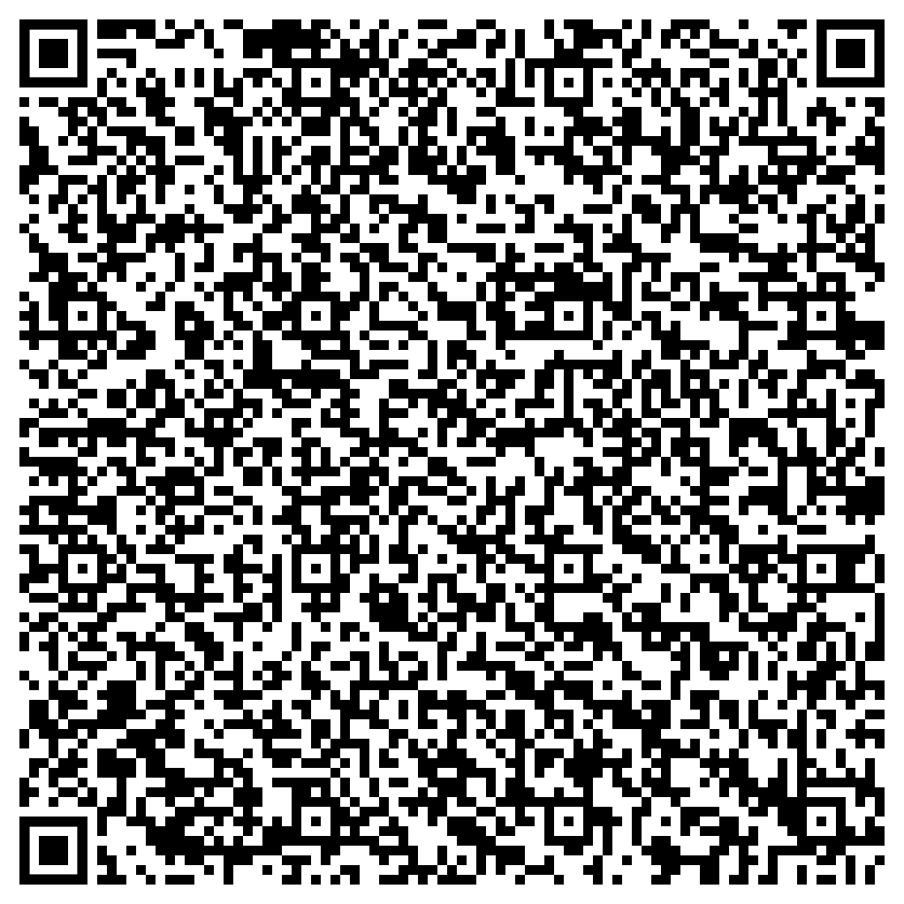
September Support Session
Suicide Awareness and Prevention
Thursday, September 19, 1 p.m. EDT
Session password: KPm3XP6HDm7

