Slide 1

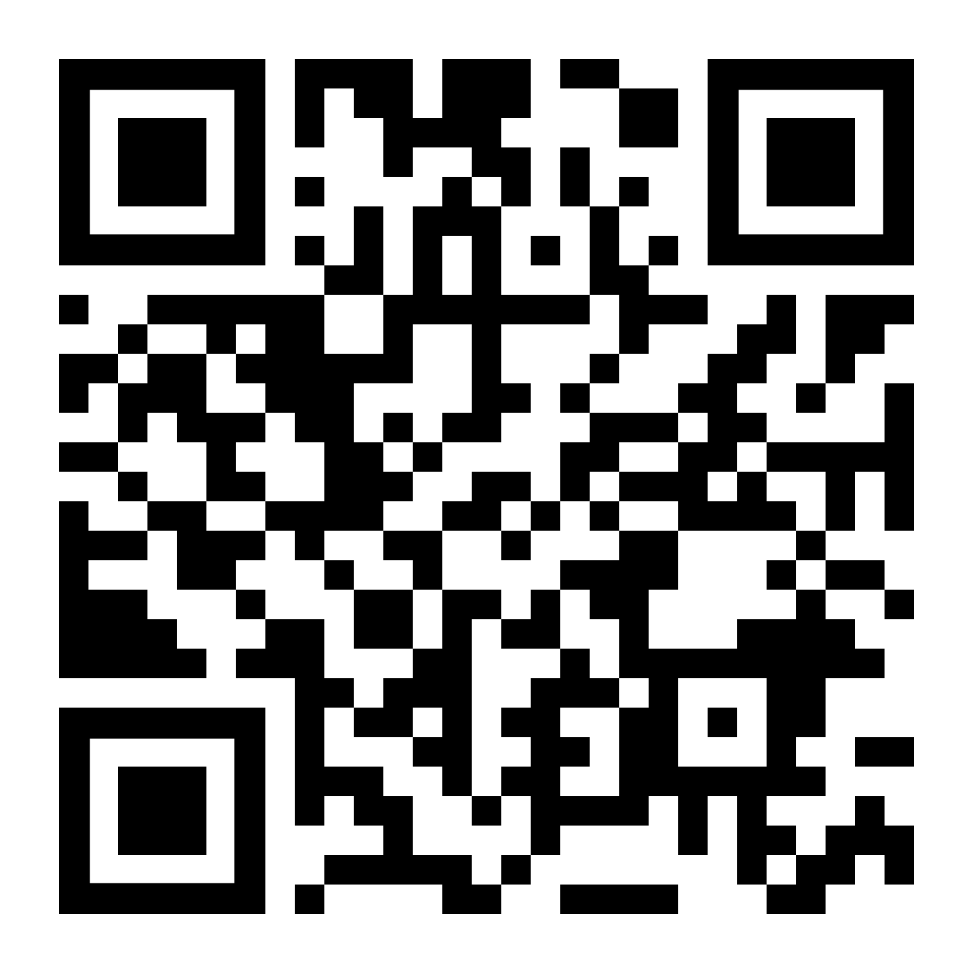

If alcohol or drugs are becoming a problem, LifeMatters can help.

Slide 2

Is it time to rebuild your resilience?
LifeMatters can help.

Slide 3

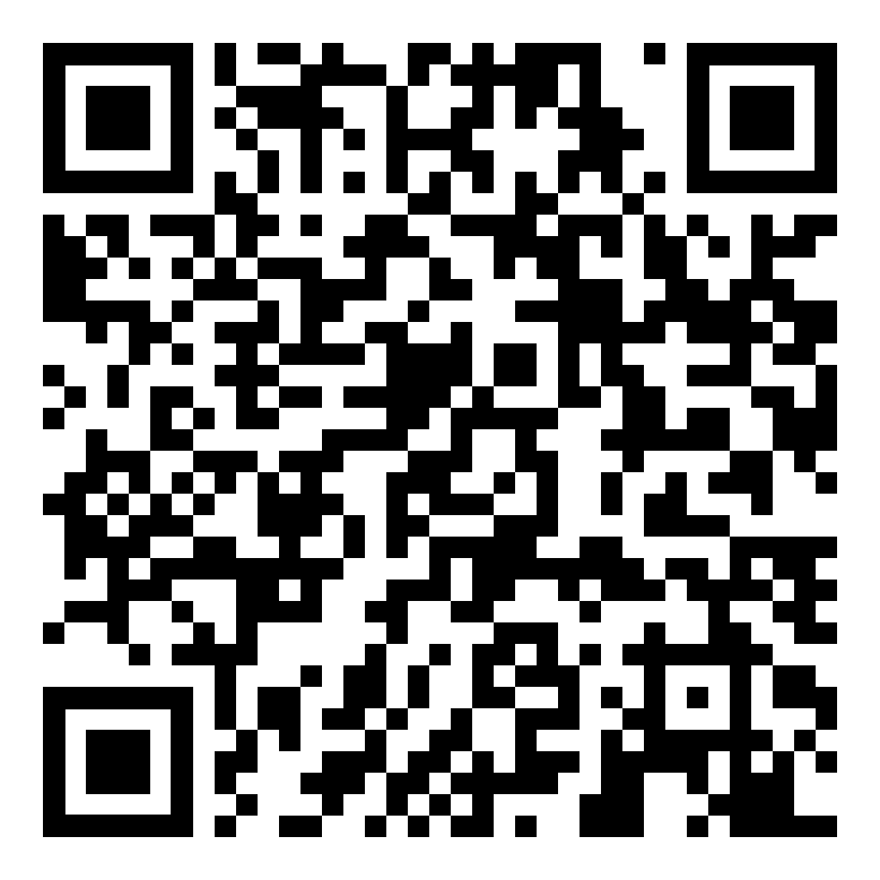
April Webinar
Title: Reinventing Retirement
Available in April on mylifematters.com
Sign up for an email alert

Slide 4

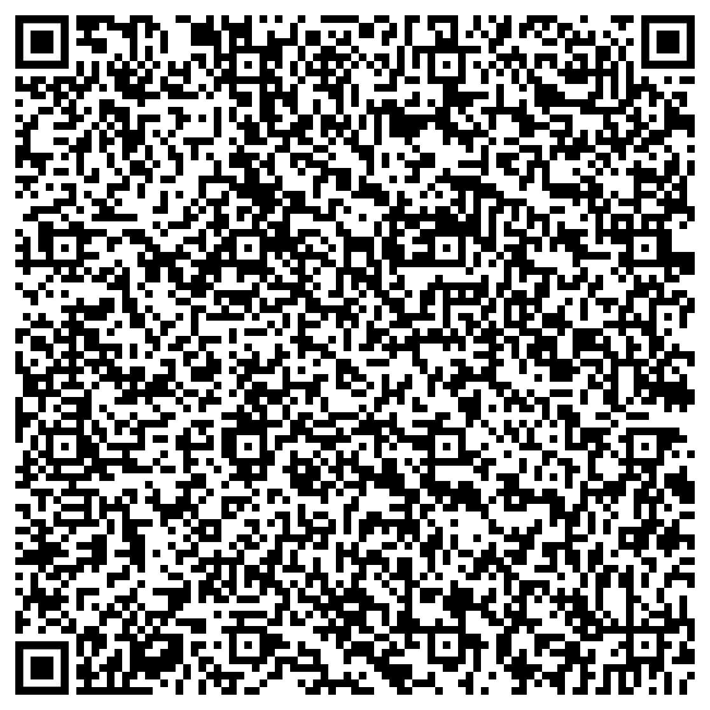
April Support Session
Daily Practices to Manage Stress and Build Resilience
April 8, 1 p.m. EDT
Session Password: K3Uc43fCHG3

