Slide 1
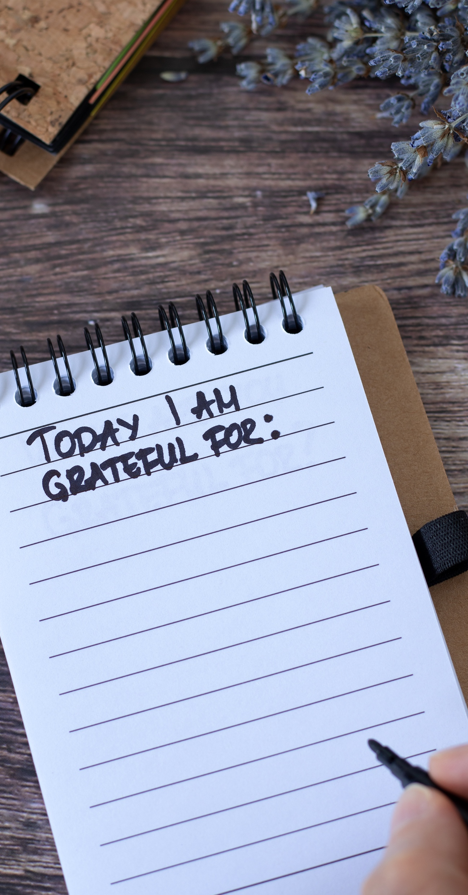
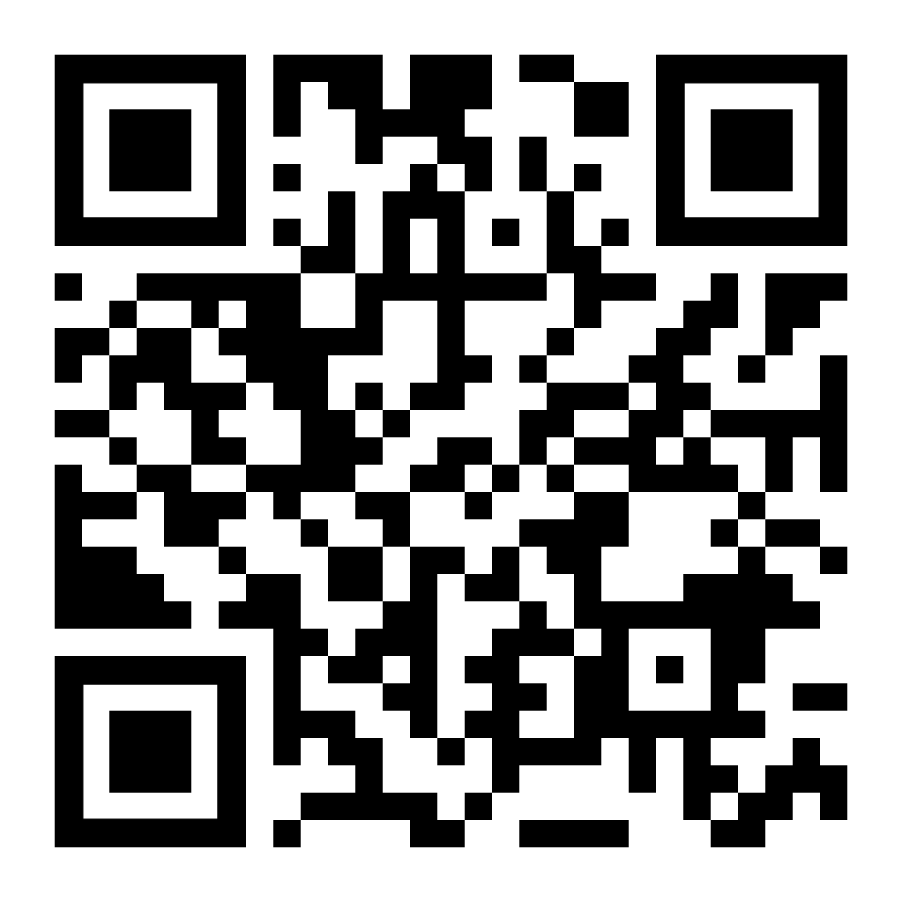

If you want to make gratitude a daily habit, LifeMatters can help.
Call 24/7/365.

Slide 2

If the holidays bring up painful memories, LifeMatters can help.
Call 24/7/365.

Slide 3

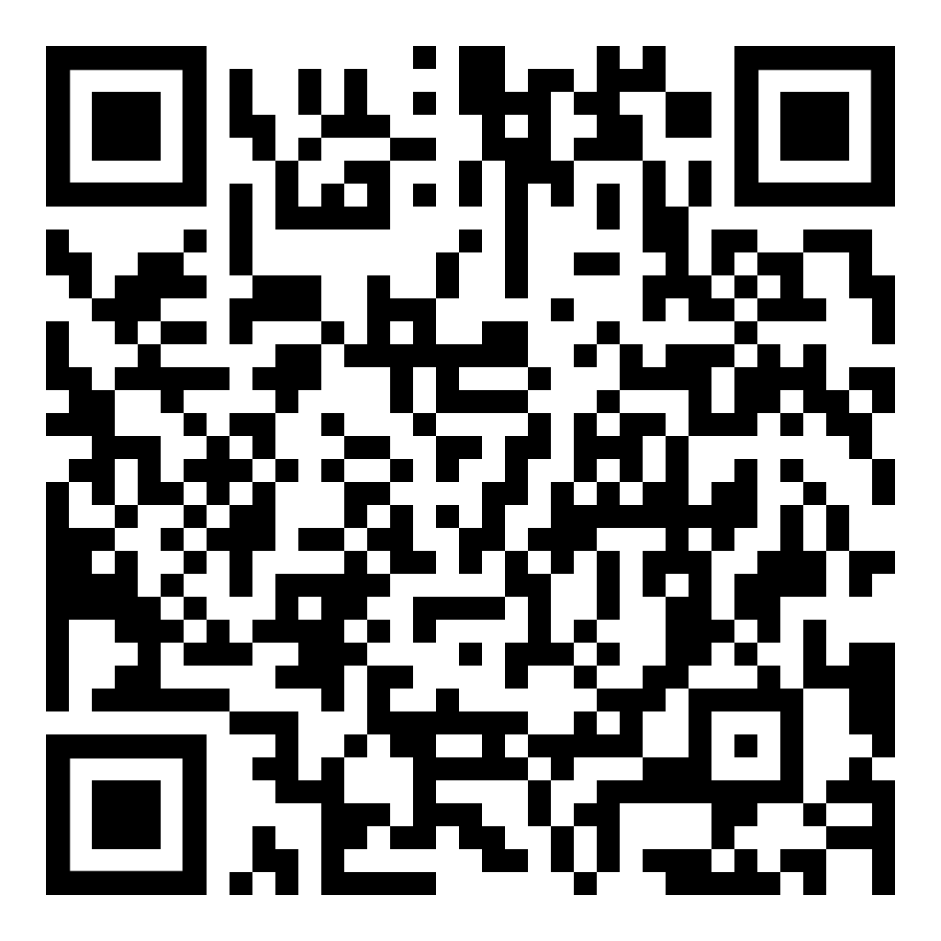
December Webinar
Emotional Intelligence: Enhancing Your Personal and Interpersonal Effectiveness
Available in December on mylifematters.com
Sign up for an email alert

Slide 4

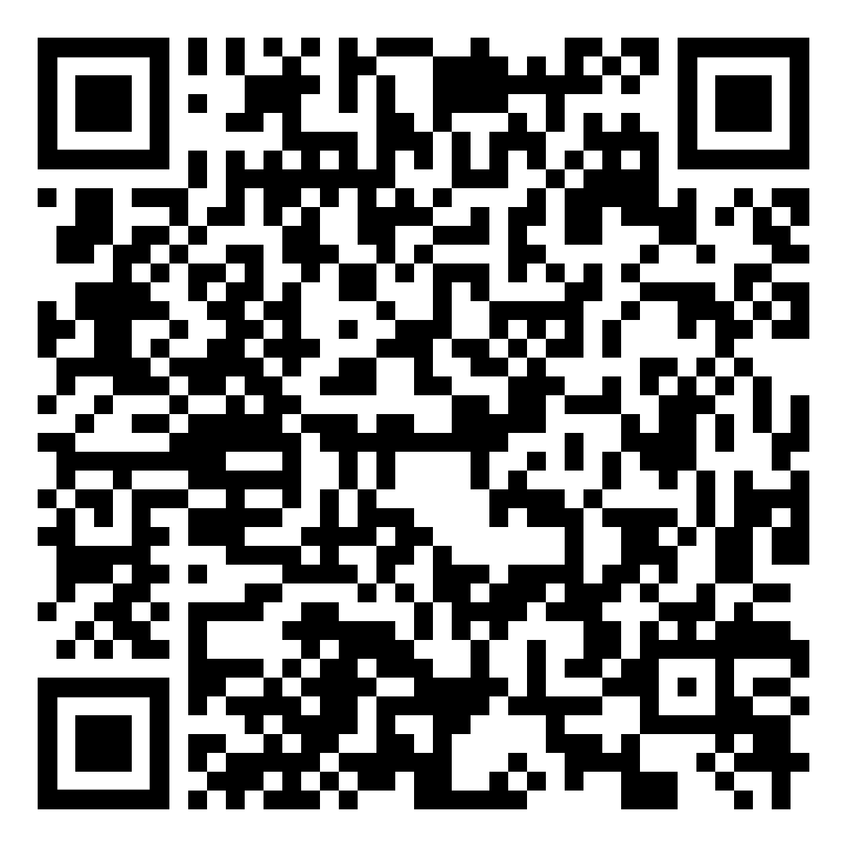
December Support Session
Mental Health and the Holidays
December 9, 1 p.m. EST
Session Password: xZTRgBru523

Slide 5

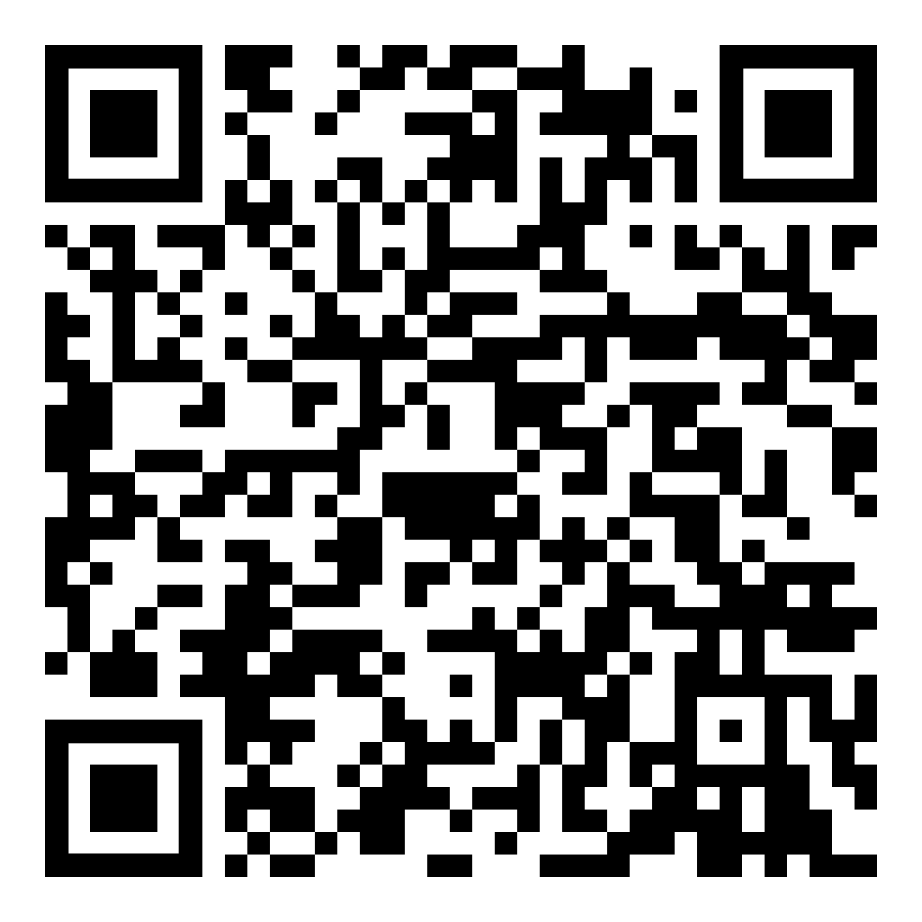
OnTopic with Empathia
On Holiday Stress with Christina Eggebeen
Available on your preferred podcast platform or at empathia.com

