Slide 1

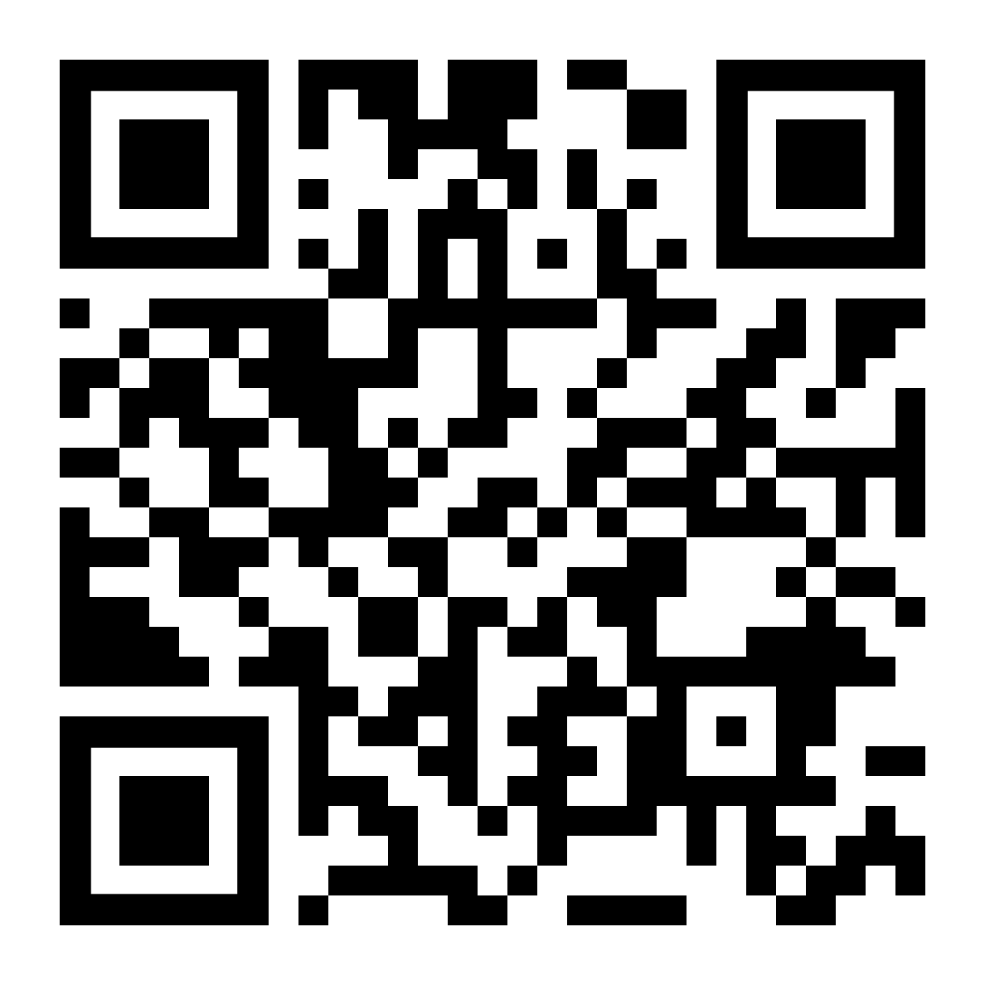

Connection
LifeMatters offers 24/7/365 assistance with:
Nurturing a partnership
Strengthening family bonds
Improving social wellness
Breaking unhealthy patterns
Any other relationship issue

Slide 2
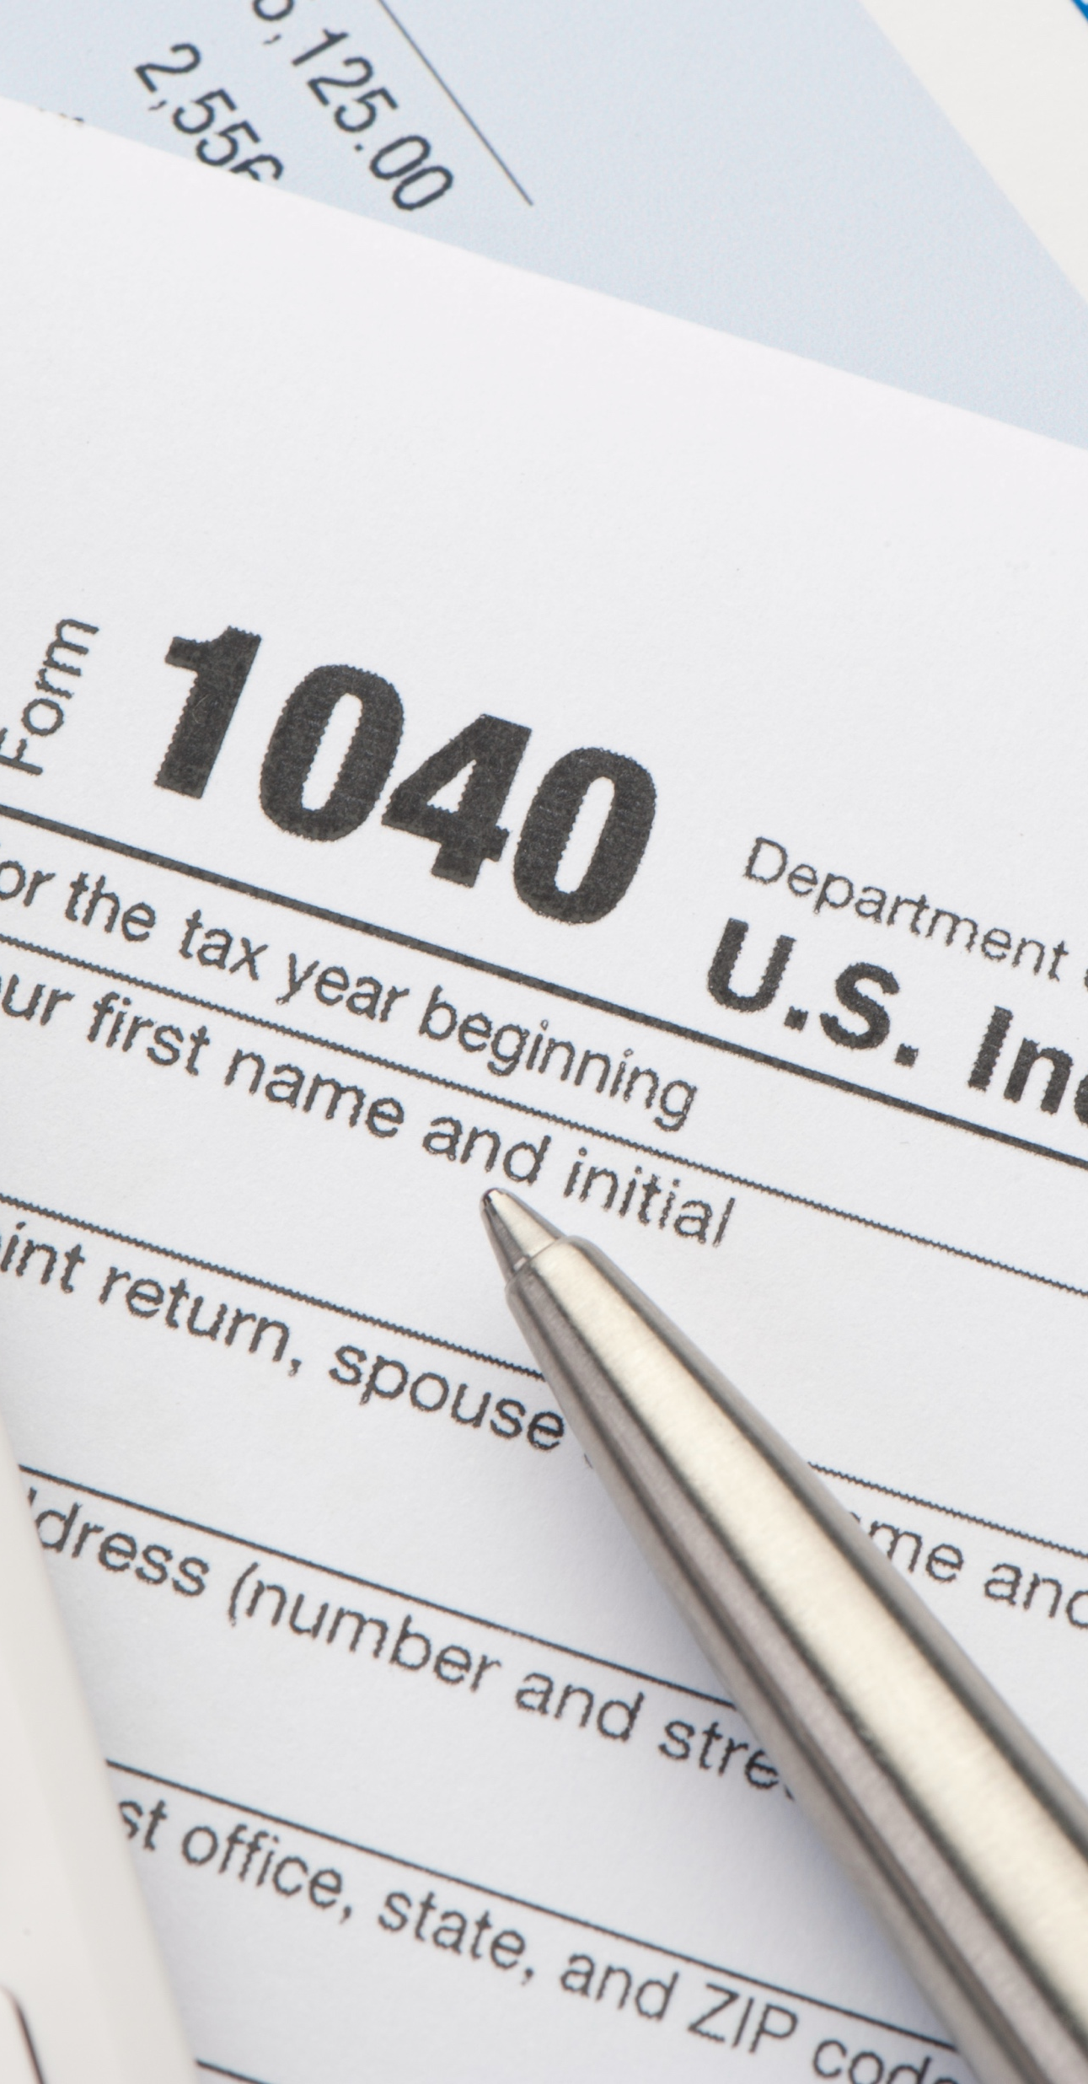
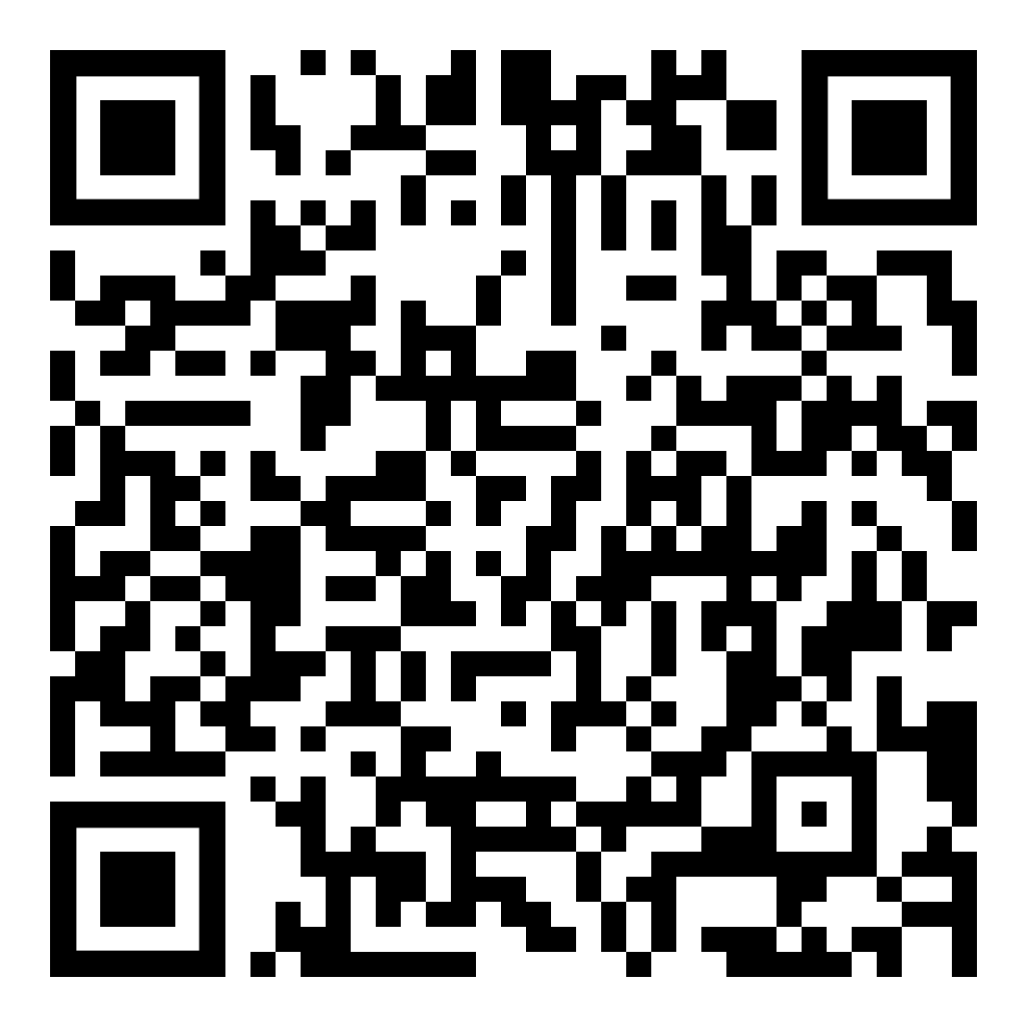
February Webinar
Title: Tips for a Tax-Smart Future
Available in February on mylifematters.com
Sign up for an email alert

Slide 3

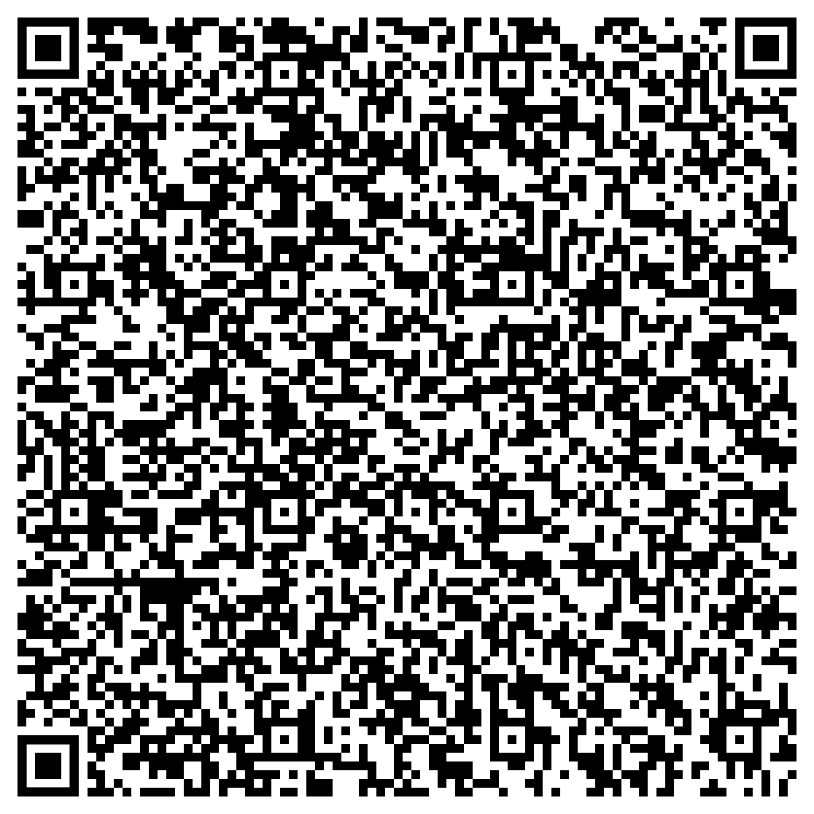
February Support Session
The Healing Effects of Social Connection
Tuesday, February 18, 1 p.m. EST
Session Password: BUarpMKQ534

