Slide 1

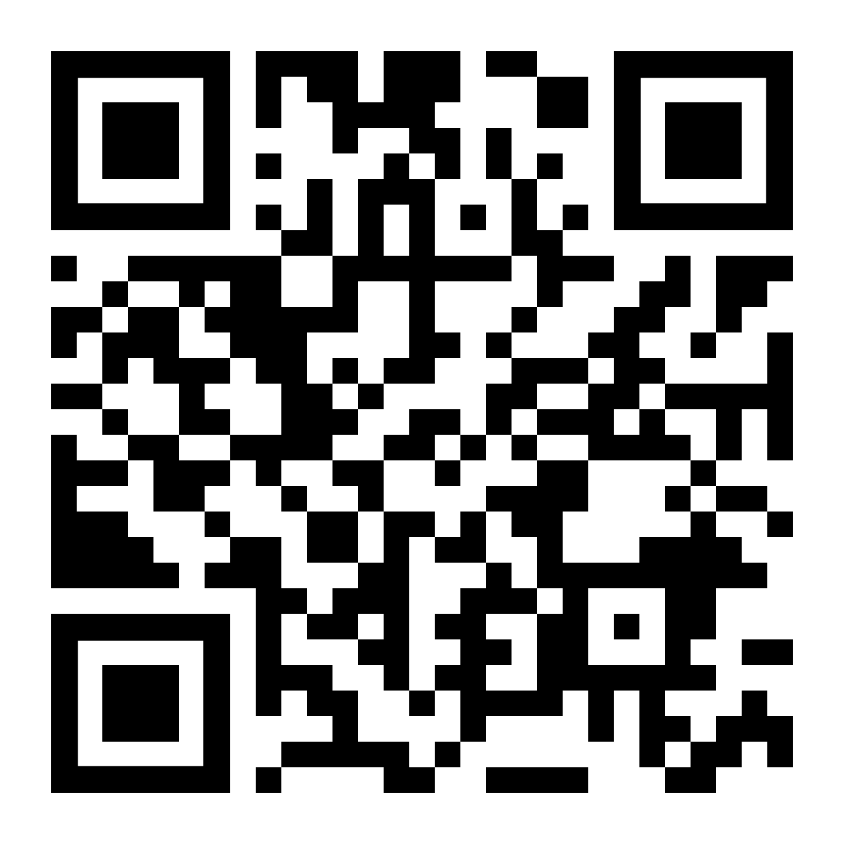
LifeMatters can help you make your goals a reality.

Slide 2

LifeMatters can help you cope with a stressful change.

Slide 3

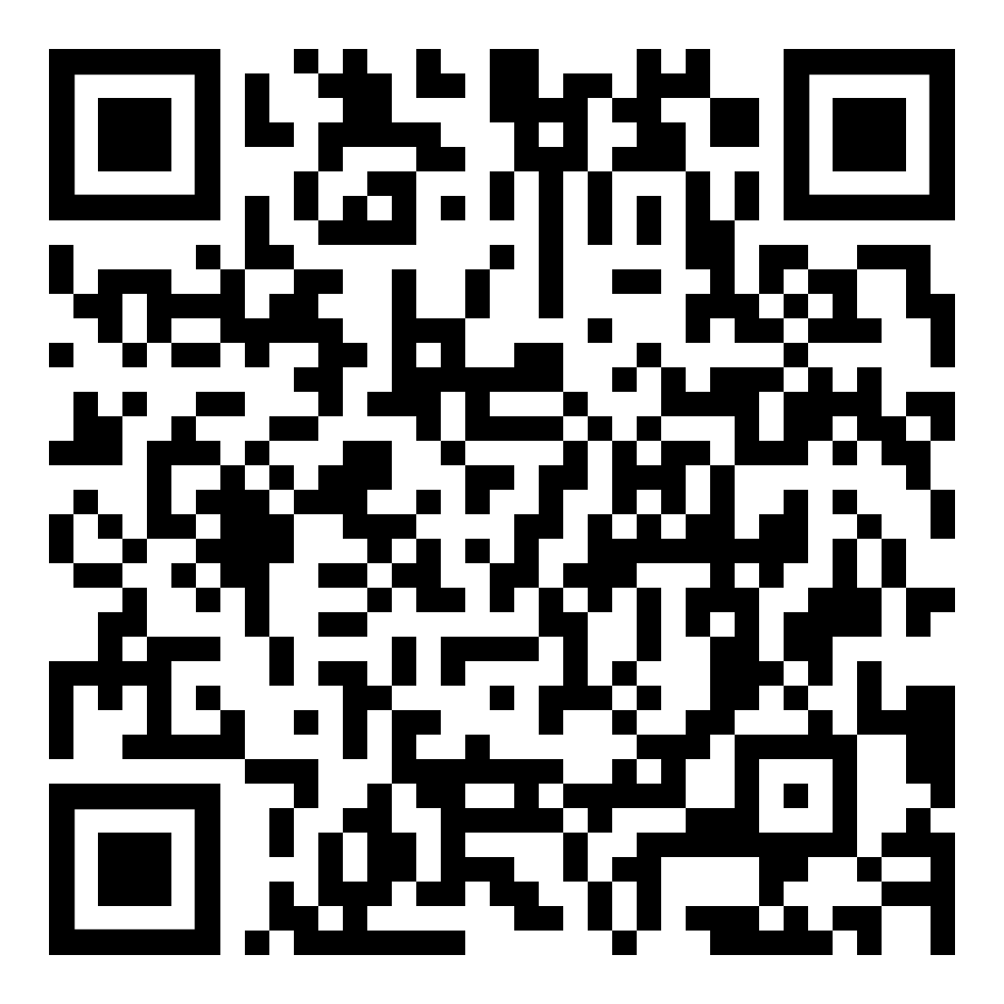
January Webinar
Title: Wills, Trusts, and Estate Planning
Available in January on mylifematters.com
Sign up for an email alert

Slide 4

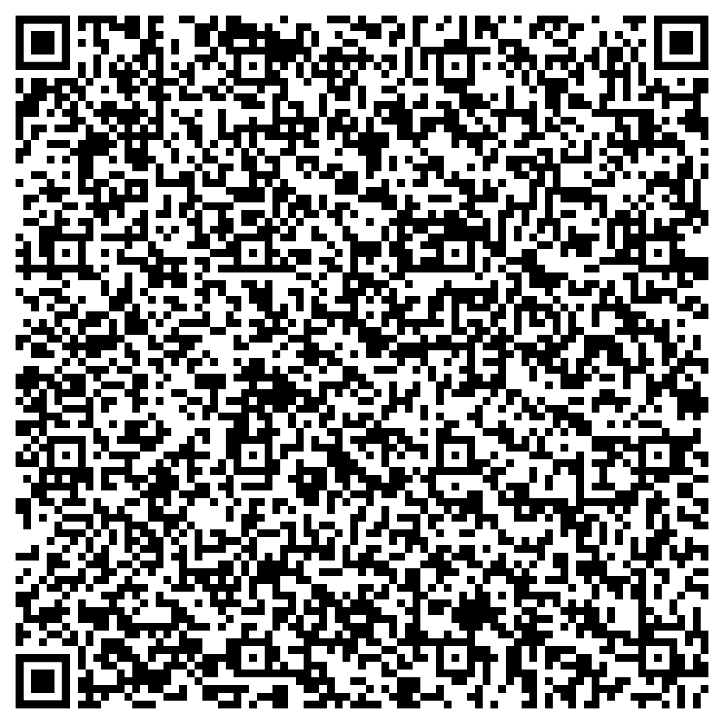
January Support Session
Improving Your Health and Well-being in 2025
Tuesday, January 14, 1 p.m. EST
Session password: PdnXr7ufH33

