Slide 1

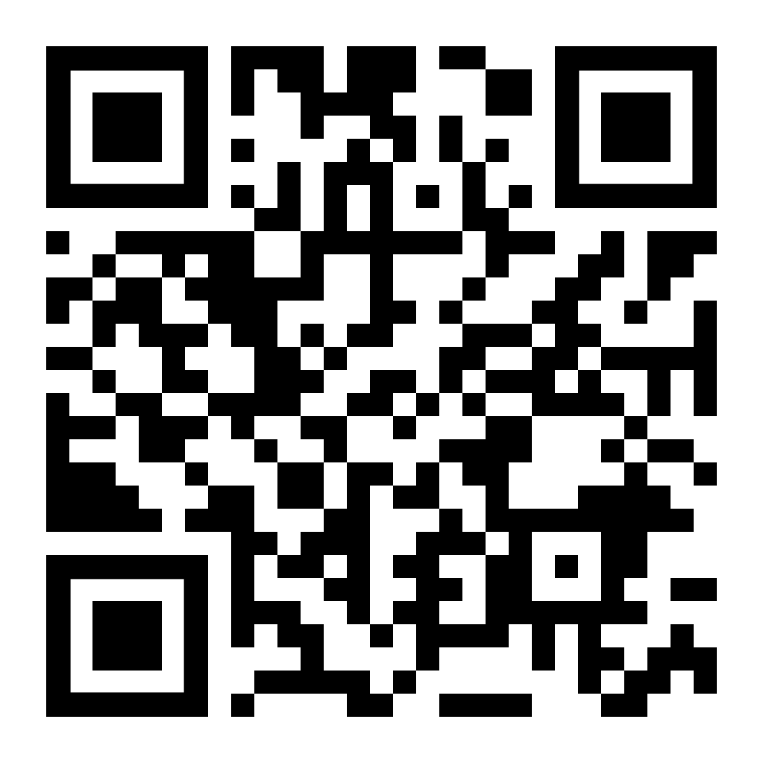
If you would like to communicate more effectively, LifeMatters can help. Call 24/7/365.

Slide 2

LifeMatters can help you make the most of family time.
Call 24/7/365.

Slide 3

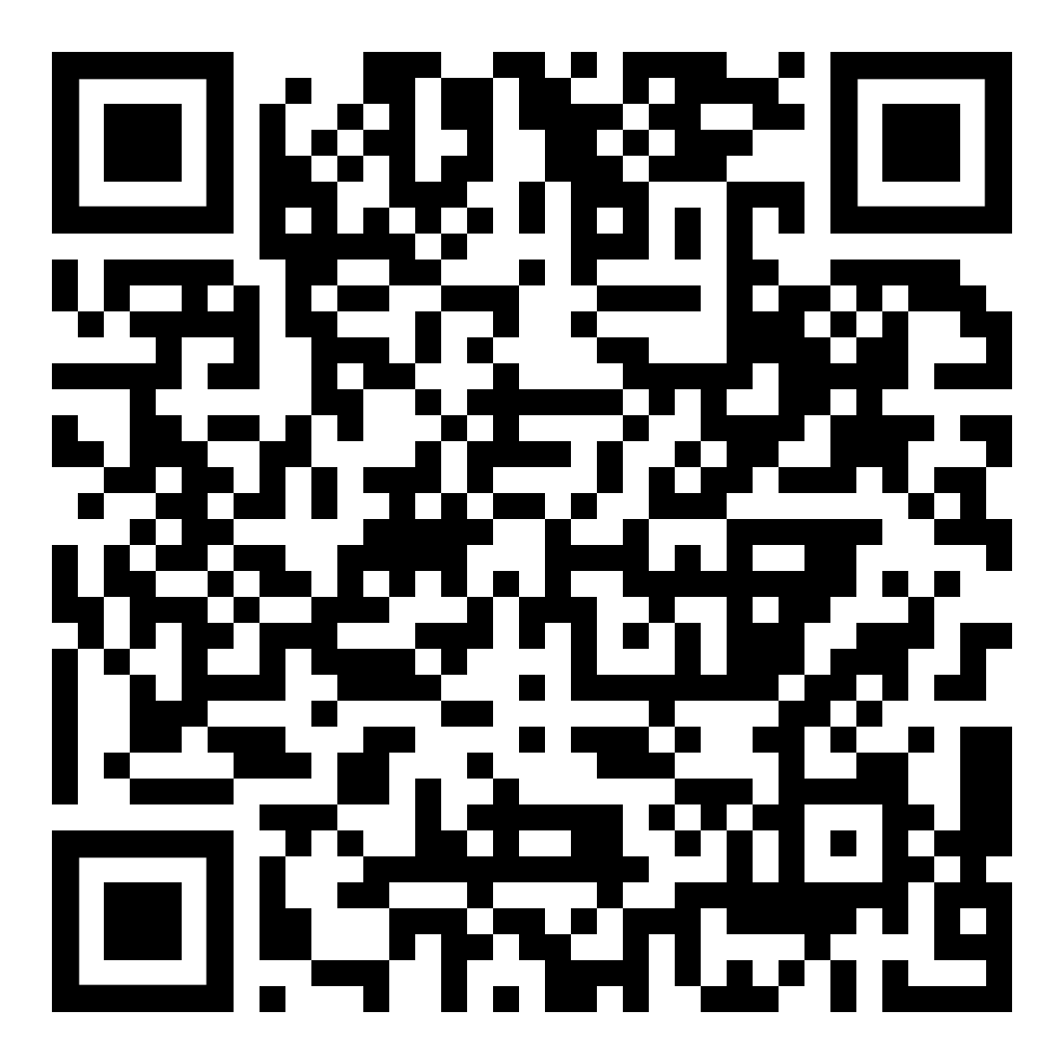
July Webinar
Financial Basics: Aligning Lifestyle and Income for Future Security
Available in July on mylifematters.com
Sign up for an email alert

Slide 4

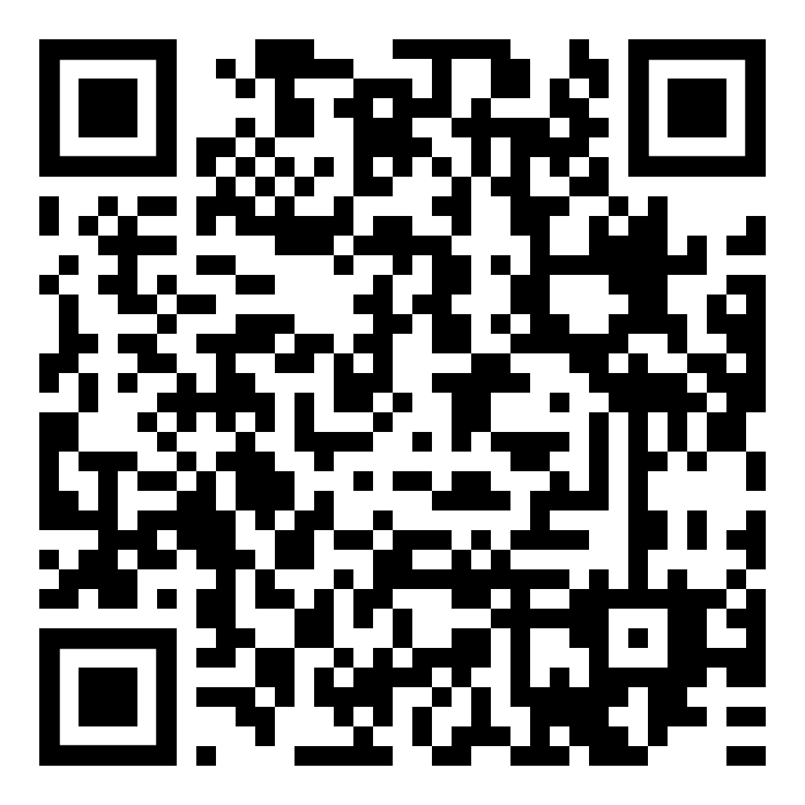
July Support Session
Coping with Disappointment
July 15, 1 p.m. EDT
Session password: AJntn3aUZ92

Slide 5

Take the All-New MyWellbeing Profile
Evaluate your current circumstances and identify opportunities for growth in five domains:
Physical
Community
Social
Career
Financial
Go to mylifematters.com and log in with your password. Then, go to the Wellbeing & Personal Growth tile.

