Slide 1
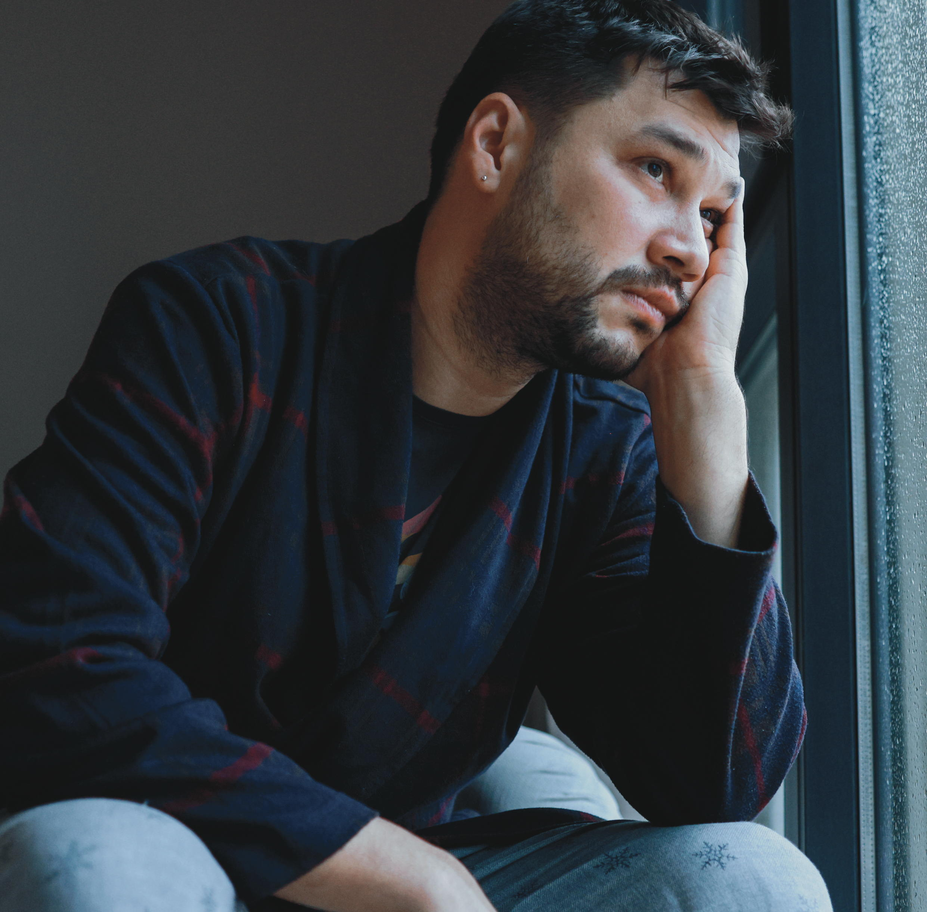
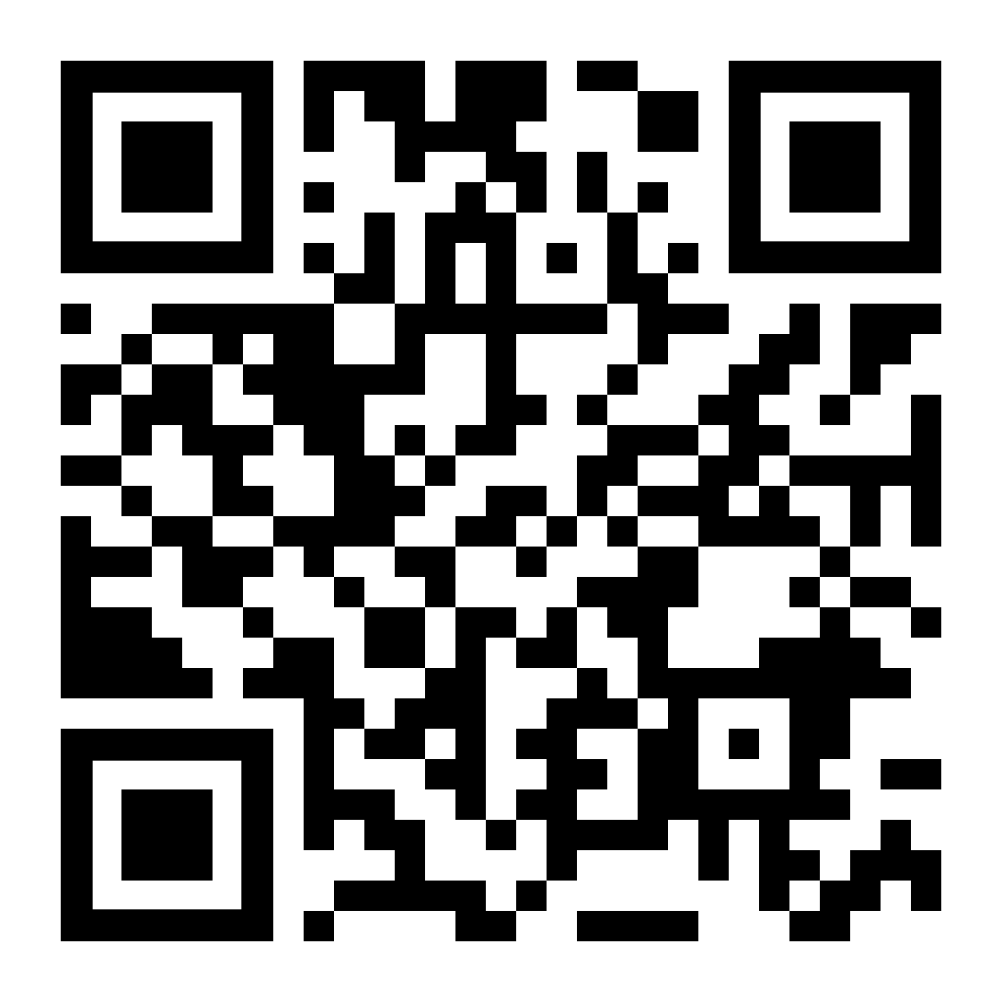
If being a caregiver is wearing you down, LifeMatters can help.
Call 24/7/365.

Slide 2
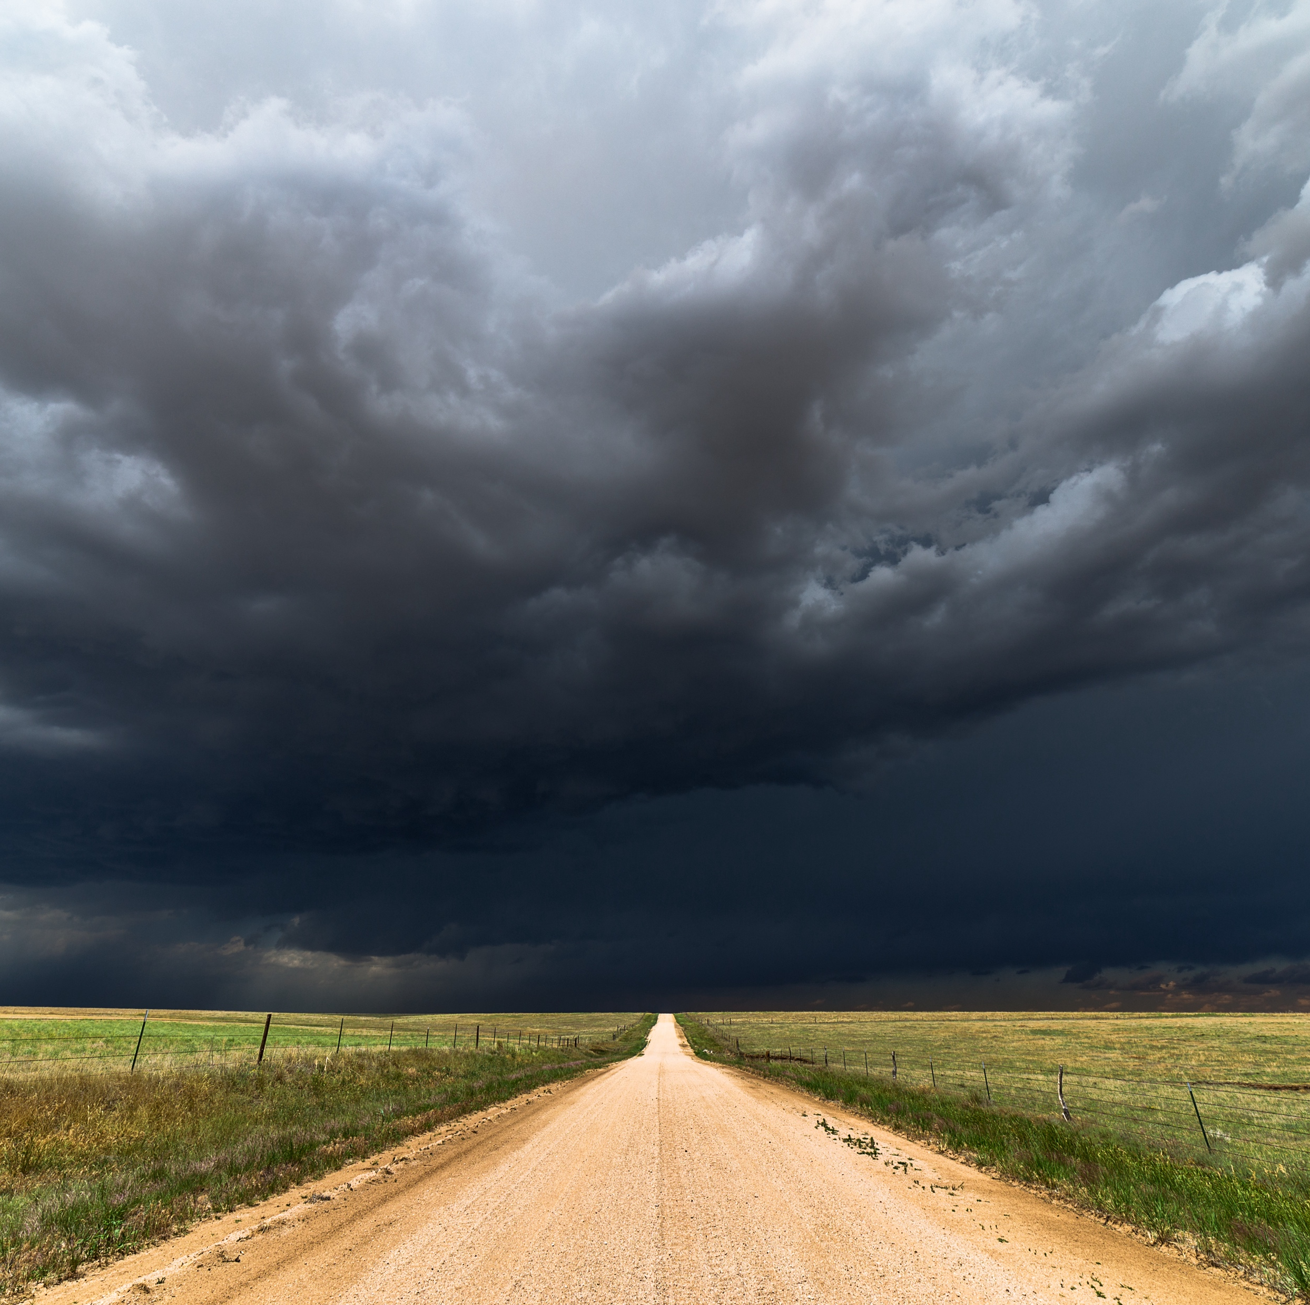
LifeMatters can help you plan for or recover from a natural disaster.
Call 24/7/365.

Slide 3
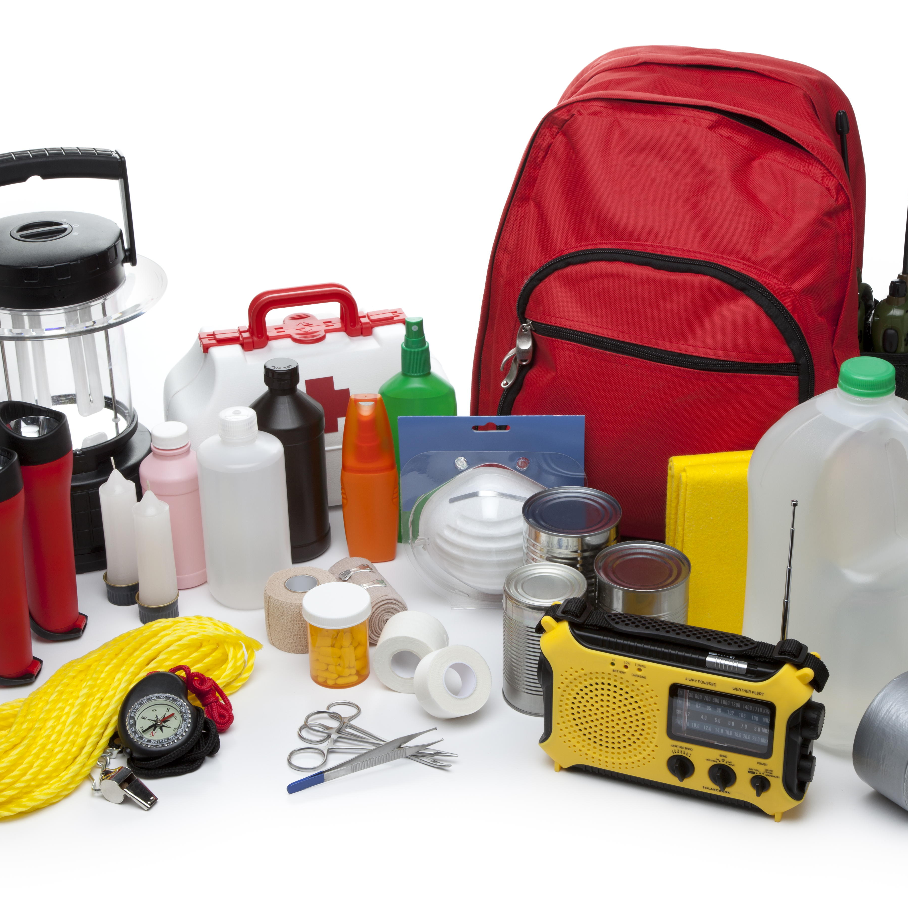
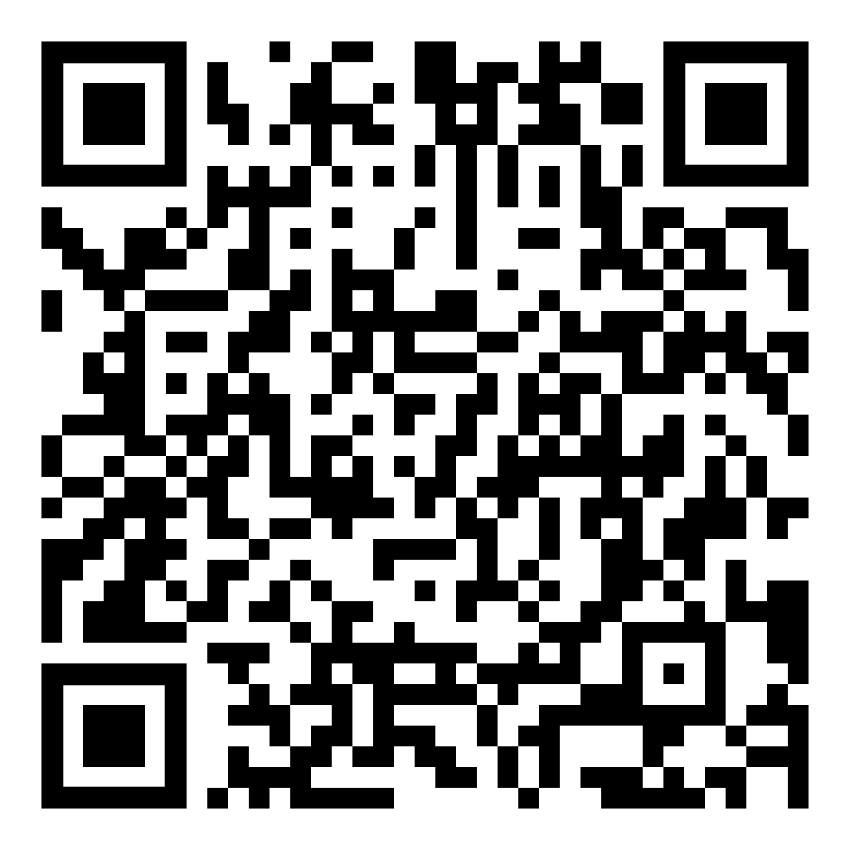
June Webinar
Title: Preparing Your Family for Emergencies
Available in June on mylifematters.com
Sign up for an email alert

Slide 4

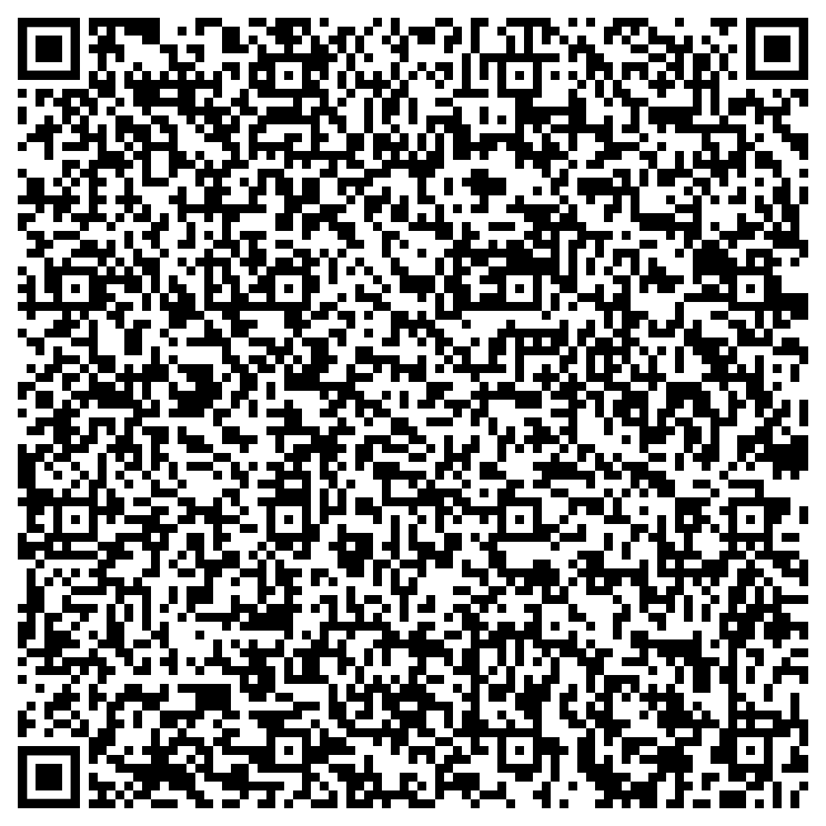
June Support Session
How to Be an Ally to the LGBTQIA+ Community
June 5, 1 p.m. EDT
Session password: neJTYRUY623

