Slide 1

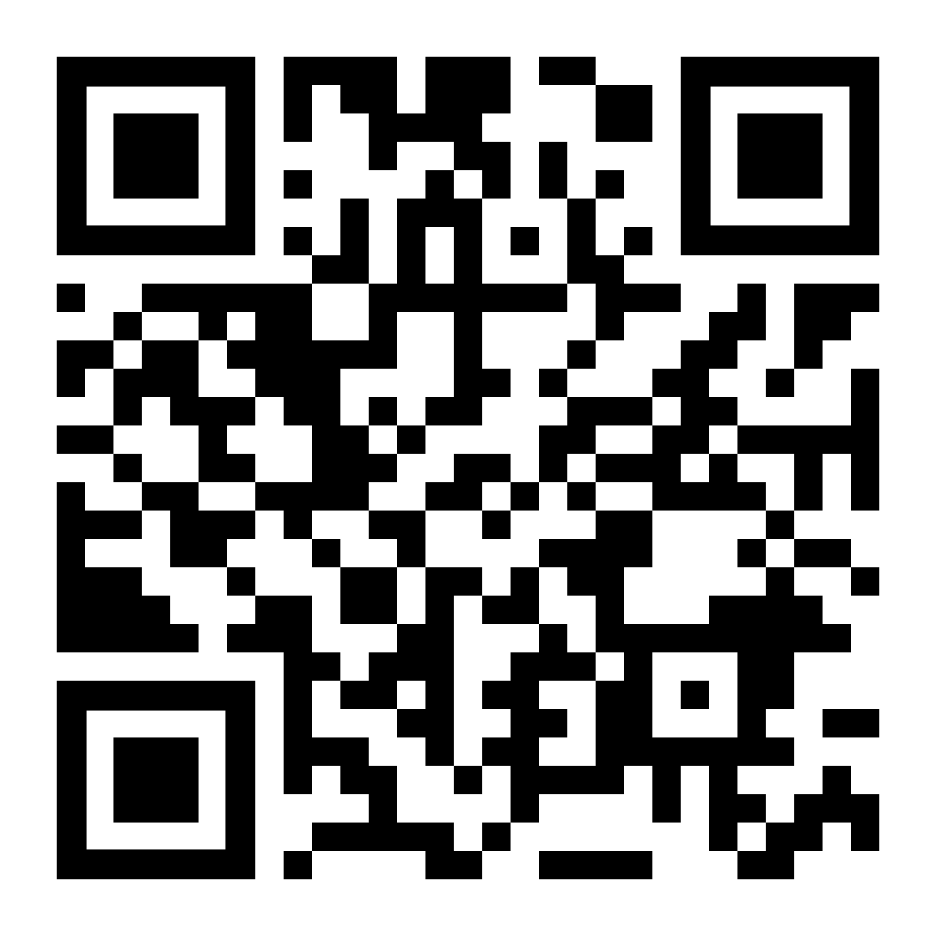
LifeMatters can help you strengthen your ability to regulate your emotions.

Slide 2
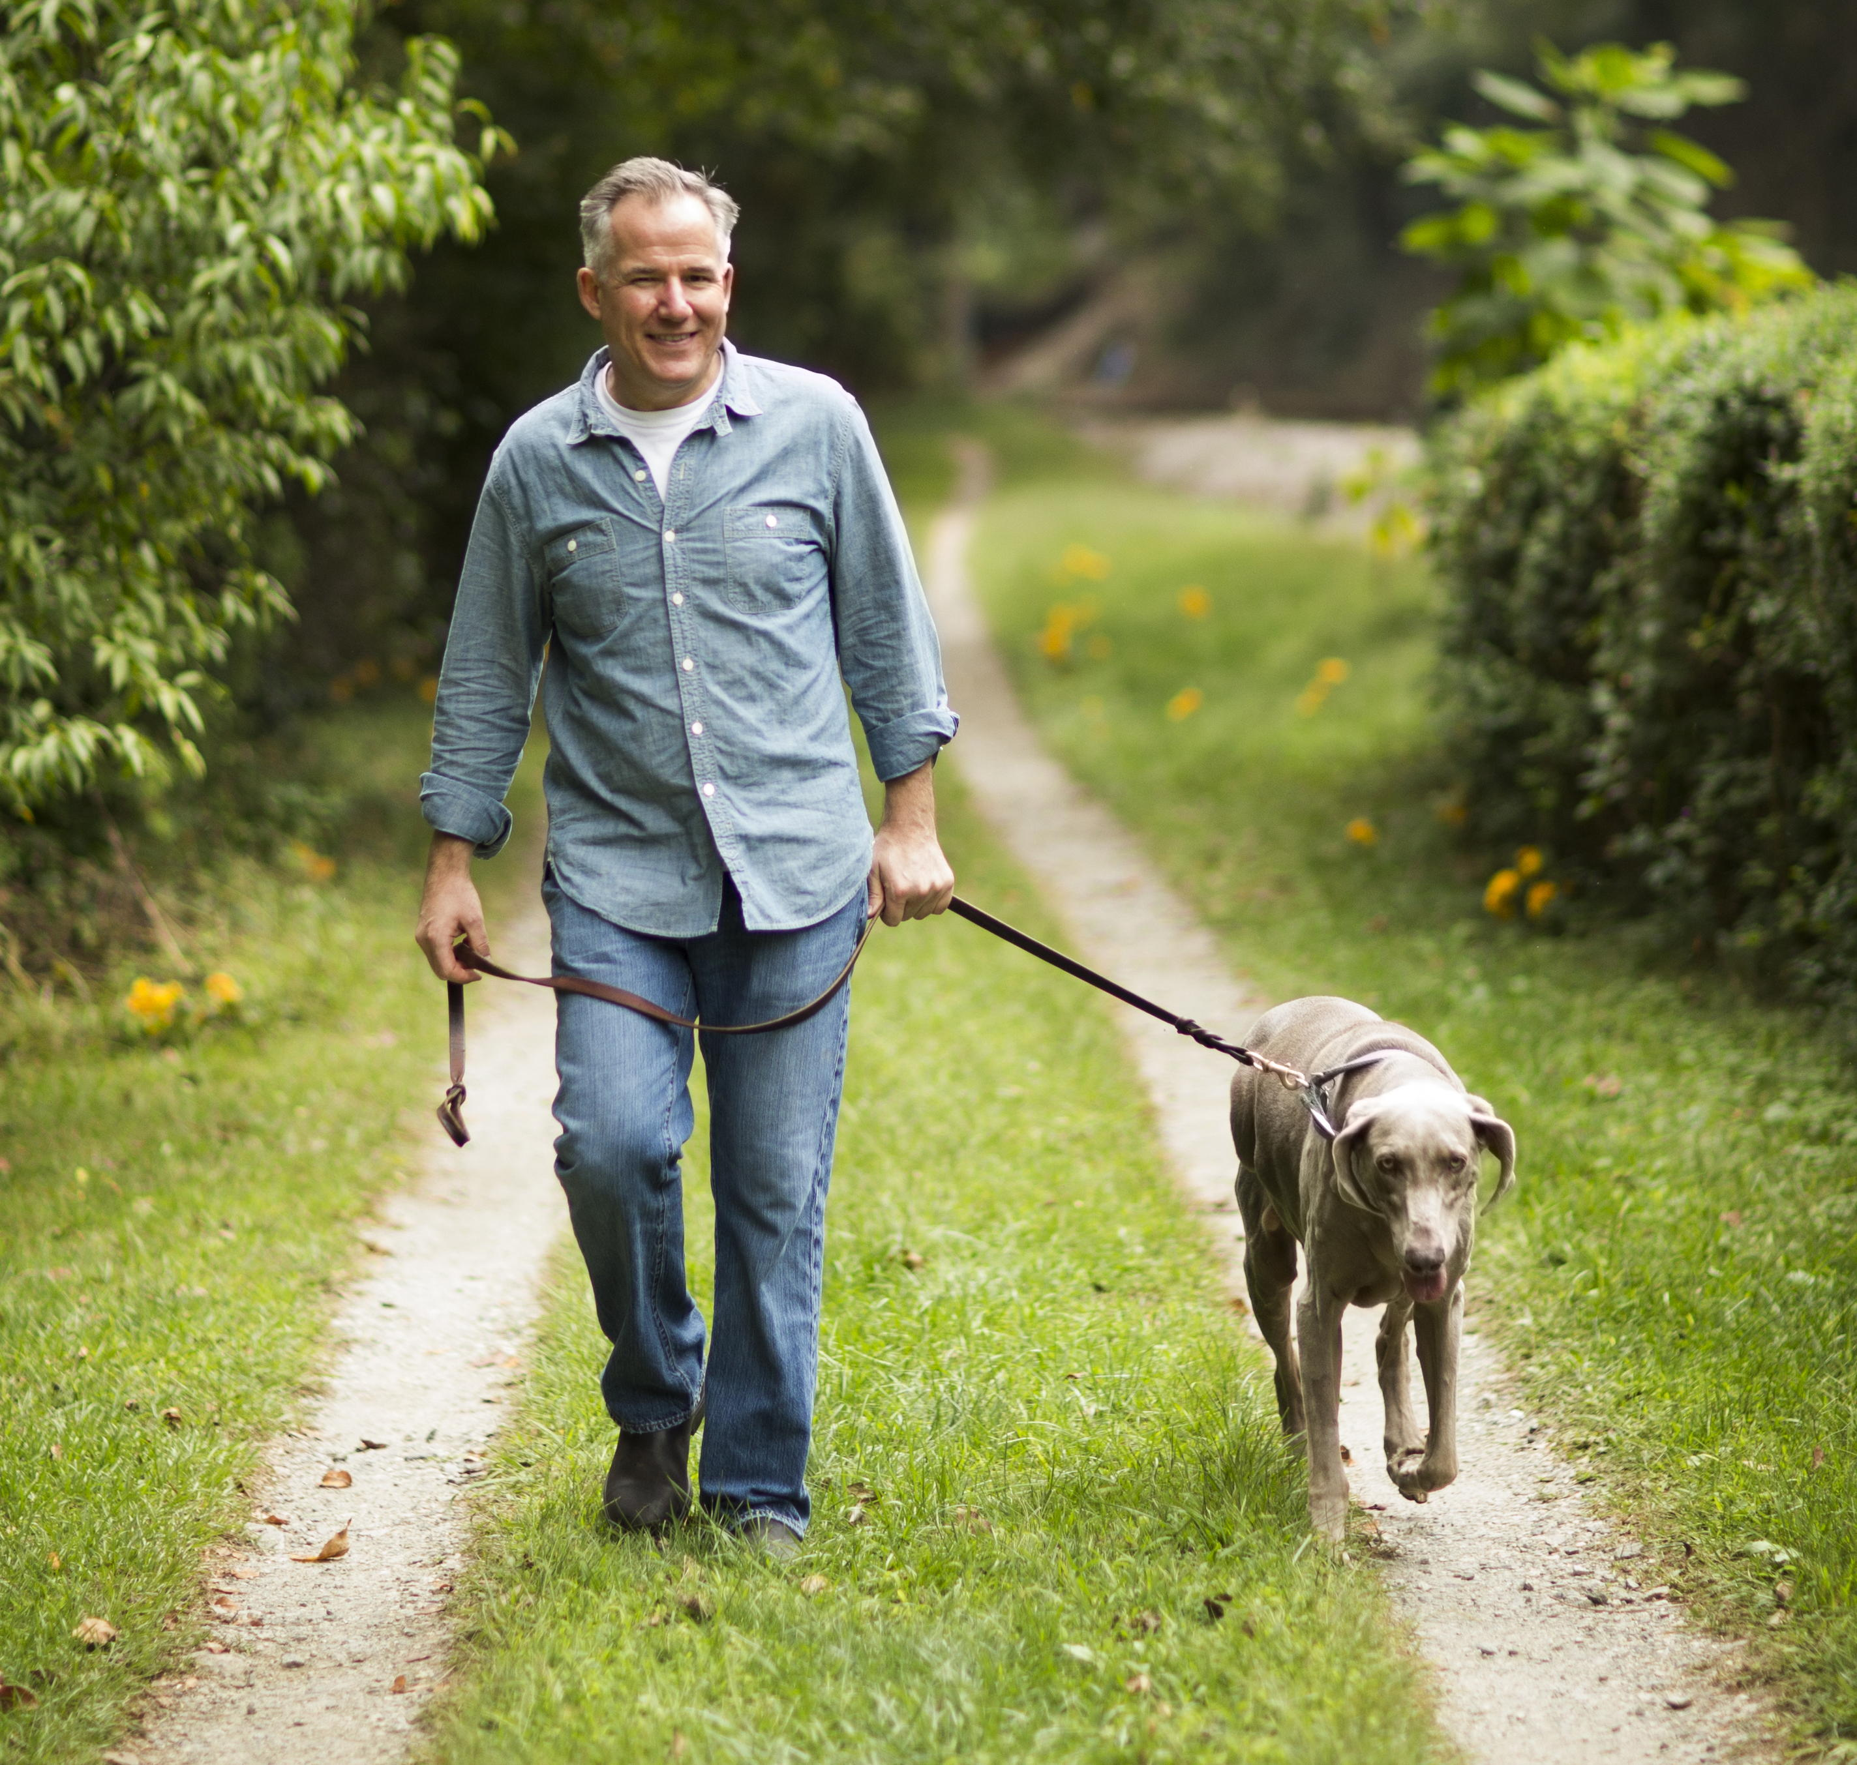
LifeMatters can suggest ways to increase your daily step count.

Slide 3

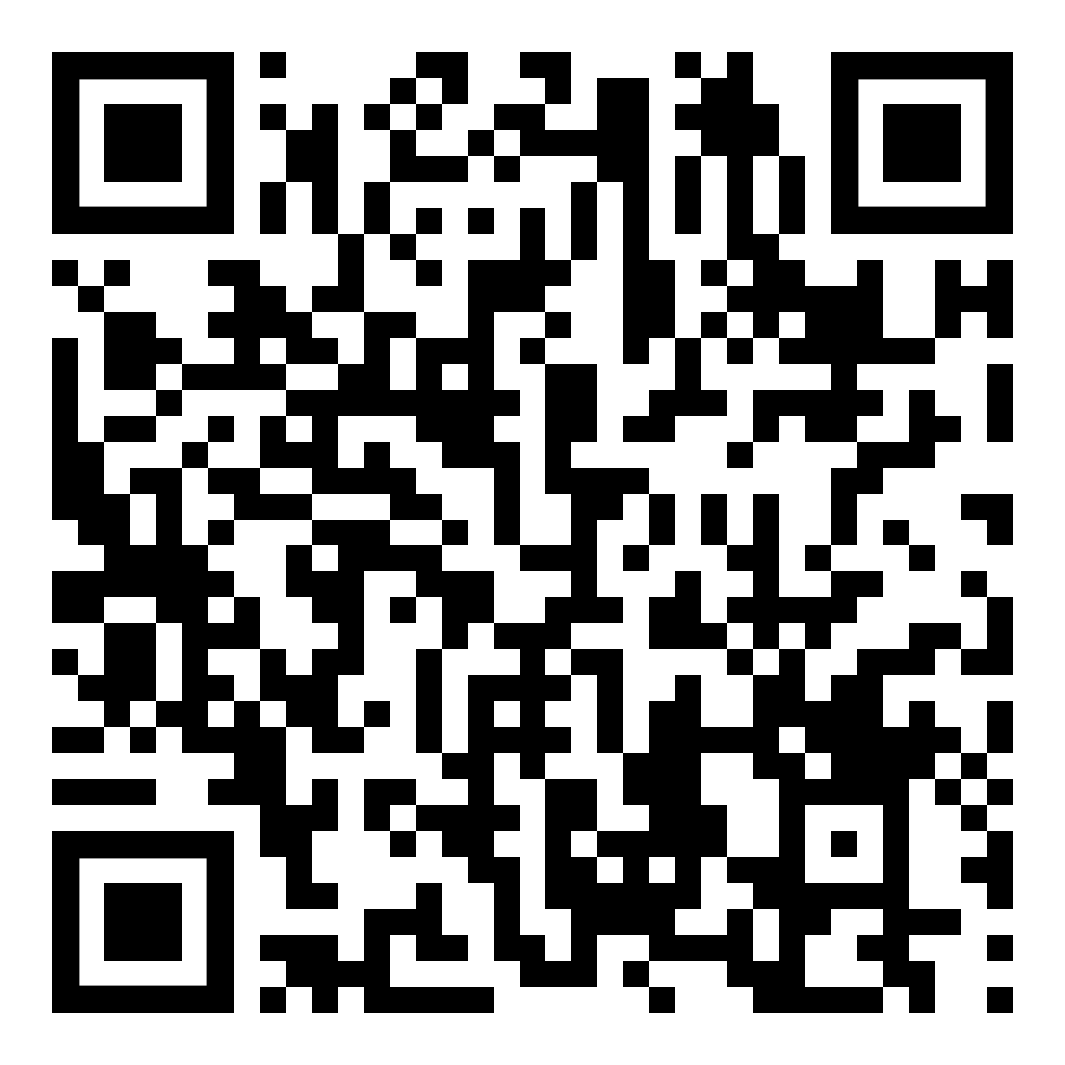
March Webinar
Title: So, You Think You Want a Pet?
Available in March on mylifematters.com
Sign up for an email alert

Slide 4

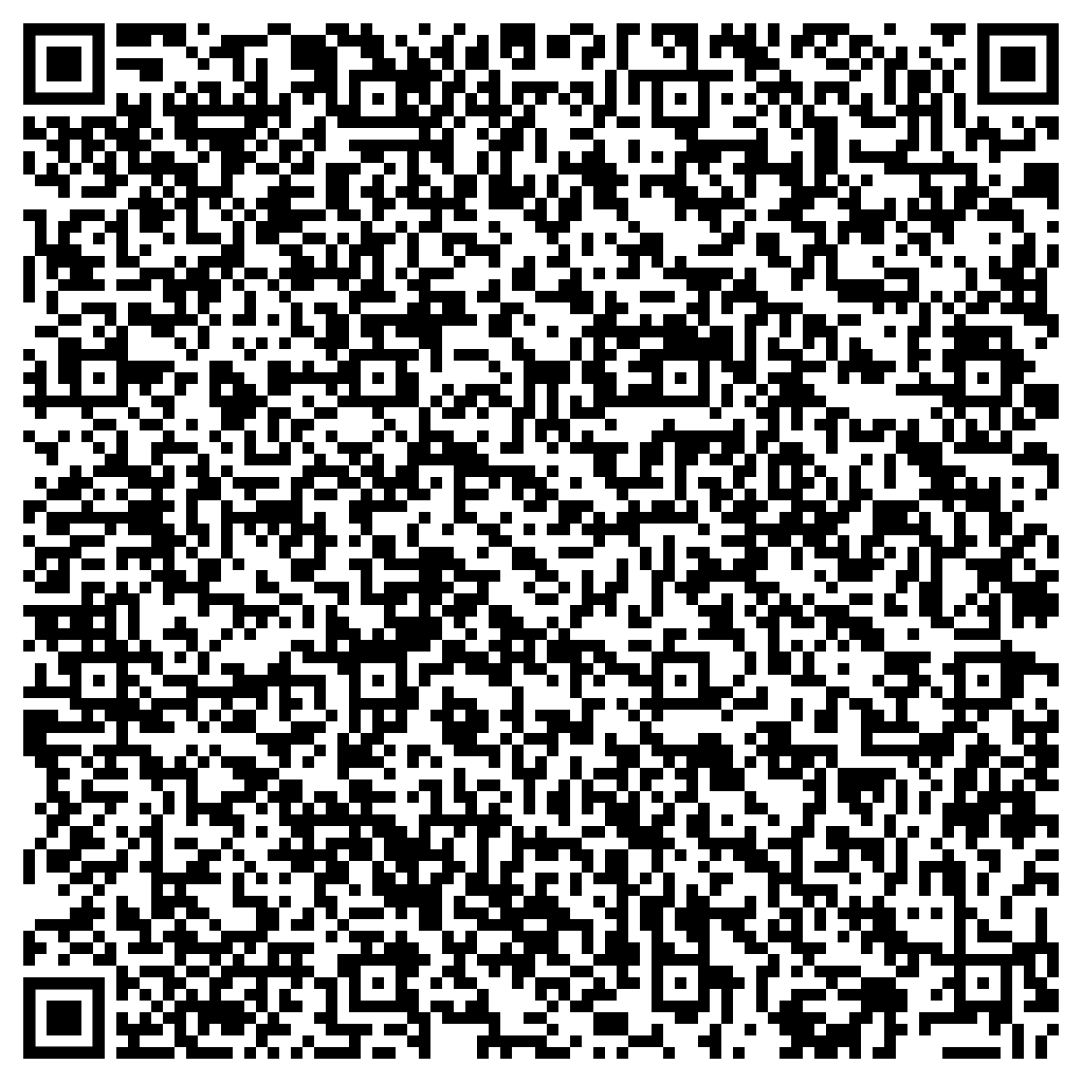
March Support Session
Develop Your Empathy Muscle to Strengthen ALL Your Relationships
March 20, 1 p.m. EDT
Session password: bYWMYxd5w33

