Slide 1

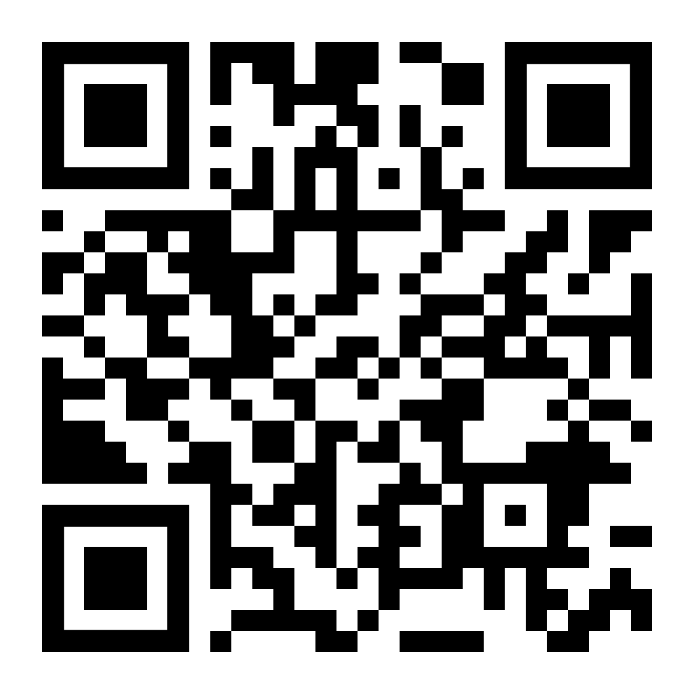

Uncertain Times
LifeMatters offers 24/7/365 assistance with:
Adjusting your budget
Coping with worry and stress
Building resilience
Maintaining wellbeing
Any other issue

Slide 2

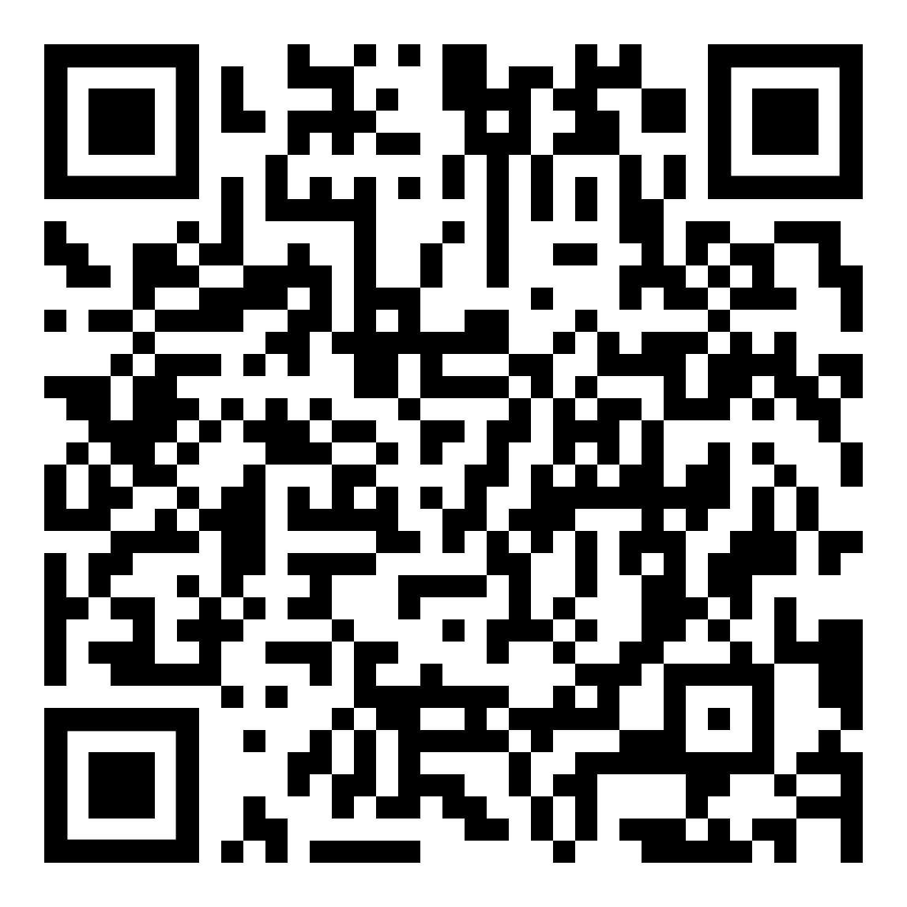
May Webinar
Title: Boosting Your Confidence
Available in May on mylifematters.com
Sign up for an email alert

Slide 3

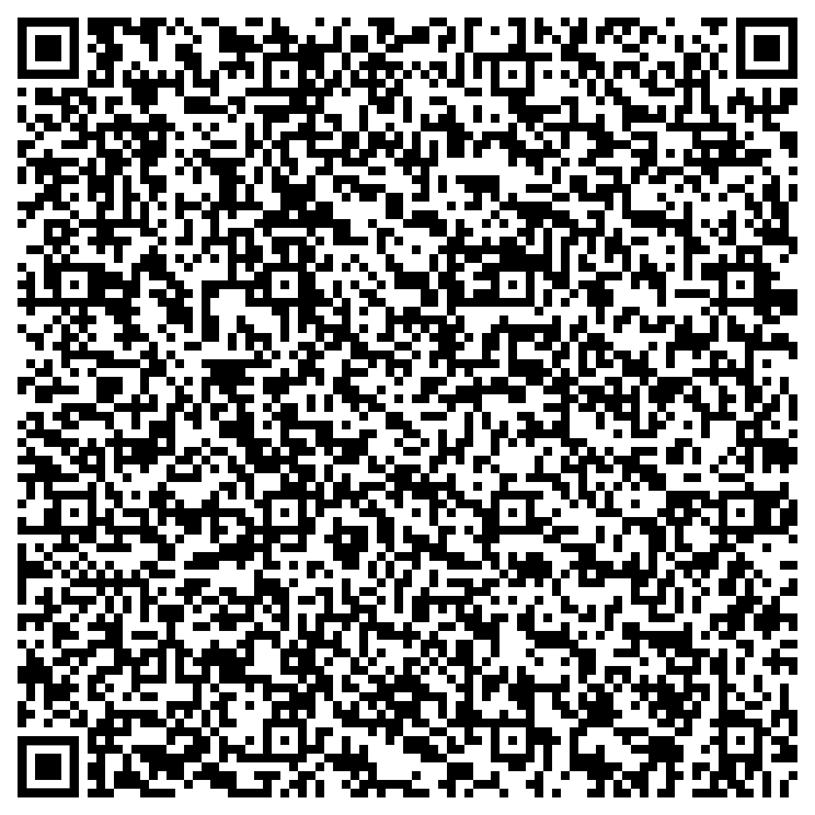
May Support Session
Anxiety: Triggers and Treatment
May 13, 1 p.m. EDT
Session Password: MmG86V3aaPh

