Slide 1
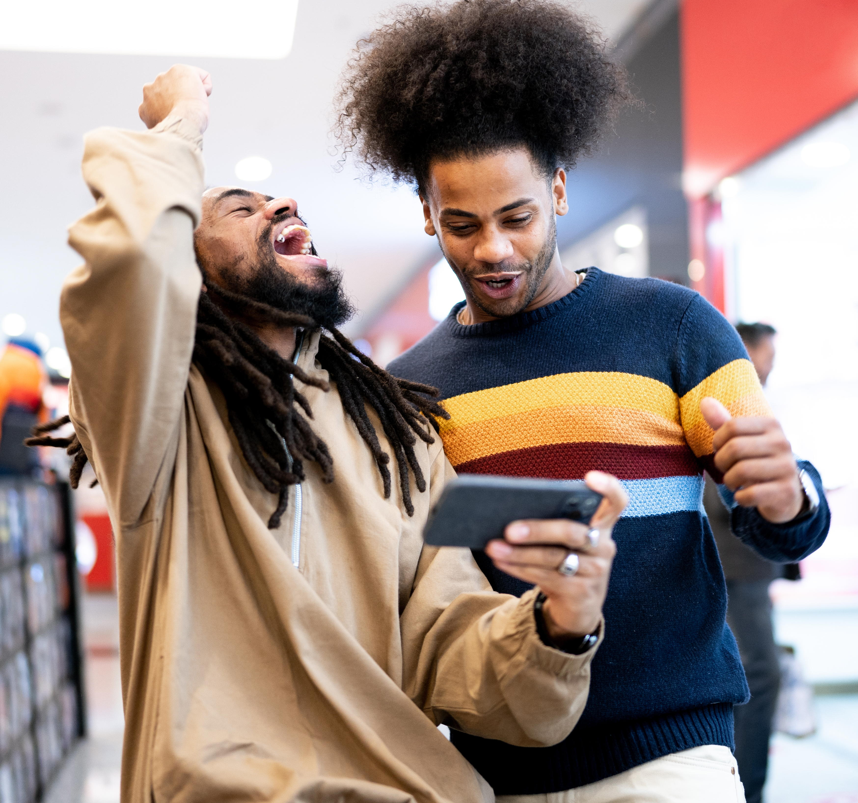
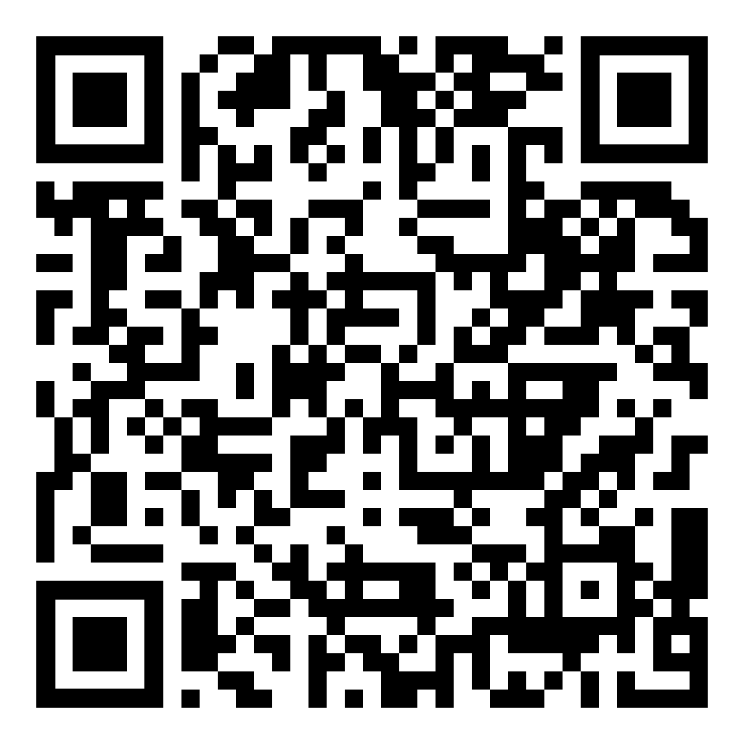
November Webinar
Gambling
Available in November on mylifematters.com
Sign up for an email alert

Slide 2

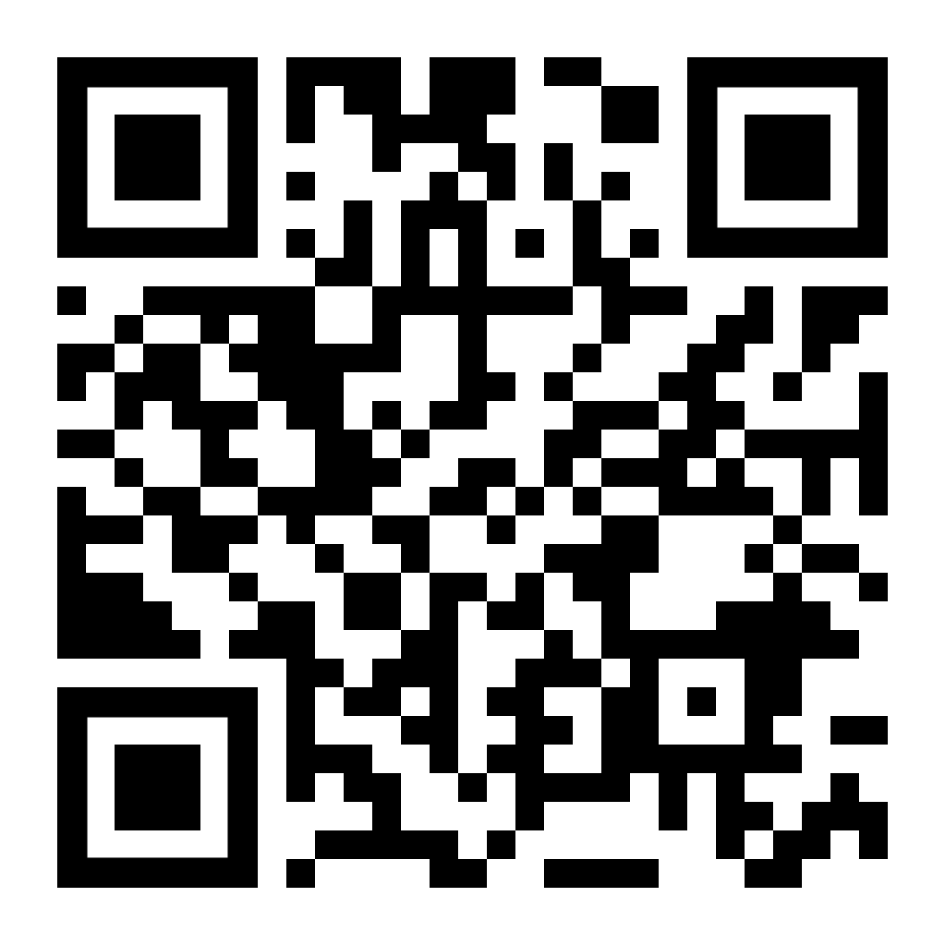
Natural Defenses
LifeMatters offers 24/7/365 assistance with:
Eating healthy
Developing an exercise routine
Establishing a sleep schedule
Increasing your wellbeing
Any other issue

Slide 3

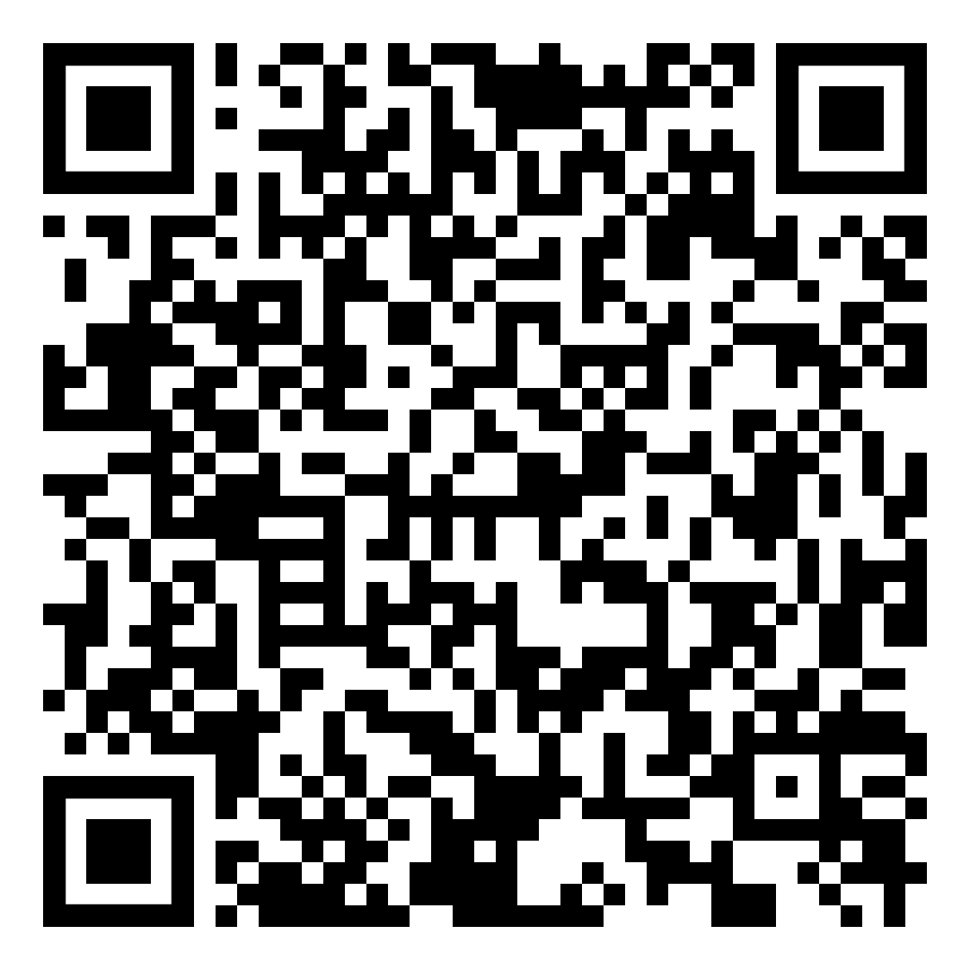
November Support Session
Caregiving for YOU
November 18, 1 p.m. EDT
Session Password: p9GQczqMu37

Slide 4
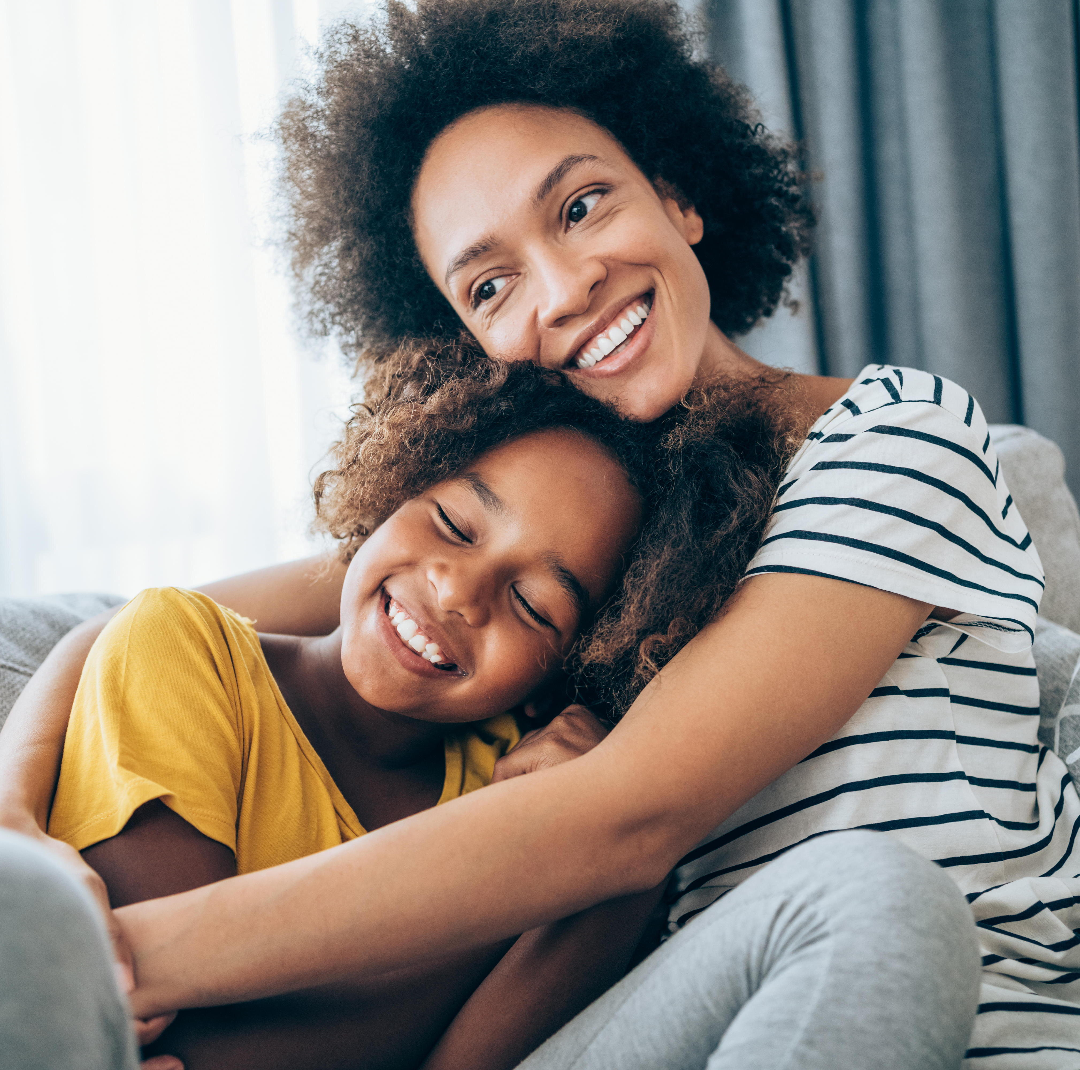
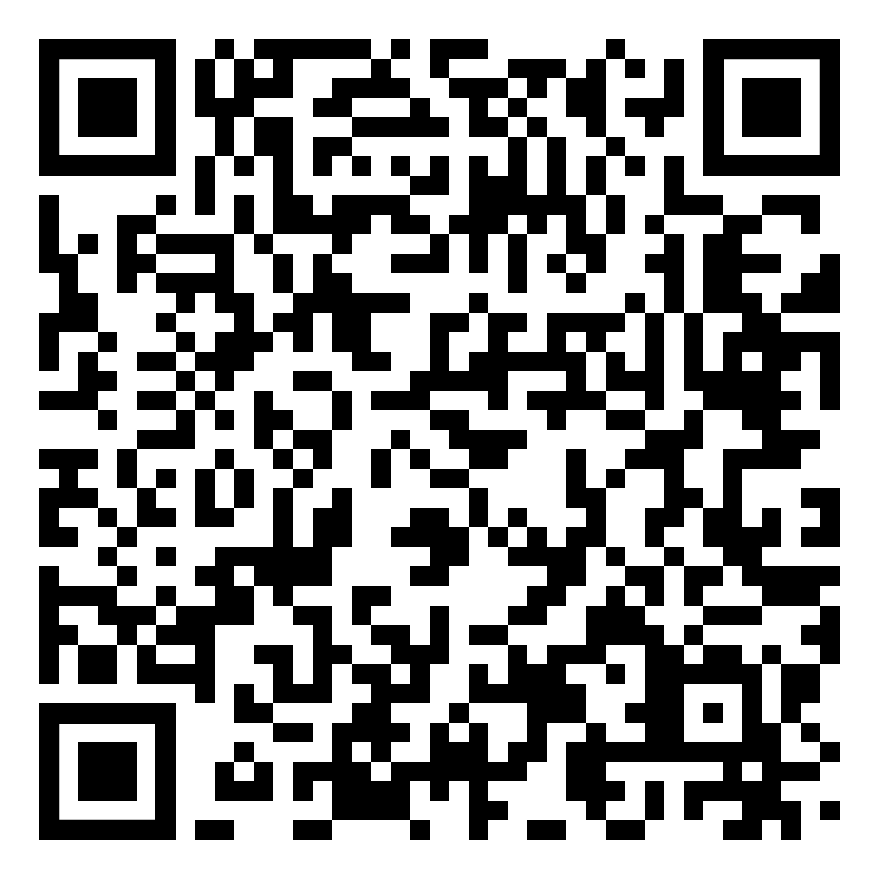
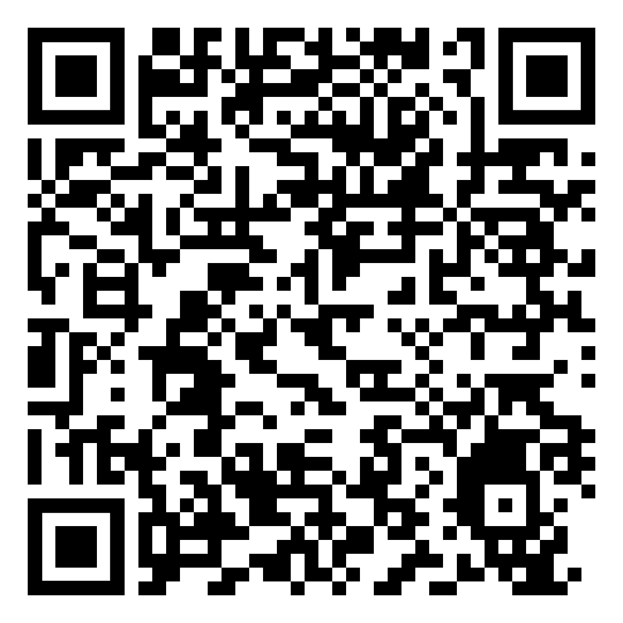
OnTopic with Empathia
Finding Joy After Tragedy with Tom Farley
Part 1
Part 2

