Slide 1
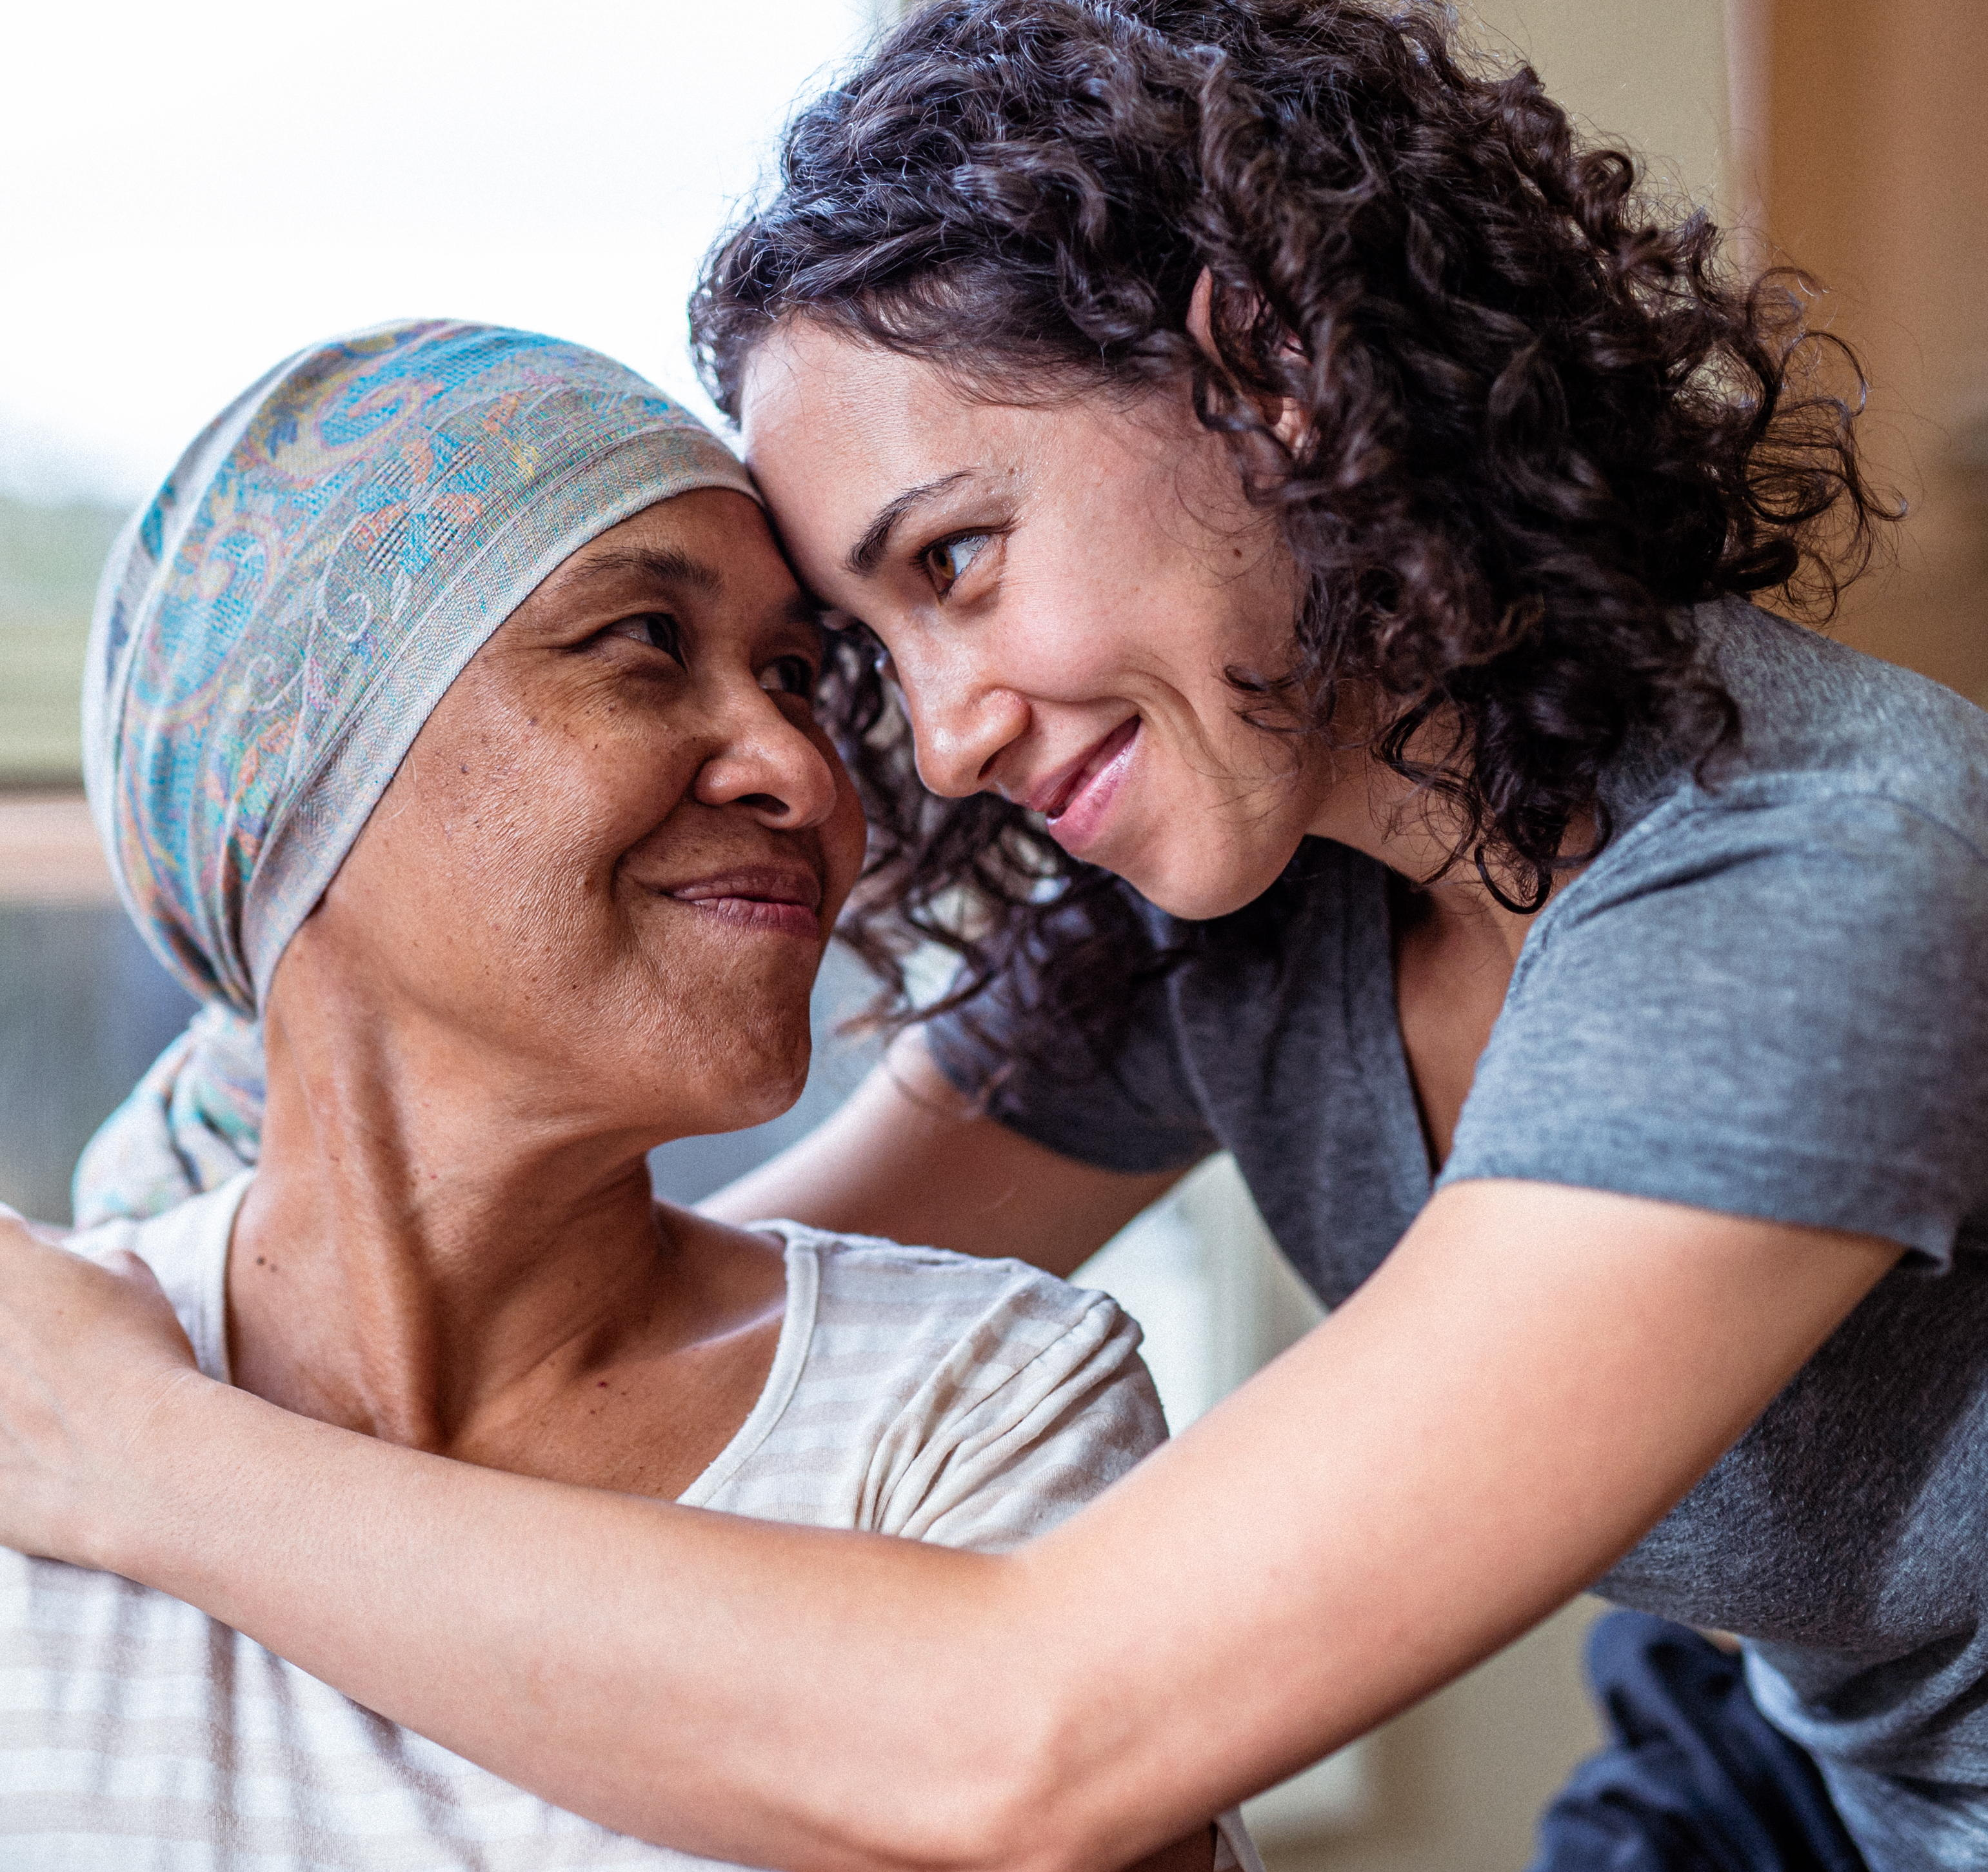
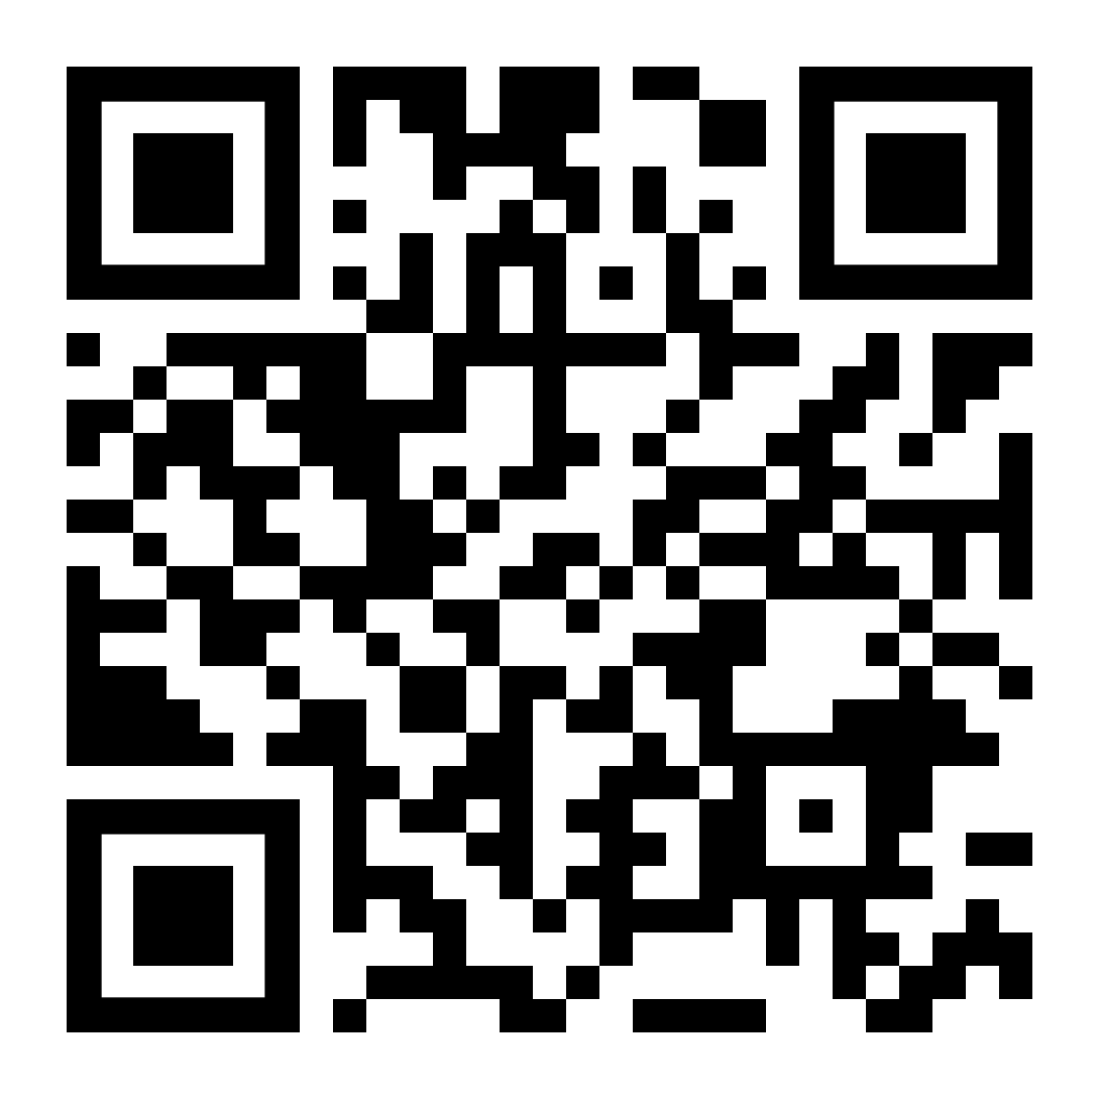
LifeMatters can help you cope with your own or a loved one’s cancer diagnosis.
Call 24/7/365.

Slide 2

If you are struggling and need emotional support, LifeMatters can help.
Call 24/7/365.

Slide 3

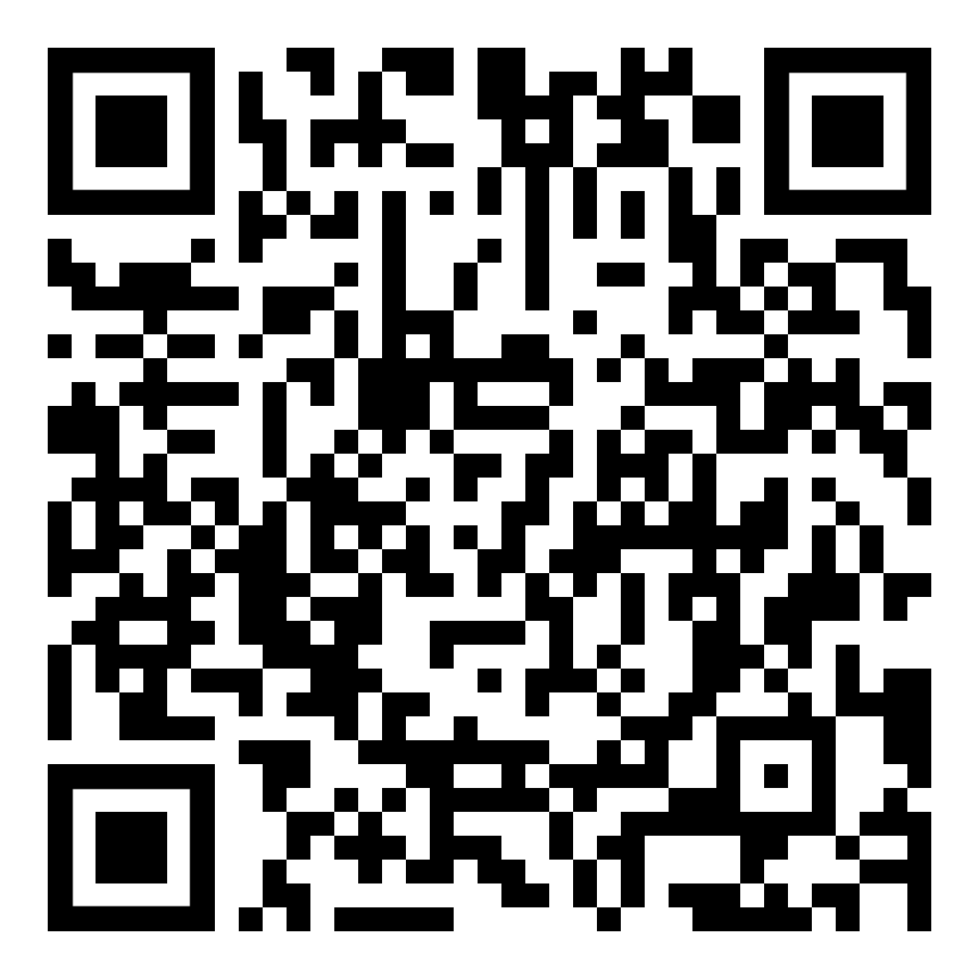
October Webinar
Sleep: A How-To
Available in October on mylifematters.com
Sign up for an email alert

Slide 4

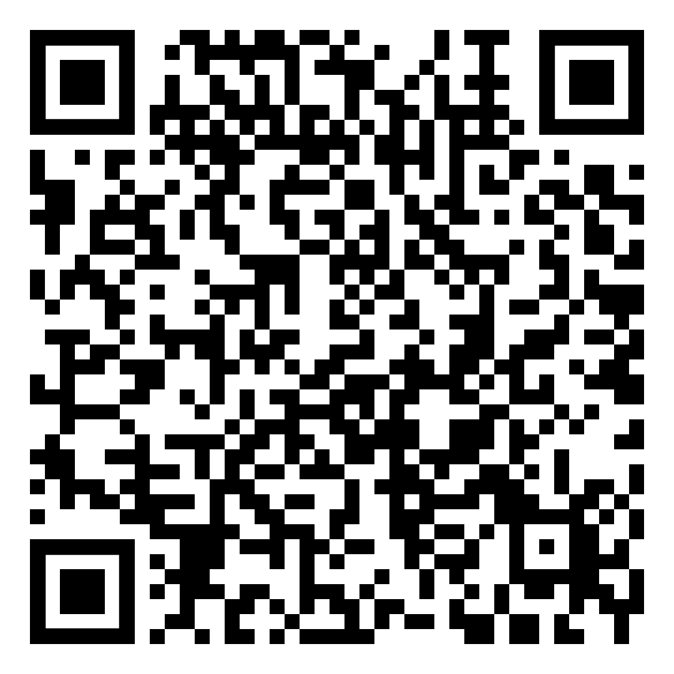
October Support Session
Managing Your Emotions for Improved Mental Health
October 7, 1 p.m. EDT
Session password: ZhEnaMXd393

Slide 5
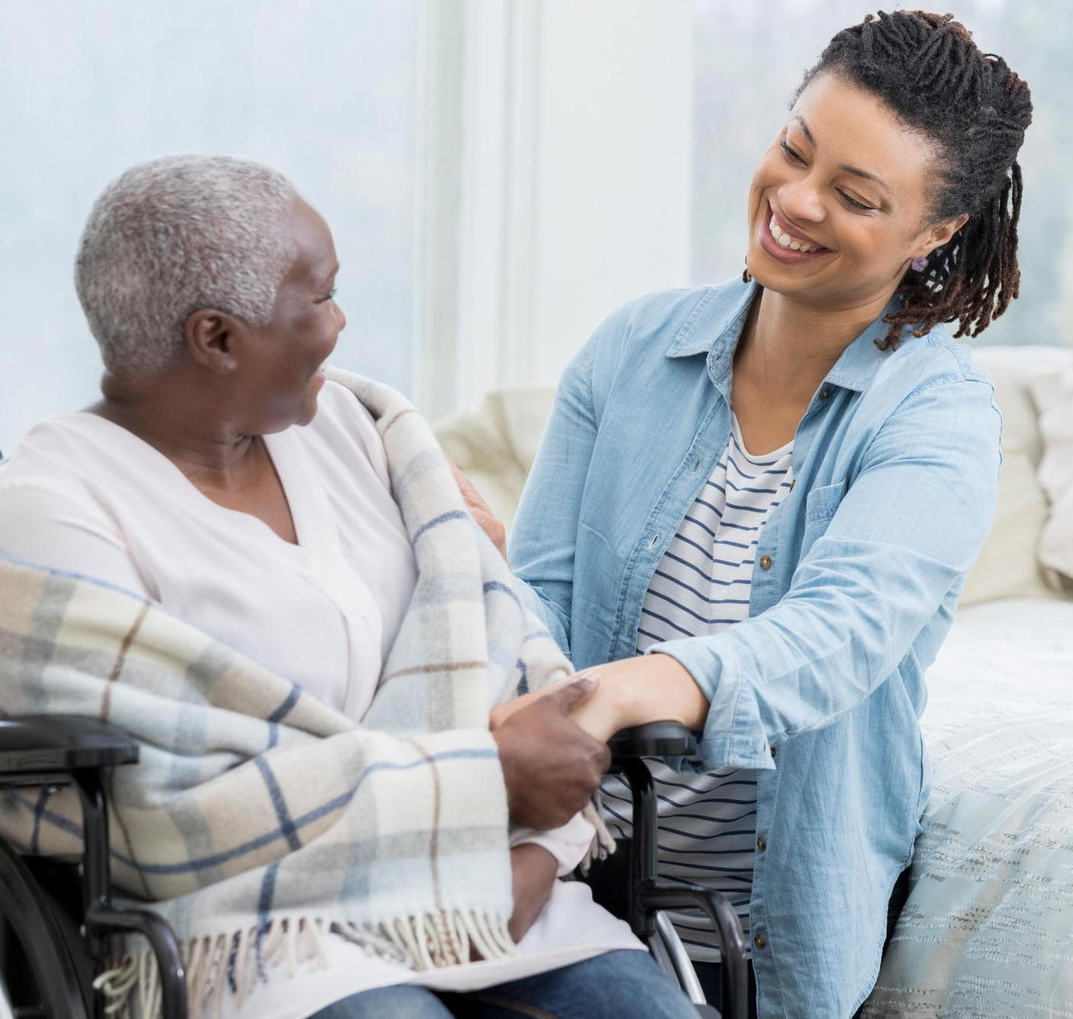
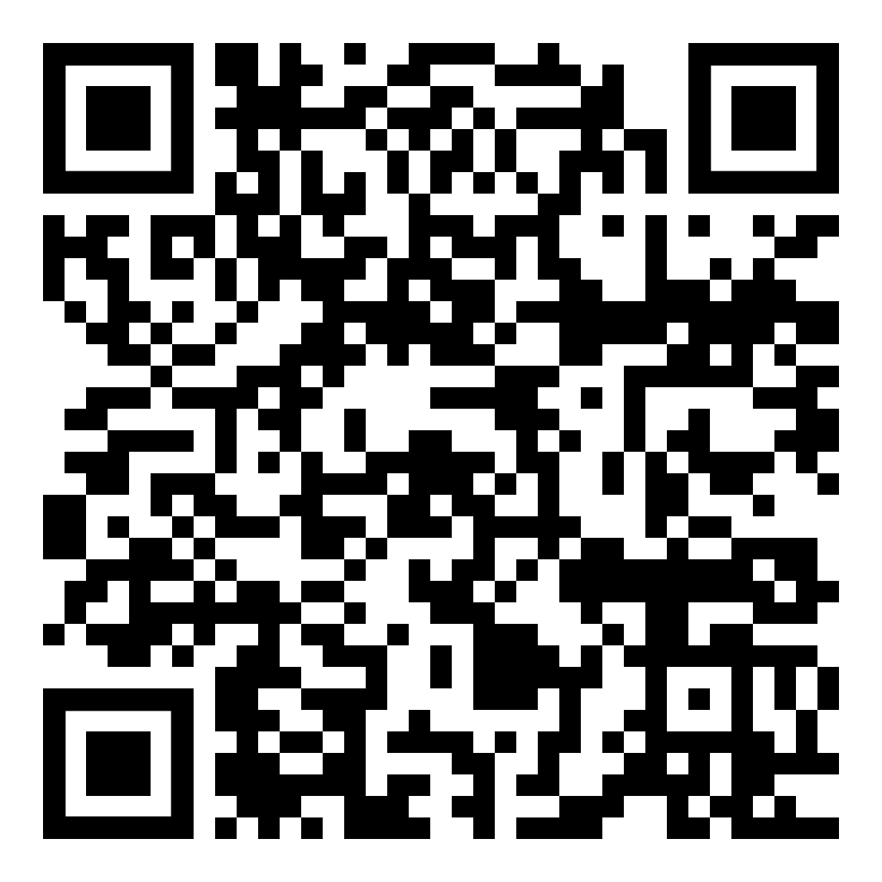
OnTopic with Empathia
Community Support: A Key to Mental Health in Older Adults
Available in October

