Slide 1


If you are worried about a troubled teen, LifeMatters can help.
Call 24/7/365.

Slide 2
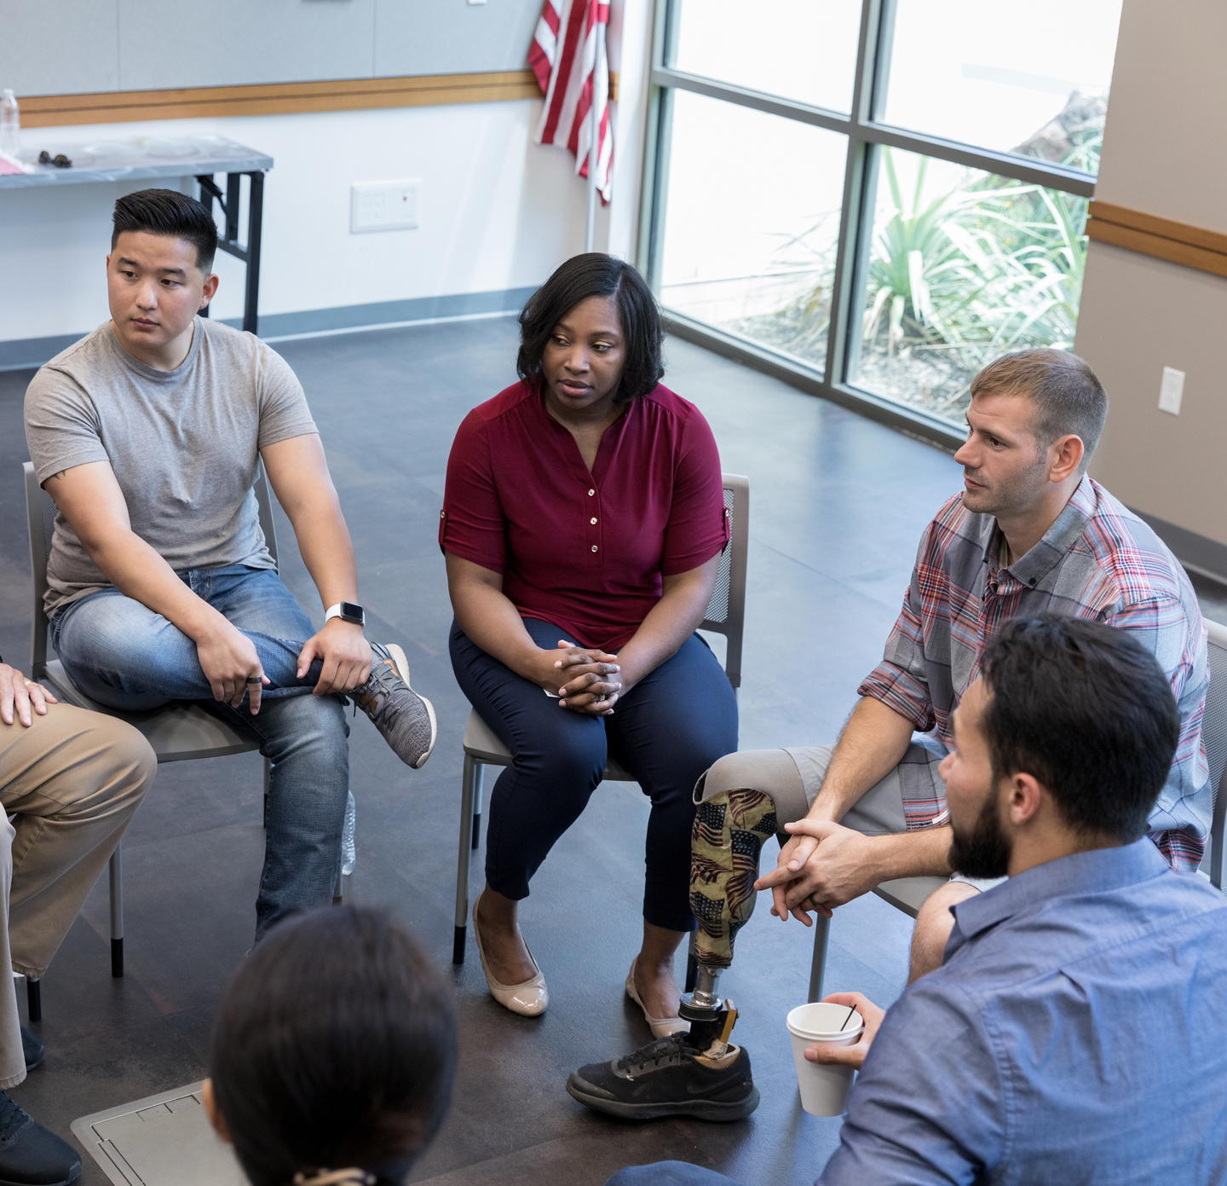
LifeMatters can help you cope with a traumatic experience.
Call 24/7/365.

Slide 3

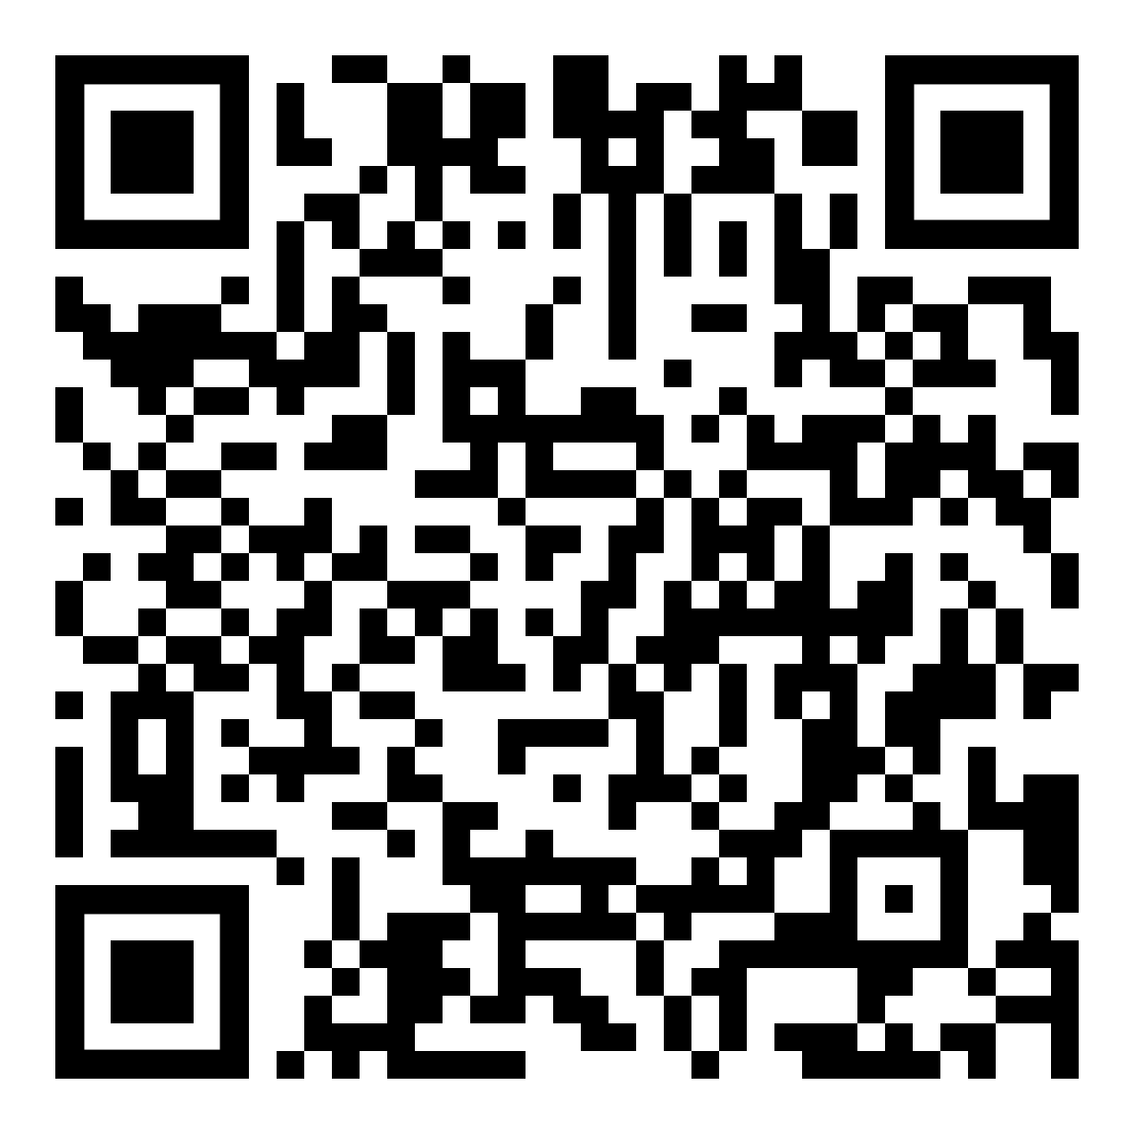
September Webinar
Helping Children Navigate Peer Pressure
Available in September on mylifematters.com
Sign up for an email alert

Slide 4

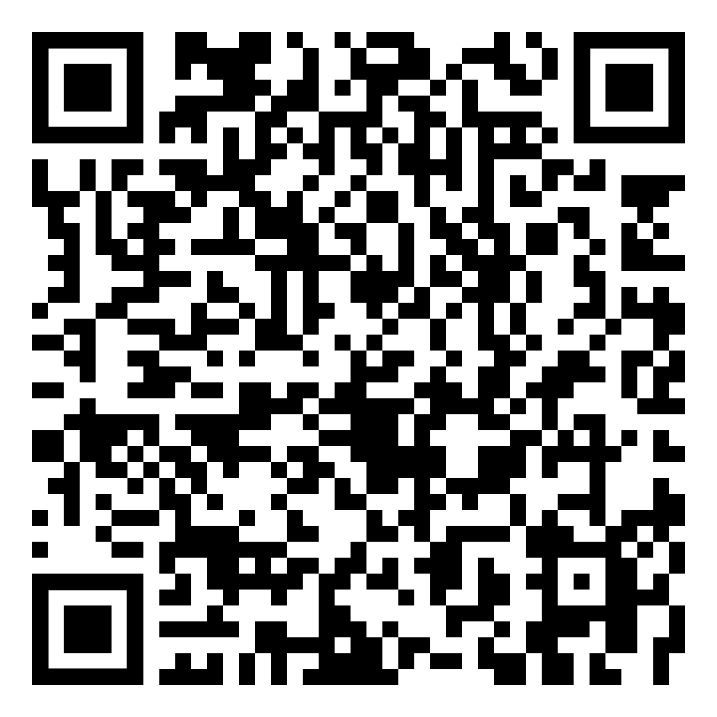
September Support Session
Suicide Awareness and Prevention
September 16, 1 p.m. EDT
Session password: 8p6kKuUDr8r

Slide 5

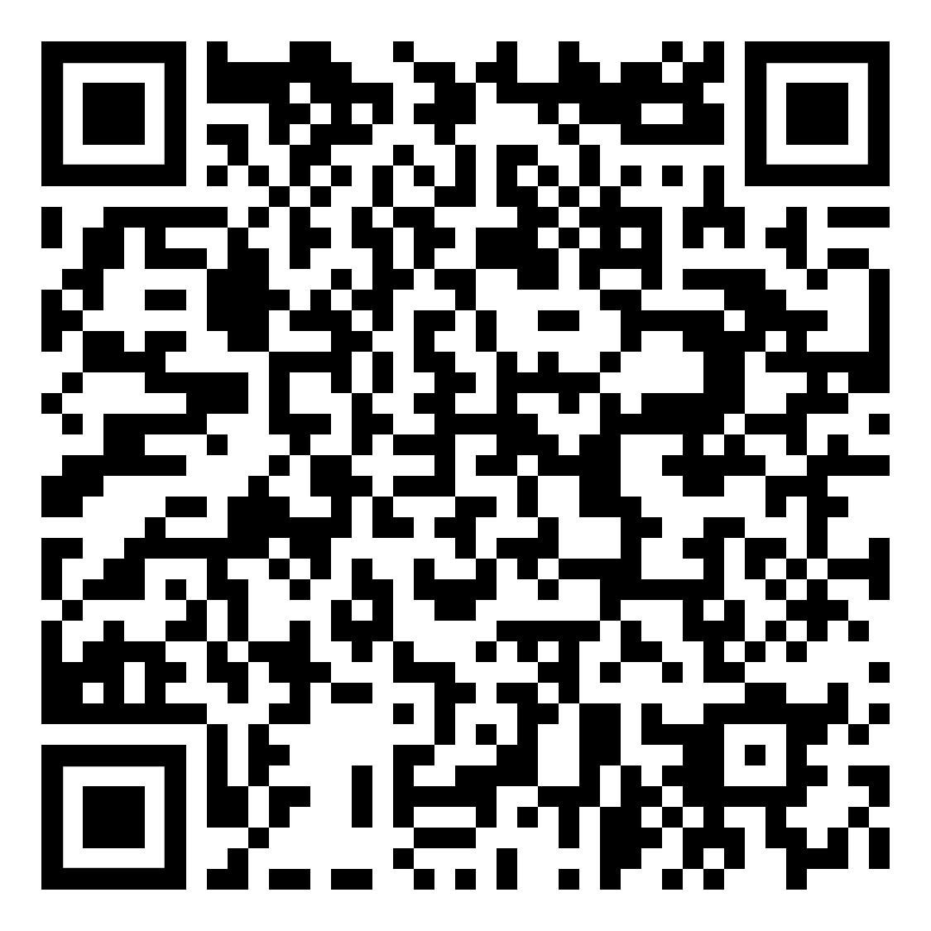
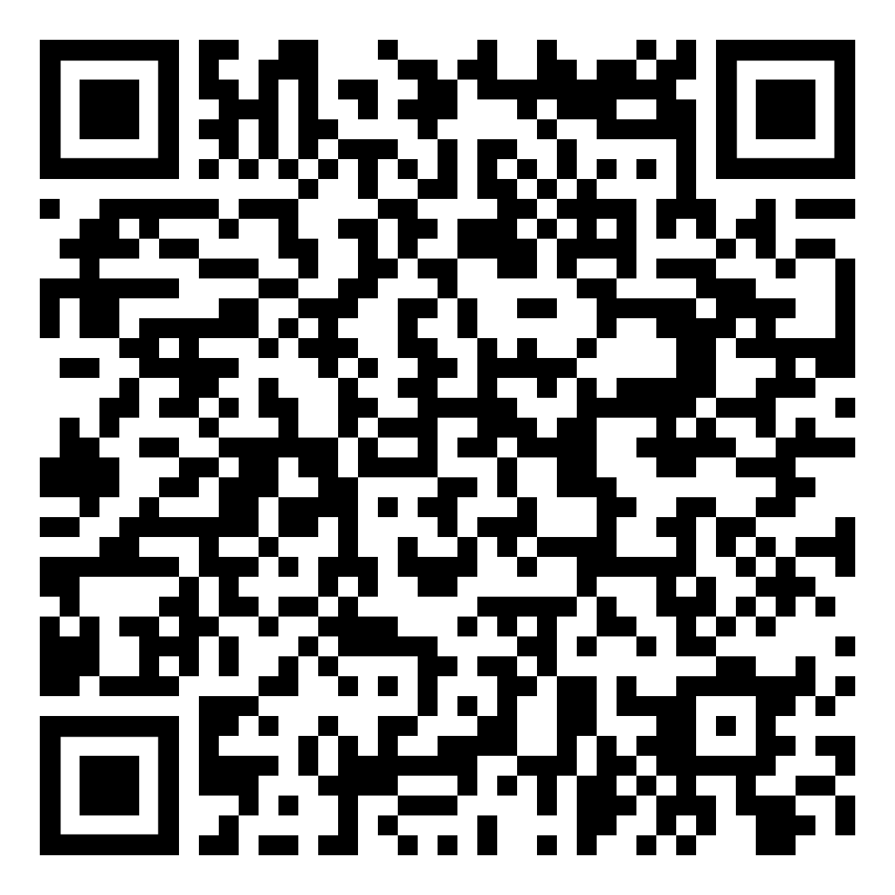
OnTopic with Empathia
Crisis Communications with Chris McCloud
Part 1
Part 2

