Slide 1
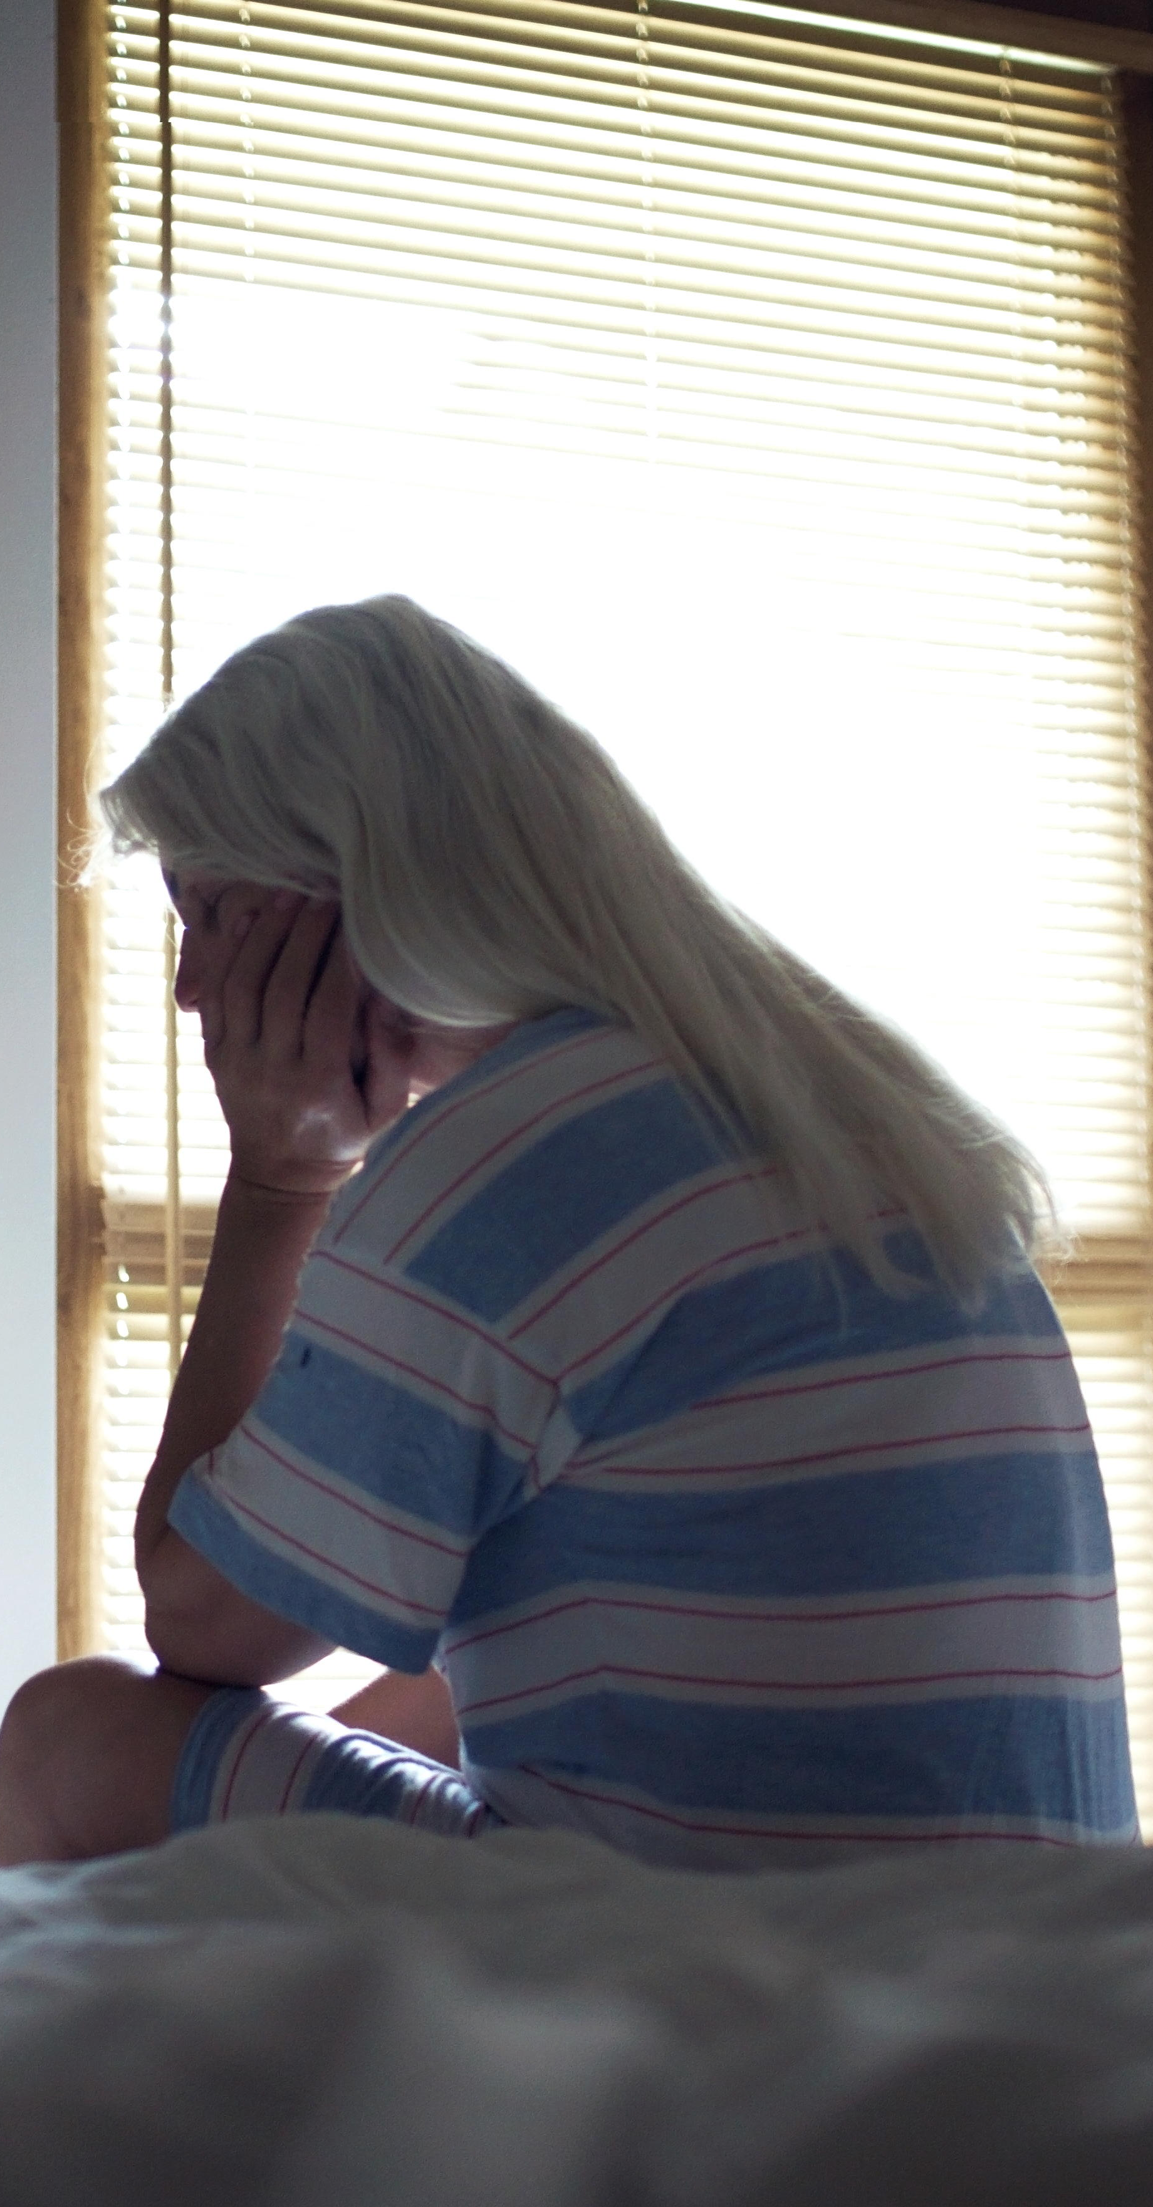
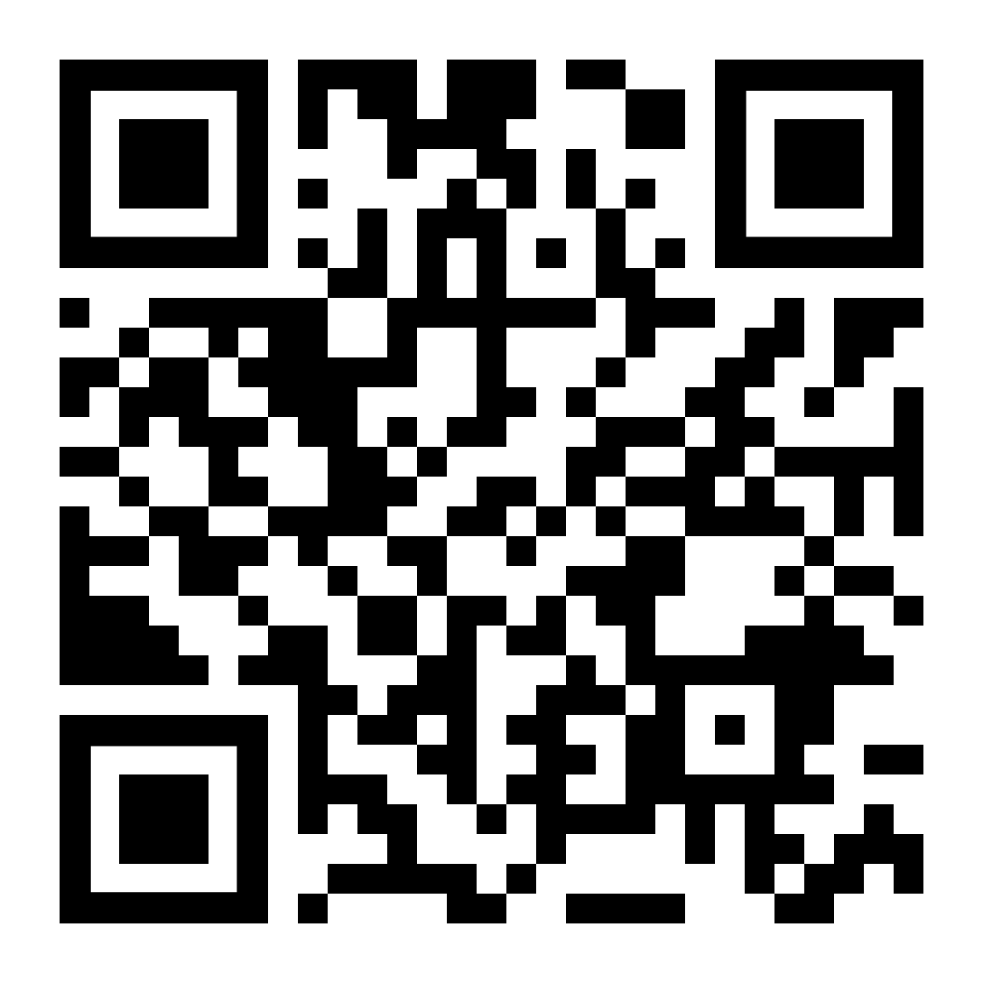

If sleep is a struggle, LifeMatters can help.
Call 24/7/365.

Slide 2

LifeMatters can suggest options for improving your eating habits.
Call 24/7/365.

Slide 3

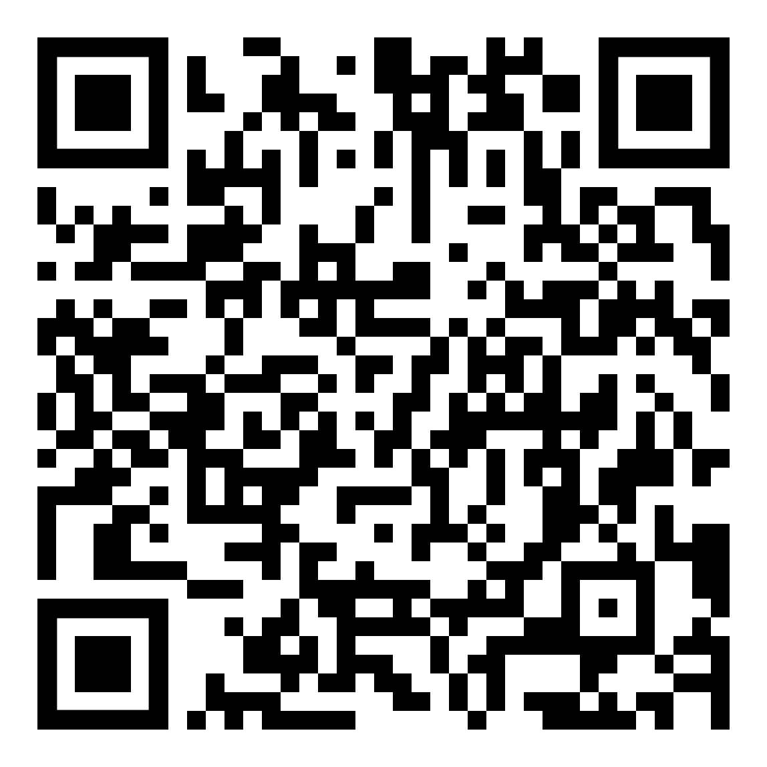
March Webinar
Exposing Common Healthy Eating Myths
Available in March on mylifematters.com
Sign up for an email alert

Slide 4

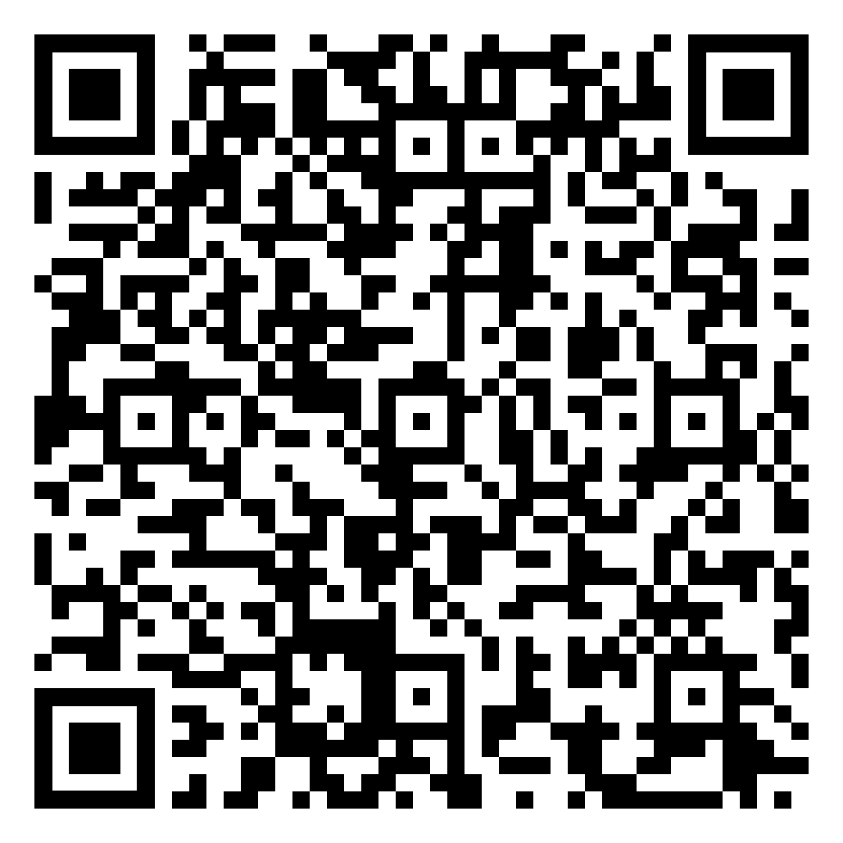
March Support Session
Conquering Burnout: Becoming More Engaged, Energized, and Motivated
March 10, 1 p.m. EDT
Please register in advance

Slide 5

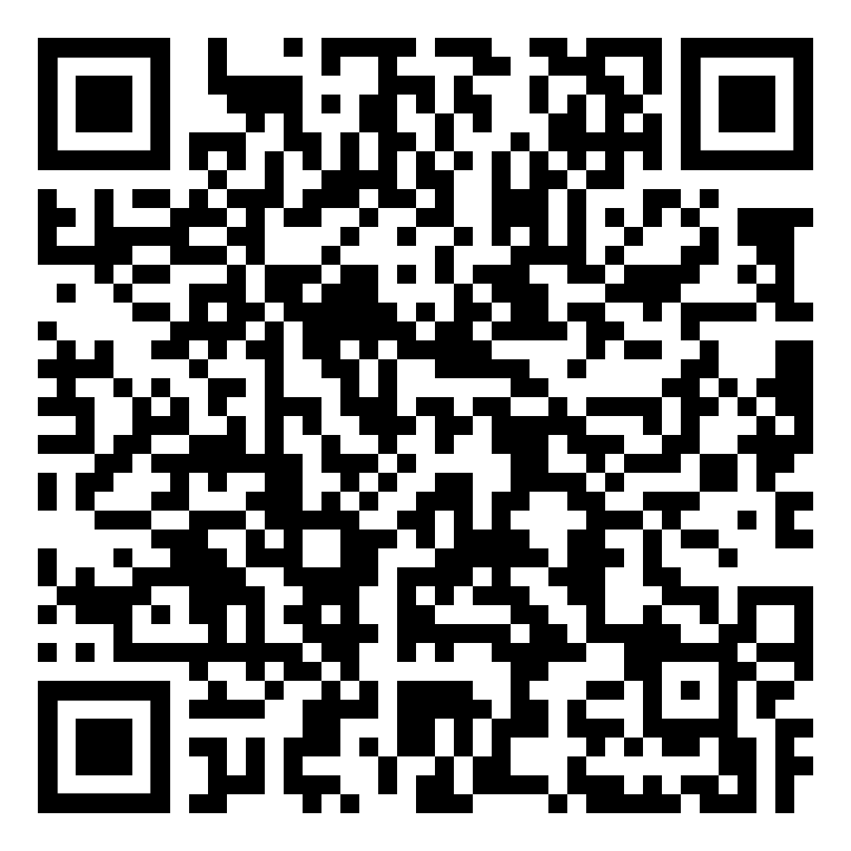
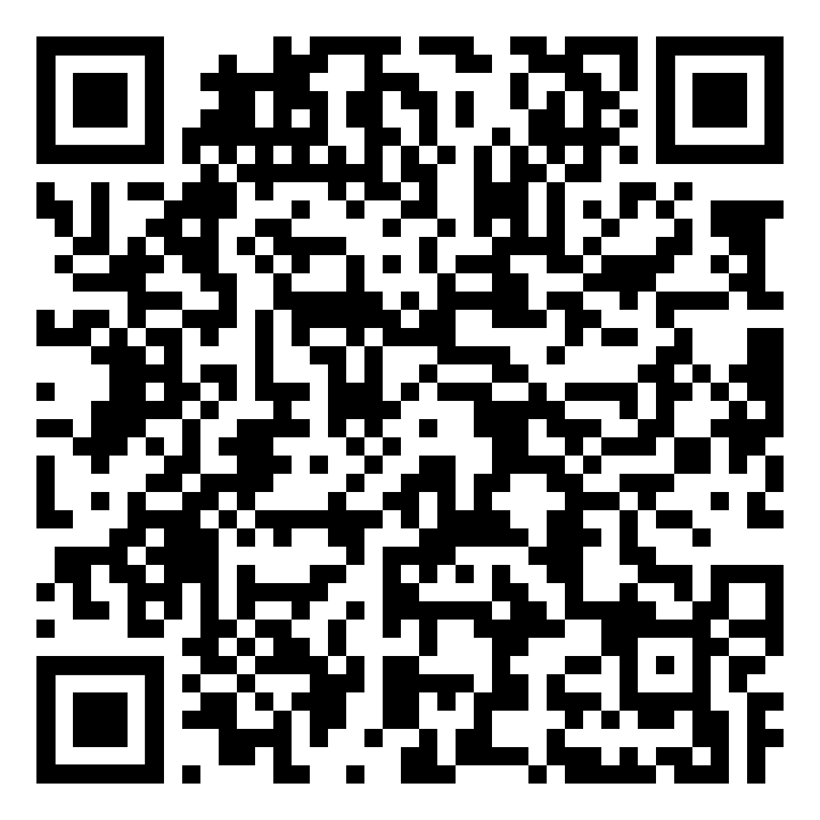
OnTopic with Empathia
Understanding the Language of Loss with Natalie Sanchez
Part 1
Part 2

